Slide 1
SPAG – Challenge 2
Friday 12th February
by Miss Taylor

Slide 2
This week we are going to look how we use personal pronouns which can be used in place of nouns (names).
Challenge 2
Revising what a personal pronoun is.

Slide 3
Friday 12th February
L.O. Use personal pronouns accurately in sentences.
Success Criteria
Recognise nouns .
Identify pronouns.
Use pronouns in the place of nouns.

Slide 4
What is a noun?

Slide 5
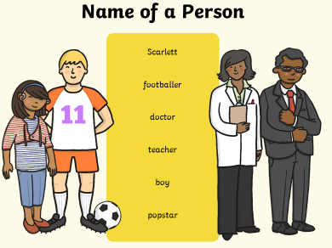
A noun is a naming word. It can name a person, place or thing.

Slide 6
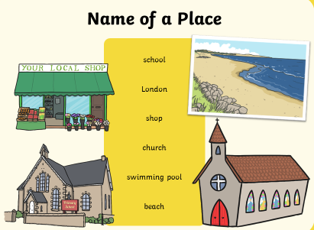
A noun is a naming word. It can name a person, place or thing.

Slide 7
A noun is a naming word. It can name a person, place or thing.

Slide 8
What is a pronoun?

Slide 9
Personal Pronouns
Personal pronouns refer to people or objects. They can replace the noun in a sentence.

Slide 10
Personal Pronouns
I, you, he, she, it, we, they, me, him, her, us, them

Slide 11
Personal Pronouns
I, you, he, she, it, we, they, me, him, her, us, them

Slide 12
We are going to replace the noun with a pronoun.
noun
Mary is walking to school.
Which personal pronoun do you think should be used?
I, you, he, she, it, we, they, me, him, her,
us, them

Slide 13
Did you get it right?
noun
Mary is walking to school.
pronoun
She is walking to school.

Slide 14
Can you change the noun in each sentence to a pronoun?
Which personal pronoun do you think should be used?
I, you, he, she, it, we, they, me, him, her,
us, them
noun
Tom is fishing.
The children are playing.
He has broken his pencil.
noun
noun

Slide 15
Did you get these correct?
I, you, he, she, it, we, they, me, him, her, us, them
pronoun
He is fishing.
They are playing.
He has broken it.
pronoun
pronoun

Slide 16
Friday 12th February
L.O. Use personal pronouns accurately in sentences.
Write the date and learning objective on your paper.
Look at the next 2 slides and choose the work that you think is the correct level for you.

Slide 17
Work 1
Friday 12th February
L.O. Use personal pronouns accurately in sentences.
I, you, he, she, it, we, they, me, him, her, us, them
Choose the correct pronoun to replace the red word in the sentence.
Write the sentence using the pronoun.
The children played with the kite and the kite got stuck in the tree.
We told the boys that the boys could play with the ball.
The goalkeeper said that the ball whizzed by the goalkeeper.
Sarah wanted to go out so Sarah put her coat on.
Ali rode his bike and Ali had a puncture.
Challenge
Write 4 sentences using these pronouns.
we I him they

Slide 18
Work 2
Friday 12th February
L.O. Use personal pronouns accurately in sentences.
Choose the correct pronoun to complete each sentence.
I, you, he, she, it, we, they, me, him, her, us, them
Challenge
Write 5 of your own sentences, using any of the pronouns above.

Slide 19
Remote Learning Tracking
Please click on the link below.
https://forms.office.com/Pages/ResponsePage.aspx?id=eCY4lN73r0G0KV1rDWITzRhTQ2IZqpBOsW8cFVoooF9UNVlMS1dCVkdaM0k0WlhFTE9WVFBTWEg1Ti4u

