Slide 1
Year 3
Geography
Monday 8th February

Slide 2
Monday 8th February
L.O. Understand key aspects of physical geography.

Slide 5
The water cycle sounds like it is describing how water moves above, on, and through the Earth... and it does.

Slide 6
But, in fact, much more water is "in storage" for long periods of time than is actually moving through the cycle. The storehouses for the vast majority of all water on Earth are the oceans.

Slide 7
The oceans are the largest reservoir of water on earth – over 96 % of all water exists in the oceans.

Slide 8
Let’s look at Coastal Regions
around the UK

Slide 9
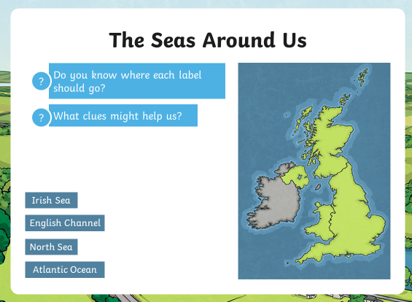

Slide 11
What is a coastline?
Click on the link below.
Coastlines - beach formation - KS2 Geography - BBC Bitesize

Slide 12
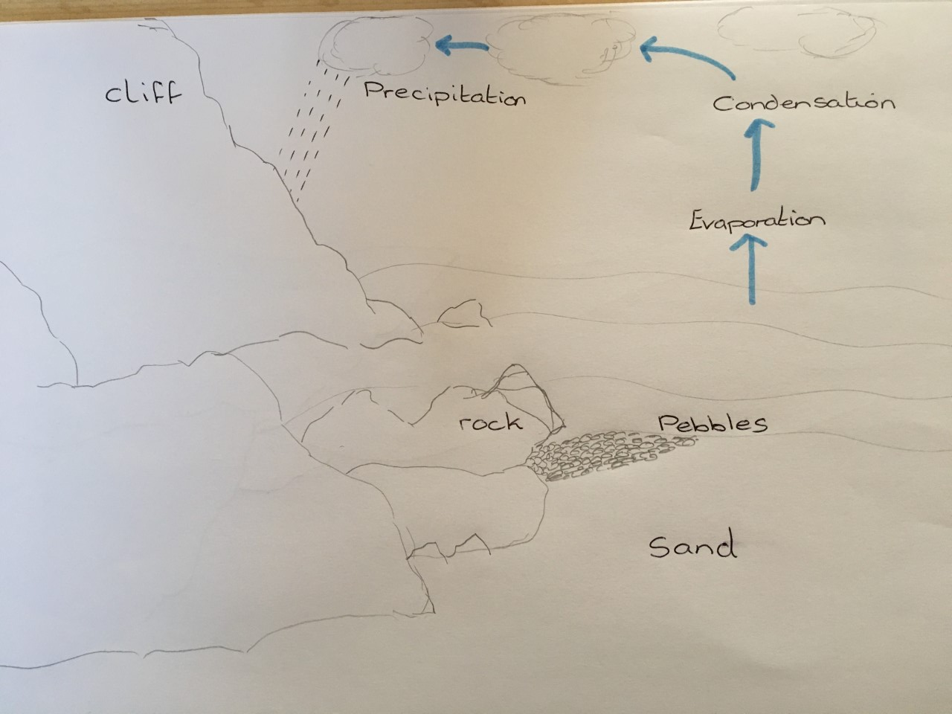
This is my rough sketch. I’m sure you can do much better than I have and include more detail!

Slide 13
All Groups – to write the names of the seas around the UK.
Then sketch a map of an imaginary beach, to show the natural features mentioned in the clip.
Include larger rocks, pebbles, and sand in the correct position of the coast line.
Include this stage of the Water Cycle.
Then choose the work from the next few slides which is the appropriate level for you.

Slide 14
Monday 8th February
Work 1
L.O. Understand key aspects of physical geography.
You should already have completed the work below
Write the names of the seas around the UK. You can draw a map or write them in a list.
Sketch a map of an imaginary beach, to show the natural features mentioned in the clip. Include larger rocks,
pebbles, and sand in the correct position of the coast line. Include this stage of the Water Cycle.
Next Step
label the different parts of their picture. Draw arrows to show what happens in the Water Cycle.

Slide 15
Monday 8th February
Work 2
L.O. Understand key aspects of physical geography.
You should already have completed the work below
Write the names of the seas around the UK. You can draw a map or write them in a list.
Sketch a map of an imaginary beach to show the natural features mentioned in the clip. Include larger rocks,
pebbles, and sand in the correct position of the coast line. Include this stage of the Water Cycle.
Next Step
label the different parts of their picture. Describe the stage of the Water Cycle occurring, using correct
terminology.

Slide 16
Monday 8th February
Work 3
L.O. Understand key aspects of physical geography.
You should already have completed the work below
Write the names of the seas around the UK. You can draw a map or write them in a list.
Sketch a map of an imaginary beach to show the natural features mentioned in the clip. Include larger rocks,
pebbles, and sand in the correct position of the coast line. Include this stage of the Water Cycle.
Next Step
Describe the formation of their beach, using terms such as ‘at first’, ‘because of that’ and ‘eventually’, as
they saw in the clip. Draw and describe the stage of the Water Cycle occurring, using correct terminology.

Slide 17
Remote Learning Tracking
Please click on the link below
https://forms.office.com/Pages/ResponsePage.aspx?id=eCY4lN73r0G0KV1rDWITzRhTQ2IZqpBOsW8cFVoooF9UNVlMS1dCVkdaM0k0WlhFTE9WVFBTWEg1Ti4u

