Slide 1
Year 3 Maths
Friday 5th February 2021

Slide 2
LO: Make a tally chart -Count how many objects there are -Write it using a tally method - Fill in the total -What does the tally chart show? Most popular? Least popular?
5.2.21
White Rose Resources

Slide 3
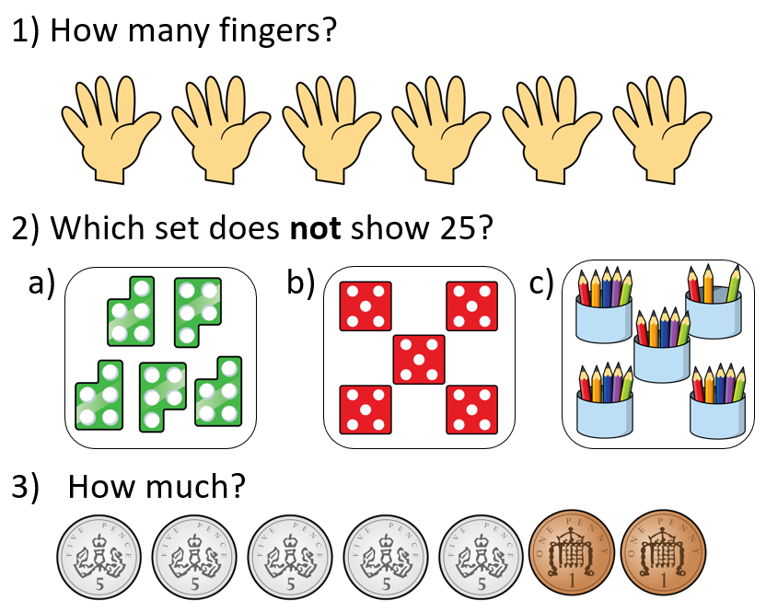
Warm up

Slide 4
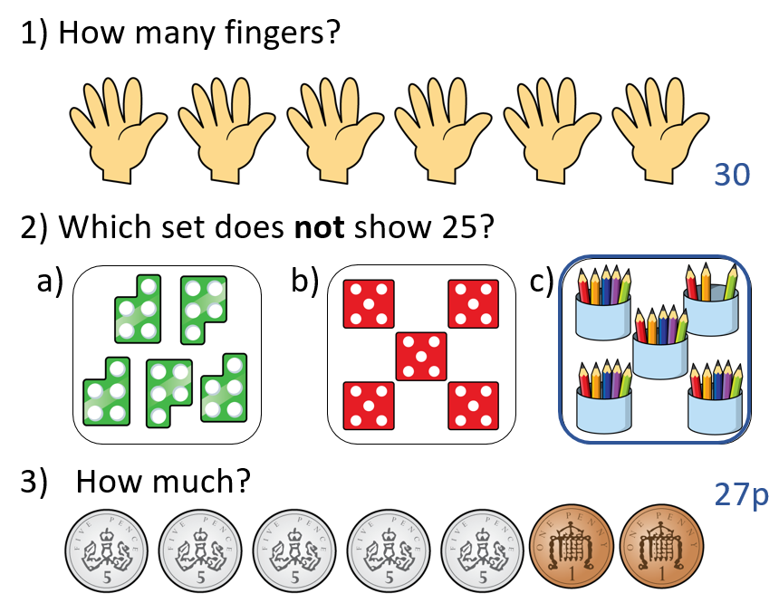

Slide 5
Let’s try together
What would
you suggest
to Teddy
about his
tally chart?

Slide 7
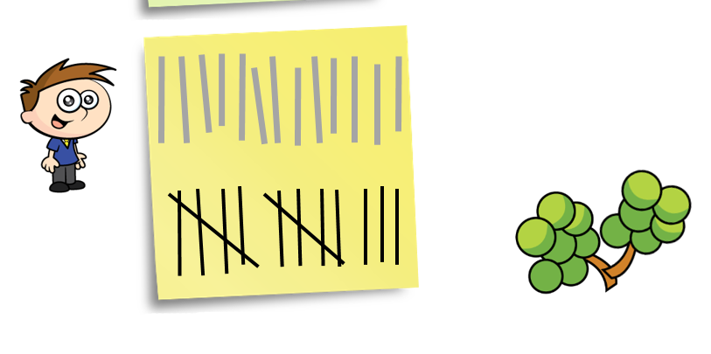

Slide 8
You try

Slide 9
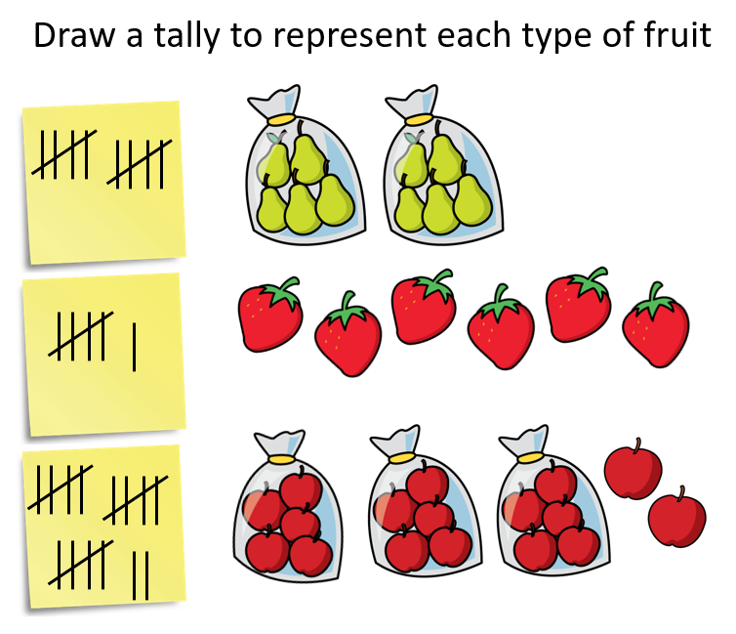

Slide 10
Let’s try together

Slide 11
You try

Slide 12
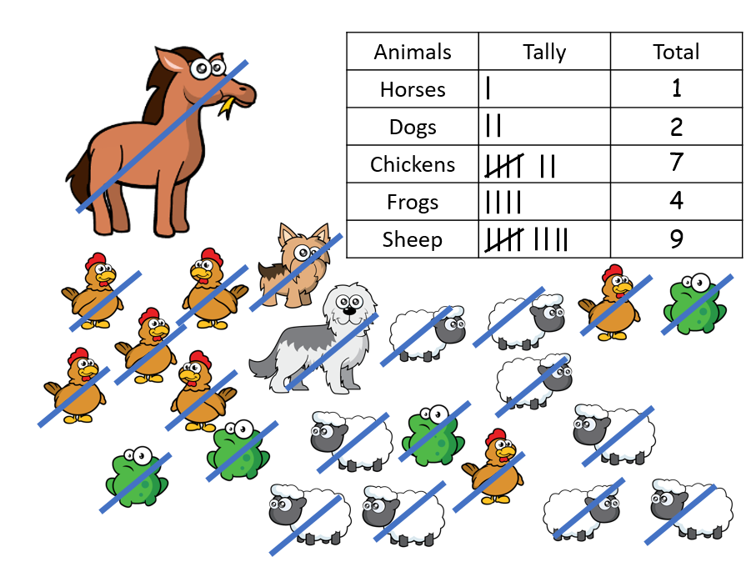
Total

Slide 13
What went wrong?
The girl jumped 7 times, whereas the boy jumped 6 times.
What went wrong with their tally charts?

Slide 15
LO: Make a tally chart -Count how many objects there are -Write it using a tally method - Fill in the total -What does the tally chart show? Most popular? Least popular?
5.2.21
White Rose Resources

Slide 16
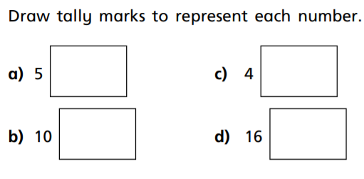
Work 1
1.

Slide 17
2.

Slide 18
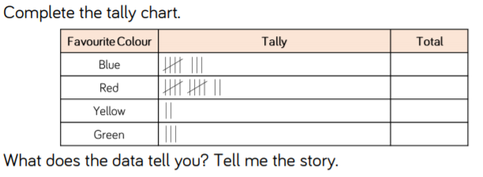
3. Fill in the totals

Slide 19
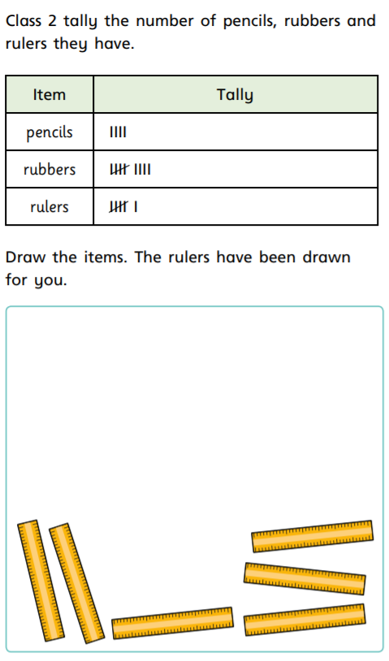
4.

Slide 20
Work 2
1.

Slide 21
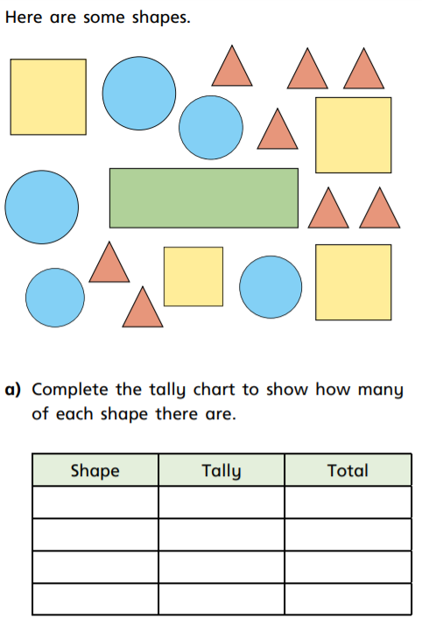
2.

Slide 22
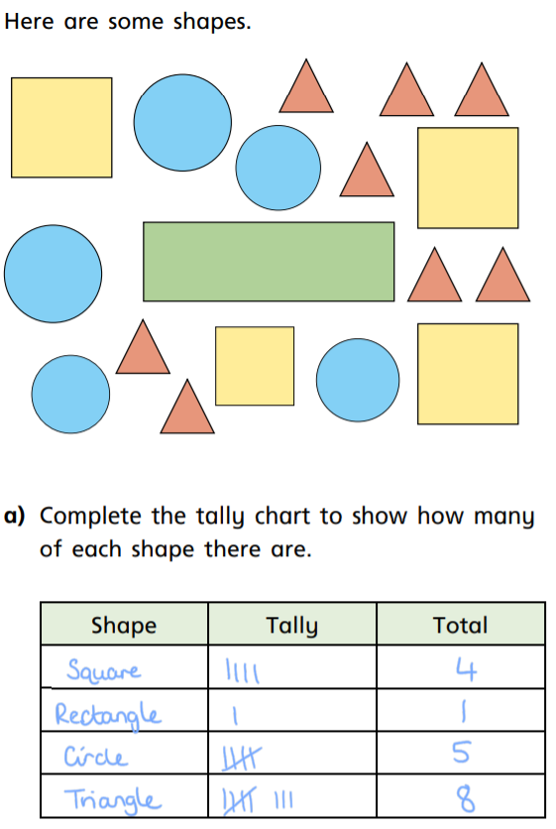
2.

Slide 23
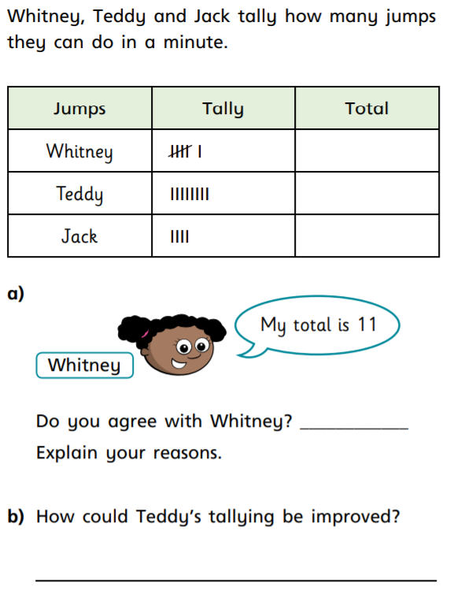
3.

Slide 24
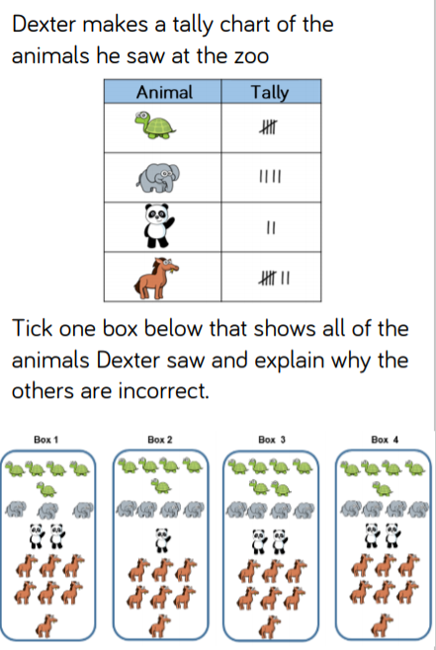
Work 3
1.

Slide 25
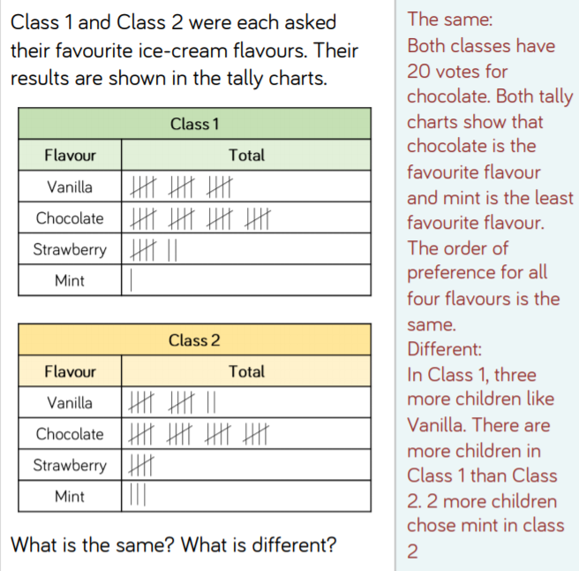
2.

Slide 26
3. You could count things in your kitchen, your toys etc.
It’s up to you!

Slide 27
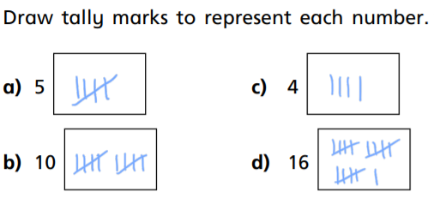
Work 1 ANSWERS
1.

Slide 28
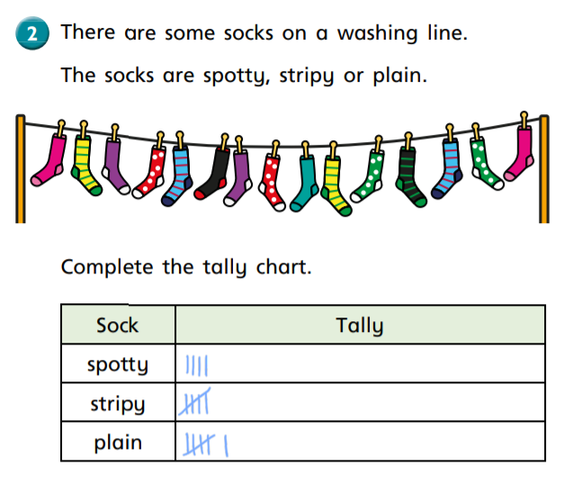
2.

Slide 29
3.
Red is the most popular colour with 12 votes whereas yellow is the least popular.
8
12
2
3

Slide 30
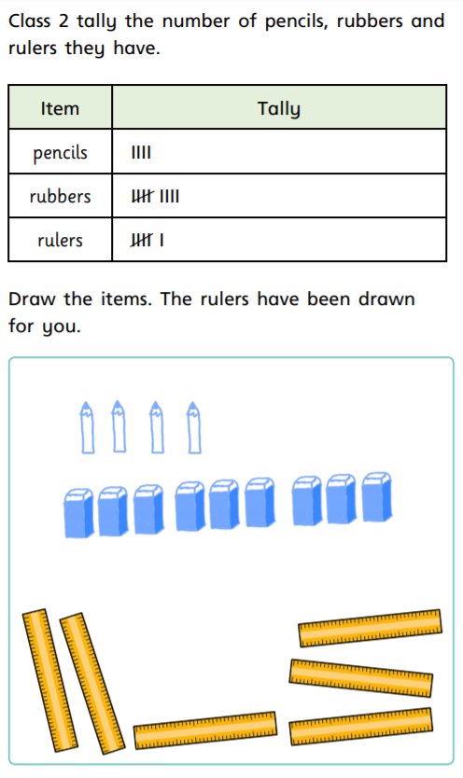
4.

Slide 31
Work 2 ANSWERS
1.
22

Slide 32
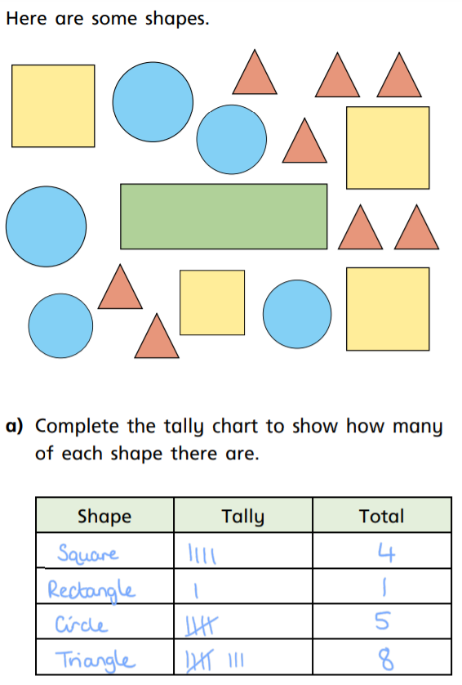
2.

Slide 33
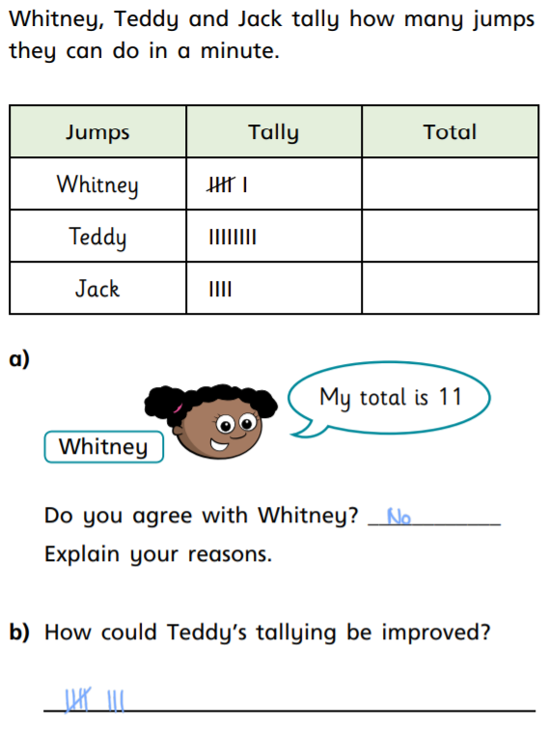
3.

Slide 34
Work 3 ANSWERS
1.

Slide 35
2.

Slide 36
Remote Learning Tracking
https://forms.office.com/Pages/ResponsePage.aspx?id=eCY4lN73r0G0KV1rDWITzRhTQ2IZqpBOsW8cFVoooF9UNVlMS1dCVkdaM0k0WlhFTE9WVFBTWEg1Ti4u

