Slide 1
Year 3 Maths
Friday 5th March 2021

Slide 2
LO: Calculate perimeter - What are the missing measurements for the side of the shape? - Add each of the shape side together - Write the perimeter with the unit of measure - Double the width + the length to find the perimeter of a rectangle
5.3.21
White Rose Resources

Slide 3
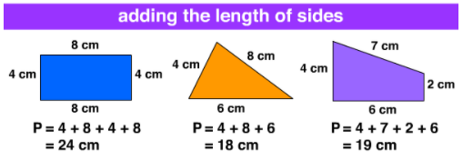
Maths Word of the Week
Perimeter
Distance around the outside of a shape, calculated by adding the length of all sides together.
To find the perimeter imagine you are walking around the whole shape and add up the length of each line.
Today’s Challenge:
What other length and height words could I have included as our word of the week? What would you have suggested?

Slide 4
Warm up 1

Slide 5
Thirty seven minutes past ten
10.37
22.37

Slide 6
Warm up 2

Slide 8
Let’s try together

Slide 9
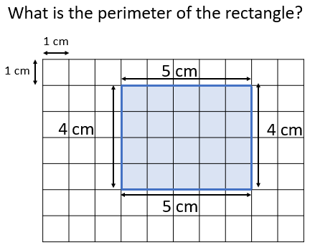

Slide 10
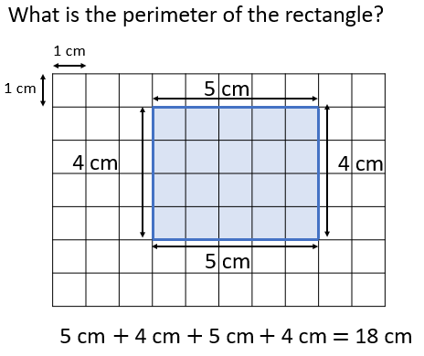

Slide 11
You try
Hint: Unit of measure!

Slide 13
You try

Slide 15
You could do…

Slide 16
You try

Slide 17
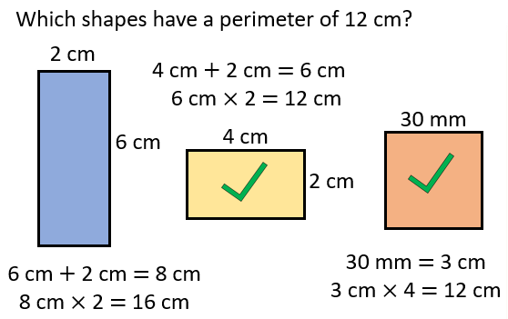

Slide 18
LO: Calculate perimeter - What are the missing measurements for the side of the shape? - Add each of the shape side together - Write the perimeter with the unit of measure - Double the width + the length to find the perimeter of a rectangle
5.3.21
White Rose Resources

Slide 19
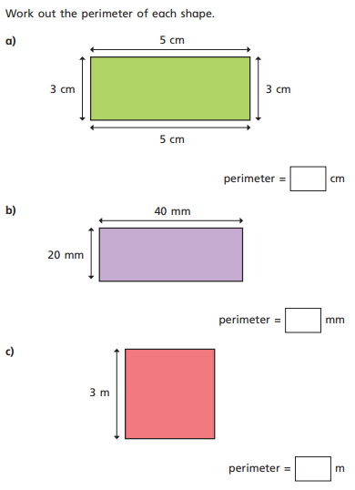
Work 1
1.

Slide 20
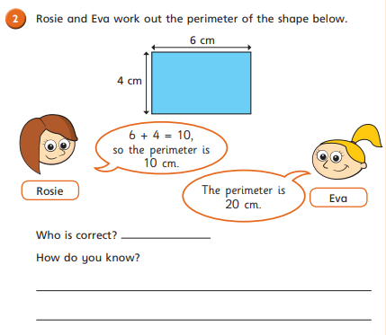
2.

Slide 21
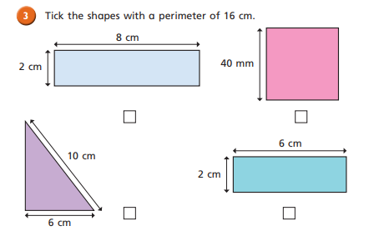
3.

Slide 22
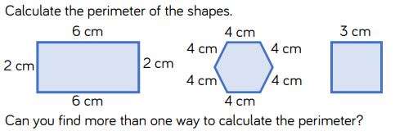
4.

Slide 23
Work 2
1.

Slide 24
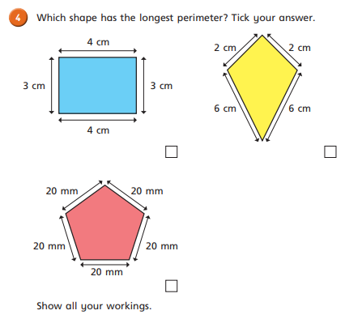
2.

Slide 25
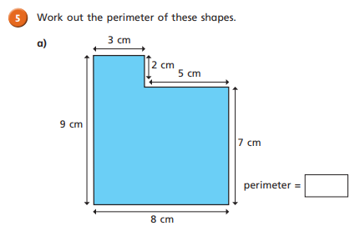
3.

Slide 26
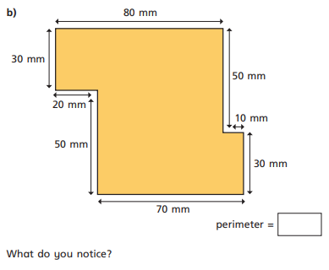
4.

Slide 27
Work 3
1.

Slide 28
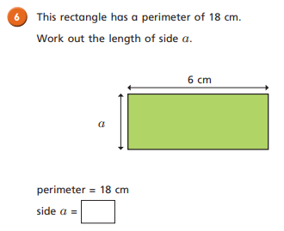
2.

Slide 29
3.

Slide 30
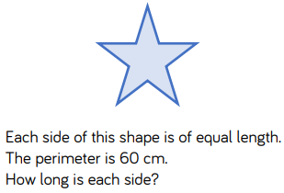
4.

Slide 31
5.

Slide 32
Work 1 ANSWERS
1.

Slide 33
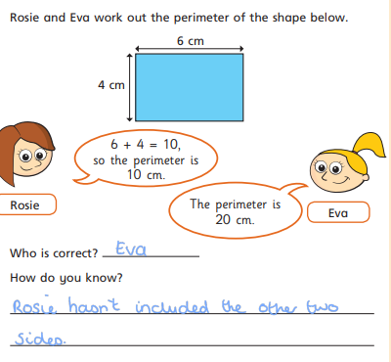
2.

Slide 34
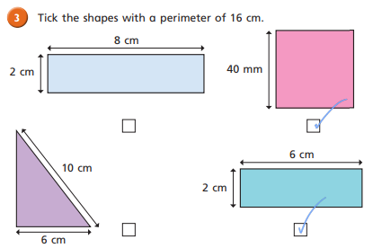
3.

Slide 35
4.
16cm
24cm
12cm

Slide 36
Work 2 ANSWERS
1.
20cm
40mm
e.g. 5 + 5 + 5 + 5 = 50
10mm x 4 = 40mm

Slide 37
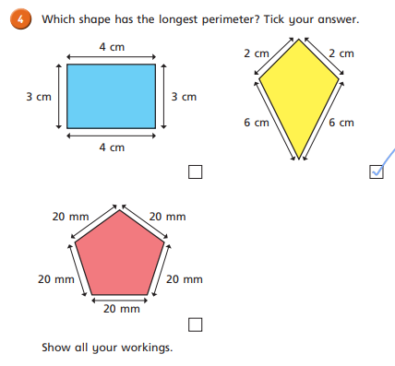
2.

Slide 38
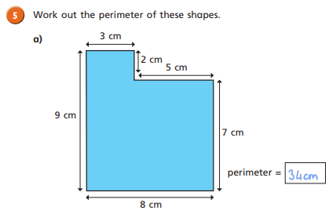
3.

Slide 39
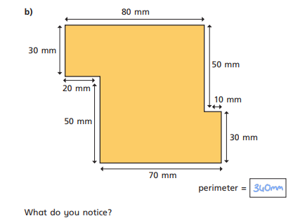
4.

Slide 40
Work 3 ANSWERS
1.
3cm.
Half of 16 is 8 so the length and the side together must equal 8. The side we know is 5 and if we find the difference between 8 and 5 we will find the missing side length.

Slide 41
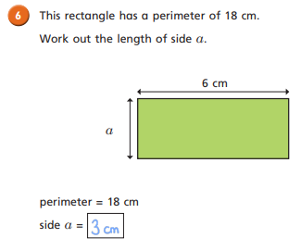
2.

Slide 42
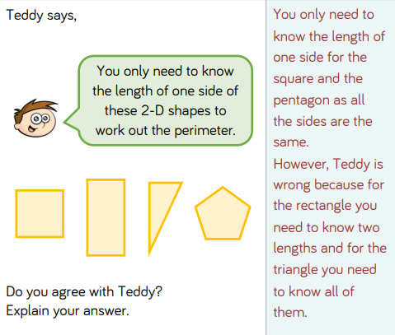
3.

Slide 43
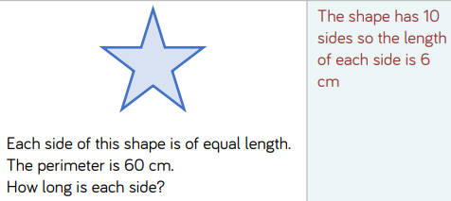
4.

Slide 44
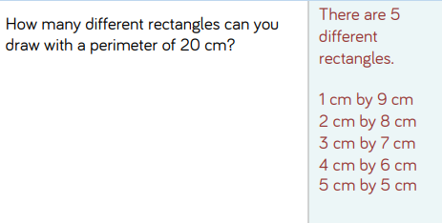
5.

Slide 45
Remote Learning Tracking
https://forms.office.com/Pages/ResponsePage.aspx?id=eCY4lN73r0G0KV1rDWITzRhTQ2IZqpBOsW8cFVoooF9UNVlMS1dCVkdaM0k0WlhFTE9WVFBTWEg1Ti4u

