Slide 1
Year 3 Maths Work 4
Monday 1st February 2021

Slide 2
LO: Select an amount of money How much do I need to make? How many pounds? How many pence? Which coins can I use? Circle or draw the coins needed
1.2.21
White Rose Resources

Slide 3
Warm up

Slide 5
Let’s try together

Slide 9
True or false?

Slide 11
LO: Select an amount of money How much do I need to make? How many pounds? How many pence? Which coins can I use? Circle or draw the coins needed
1.2.21
White Rose Resources

Slide 12
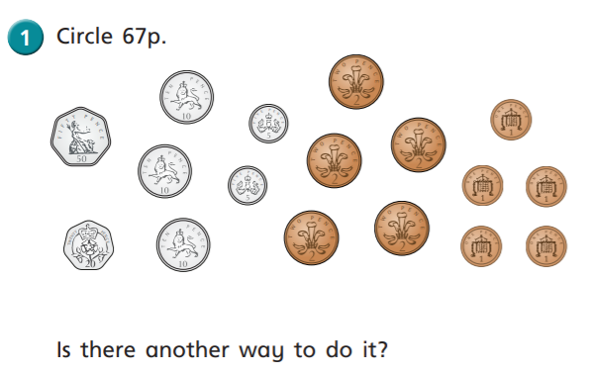
Work 4
1.

Slide 13
Work 4
2.

Slide 14
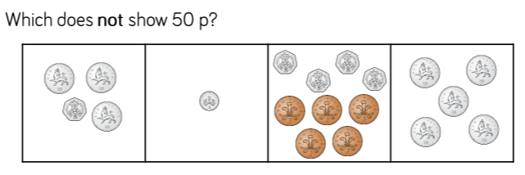
3.

Slide 15
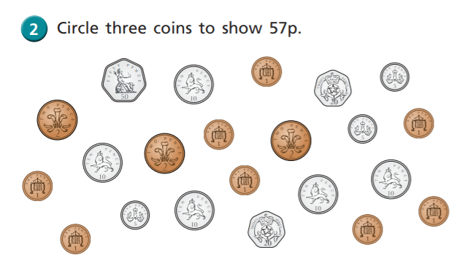
4.

Slide 16
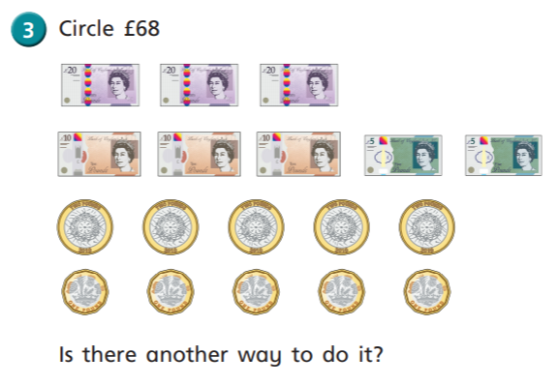
5.

Slide 17
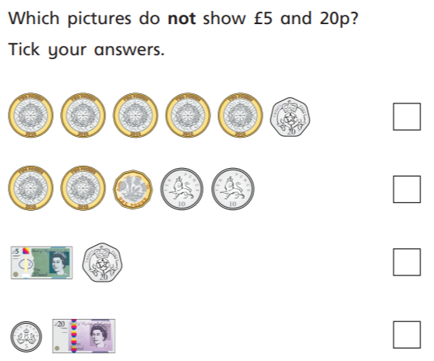
6.

Slide 18
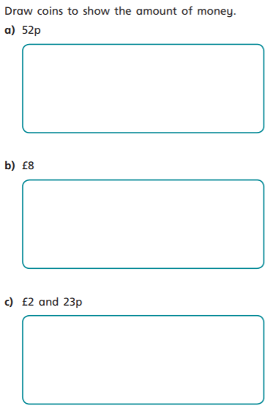
7.

Slide 19
Work 4 ANSWERS
1.

Slide 20
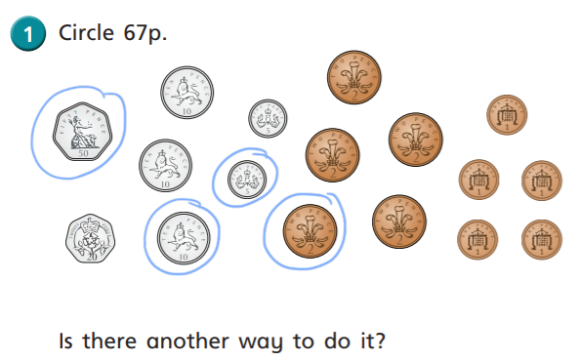
2.

Slide 21
3.

Slide 22
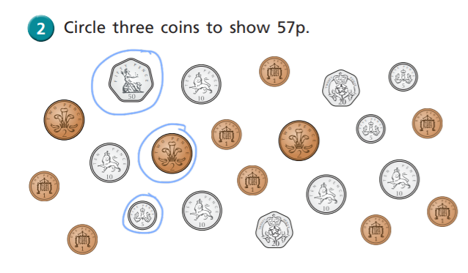
4.

Slide 23
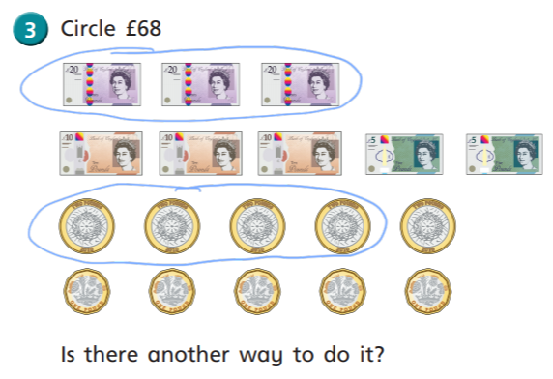
5.

Slide 24
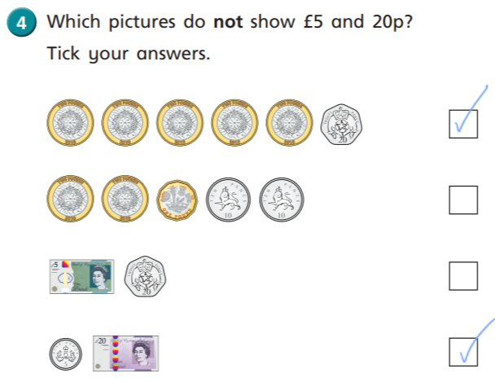
6.

Slide 25
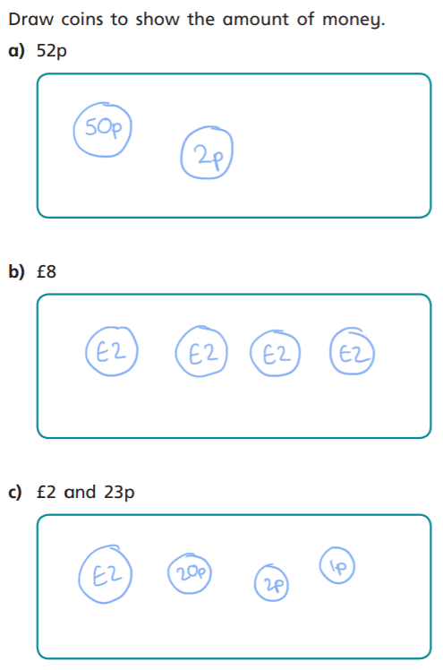
7.

