Slide 1
Year 3 Maths Work 4
Monday 18th January 2021

Slide 2
LO: Make and share equal groups - Count how many make the whole - How many groups are you sharing the whole into? - Share out the whole giving one to each group at a time -Count how many are in one group
18.1.21

Slide 3
Warm up
Let’s Count!
In 2s
0, 2, 4, 6, 8, 10, 12, 14, 16, 18, 20, 22, 24, 26, 28, 30
40, 42, 44, 46, 48, 50, 52, 54, 56, 58, 60, 62
30, 28, 26, 24, 22, 20, 18, 16, 14, 12, 10, 8, 6, 4, 2, 0

Slide 4
Warm up

Slide 6
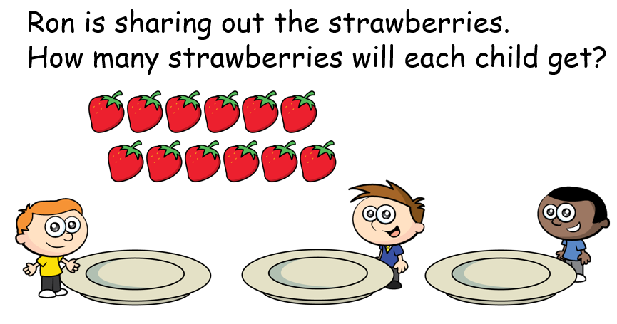
Let’s try together

Slide 7
There are 12 strawberries.
There are 3 children.
Each child will get 4 strawberries.

Slide 10
Ron is sharing out the strawberries.
How many strawberries will each child get?

Slide 12
LO: Make and share equal groups - Count how many make the whole - How many groups are you sharing the whole into? - Share out the whole giving one to each group at a time -Count how many are in one group
18.1.21

Slide 13
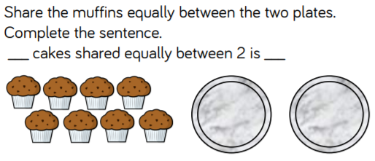
Work 4
1.

Slide 14
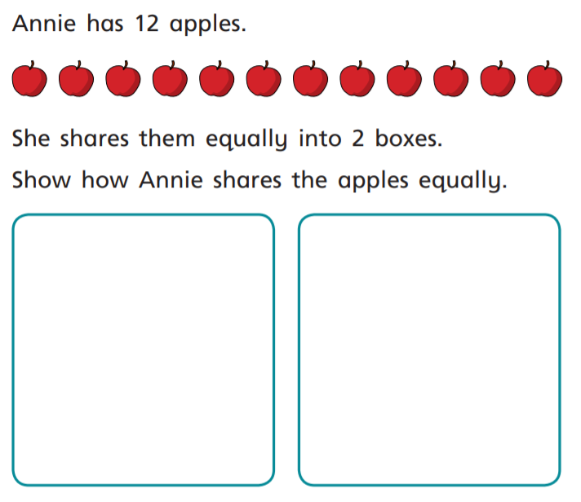
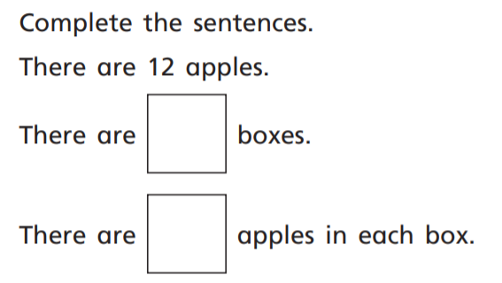
2.

Slide 15
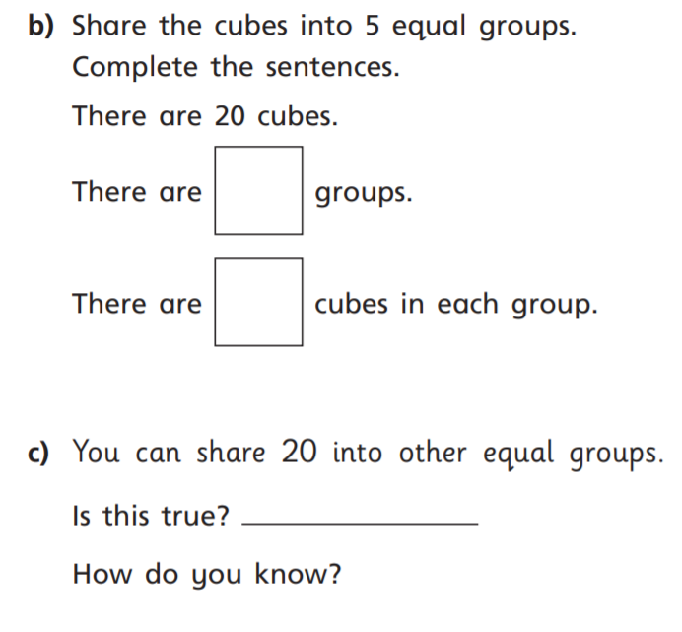
3.

Slide 16
4.

Slide 17
5.

Slide 18
Work 4 ANSWERS
1.
8
4

Slide 19
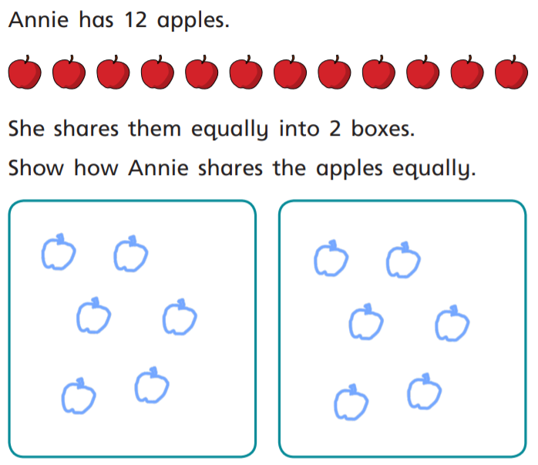
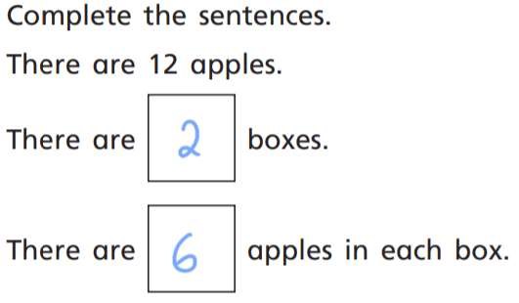

Slide 20
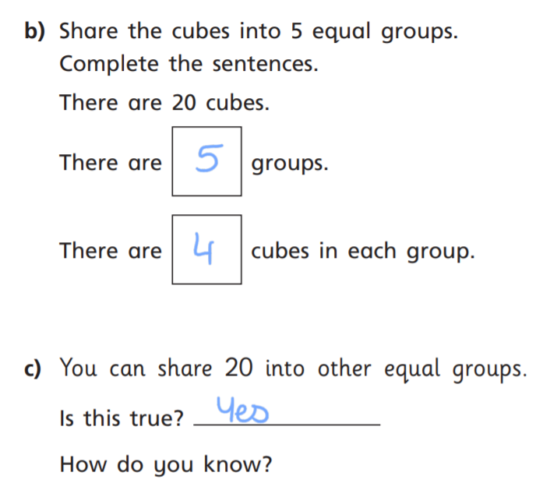
2.
4 groups of 5
10 groups of 2

Slide 21
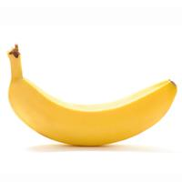
4.
8 bananas in each box.

Slide 22
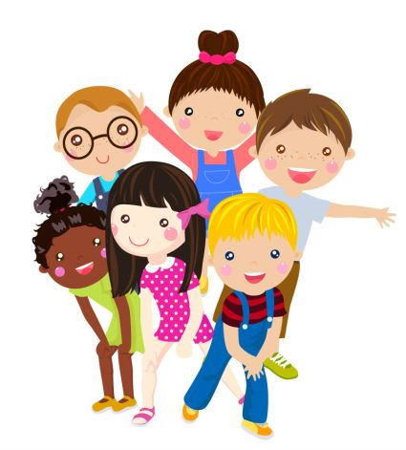
5.
24 ÷ 4 = 6
6 children in each team
Team 3
Team 4
Team 1
Team 2

