Slide 1
Year 3 Maths Work 4
Friday 5th February 2021

Slide 2
LO: Make a tally chart -Count how many objects there are -Write it using a tally method - Fill in the total - Look at the total, write the tally
5.2.21
White Rose Resources

Slide 3
Warm up 1
Let’s count in 5’s up to 50 and back again.

Slide 4
0, 5, 10, 15, 20, 25, 30, 35, 40, 45, 50
50, 45, 40, 35, 30, 25, 20, 15, 10, 5, 0

Slide 5
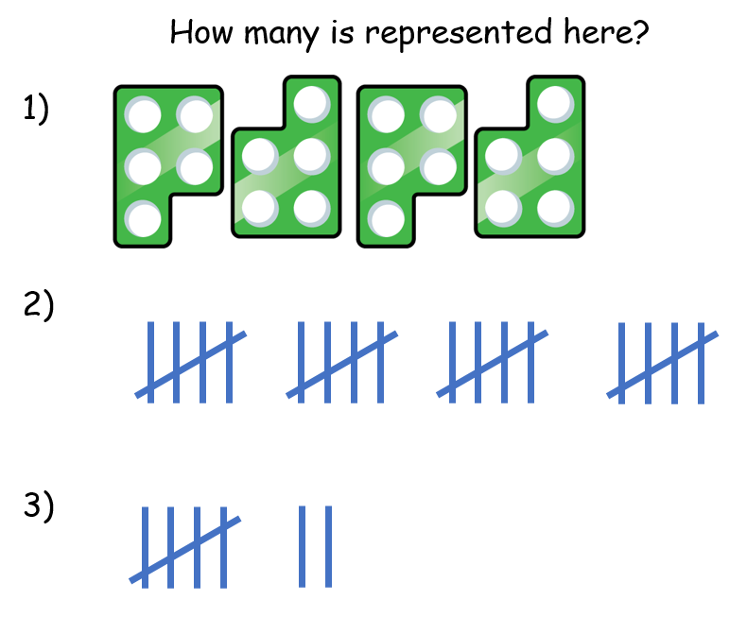
Warm up 2

Slide 6
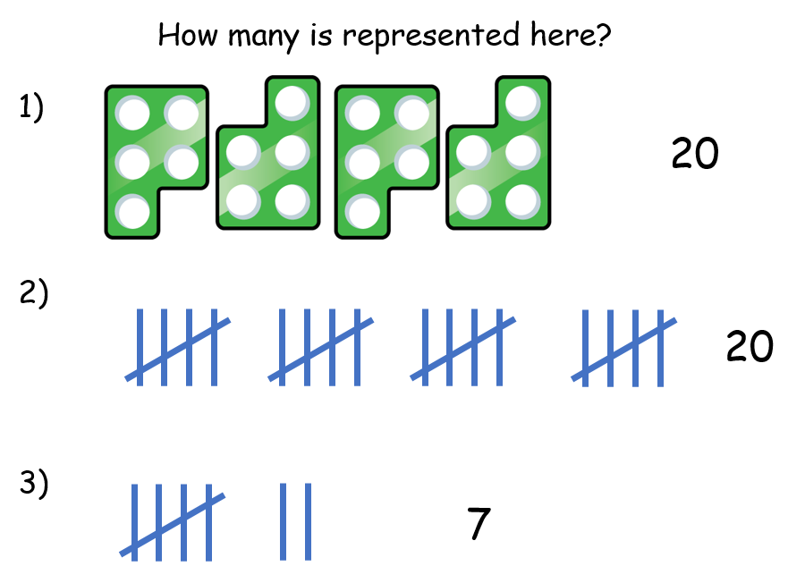

Slide 7
What is a tally chart?
Tally charts are a quick way of recording a number of objects in a table
You can create a tally each time you see something you are counting.
A tally looks like this:
= 5

Slide 8
Let’s try together
What would
you suggest
to Teddy
about his
tally chart?

Slide 10
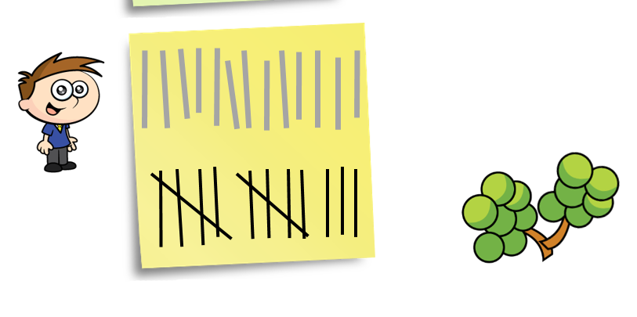

Slide 11
You try

Slide 12
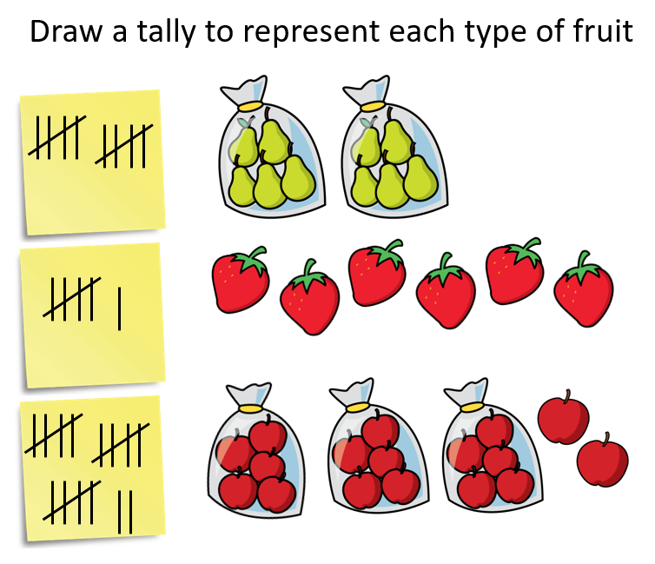

Slide 13
You try

Slide 14
Total
1
9

Slide 15
LO: Make a tally chart -Count how many objects there are -Write it using a tally method - Fill in the total - Look at the total, write the tally
5.2.21
White Rose Resources

Slide 16
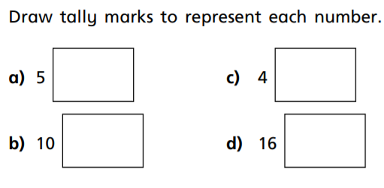
Work 4
1.

Slide 17
2. Fill in the
tally chart

Slide 18
3.

Slide 19
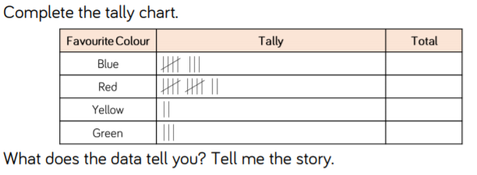
4. Fill in the totals

Slide 20
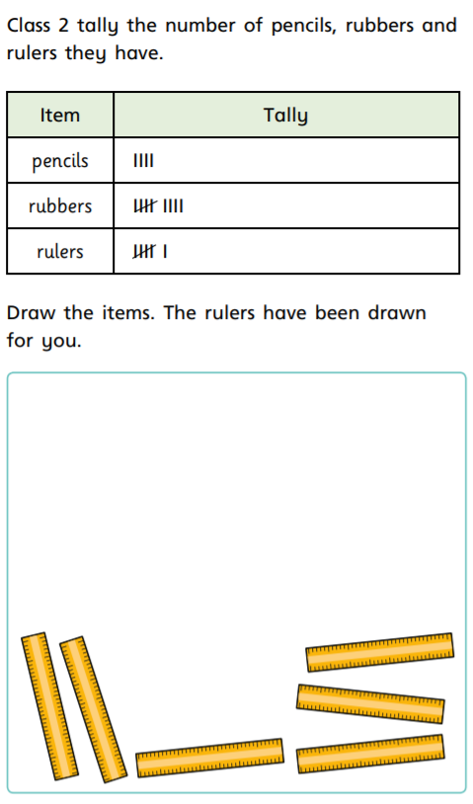
5.

Slide 21
6.

Slide 22
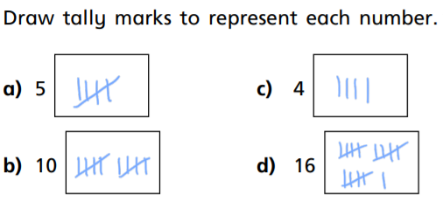
Work 4 ANSWERS
1.

Slide 23
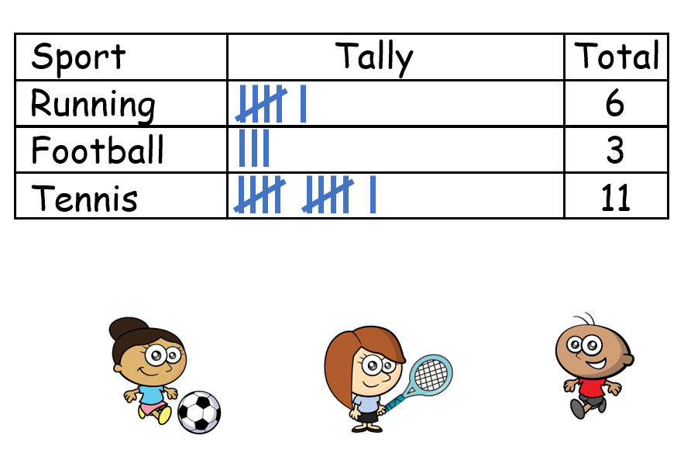
2.

Slide 24
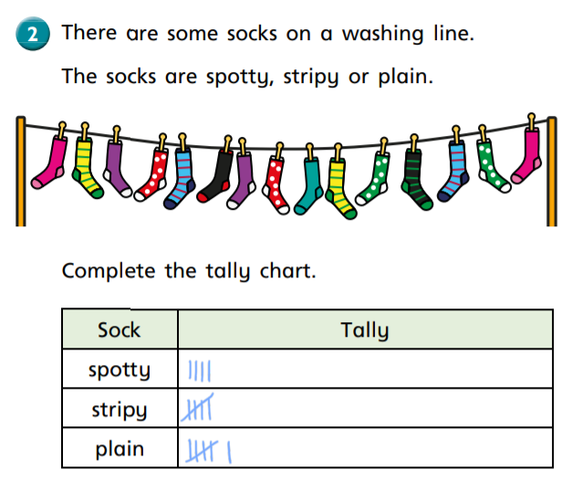
3.

Slide 25
4.
Red is the most popular colour with 12 votes whereas yellow is the least popular.
8
12
2
3

Slide 26
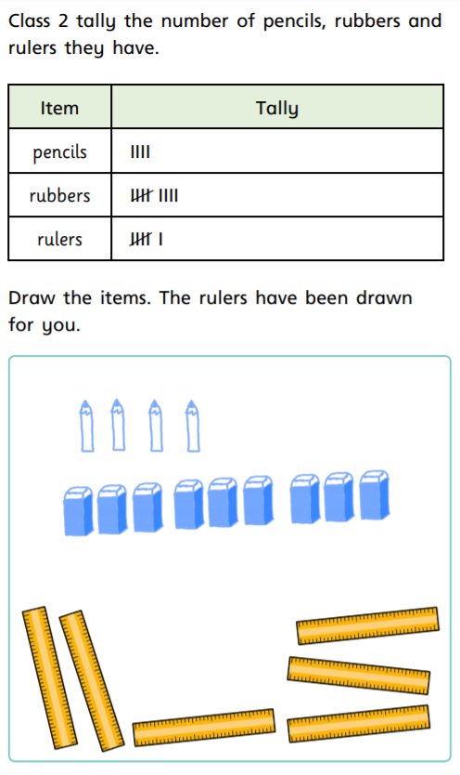
5.

Slide 27
6.
22

Slide 28
Remote Learning Tracking
https://forms.office.com/Pages/ResponsePage.aspx?id=eCY4lN73r0G0KV1rDWITzRhTQ2IZqpBOsW8cFVoooF9UNVlMS1dCVkdaM0k0WlhFTE9WVFBTWEg1Ti4u

