Slide 1
Year 3 Maths Work 4
Friday 5th March 2021

Slide 2
LO: Subtract a two digit number from two digit number - Use a part-whole model to partition the numbers to subtract more easily - Line up the tens and ones using the column method - Subtract the ones, subtract the tens
5.3.21
White Rose Resources

Slide 3
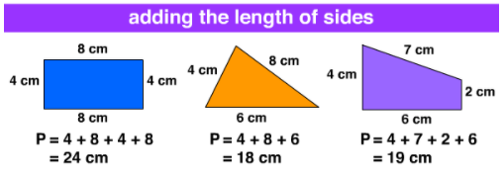
Maths Word of the Week
Perimeter
Distance around the outside of a shape, calculated by adding the length of all sides together.
To find the perimeter imagine you are walking around the whole shape and add up the length of each line.
Today’s Challenge:
What other length and height words could I have included as our word of the week? What would you have suggested?

Slide 4
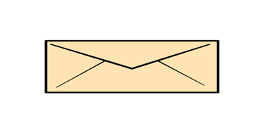
Warm up 1
cm

Slide 5
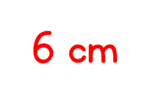
Cube
cm

Slide 6
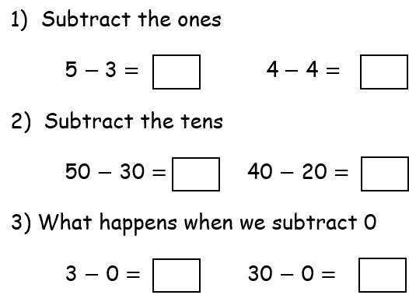
Warm up 2

Slide 8
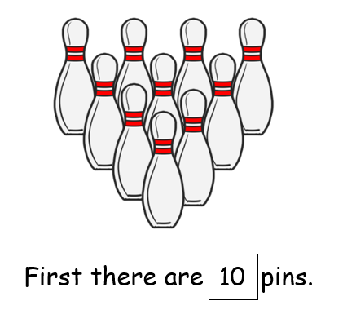
Let’s try together

Slide 9
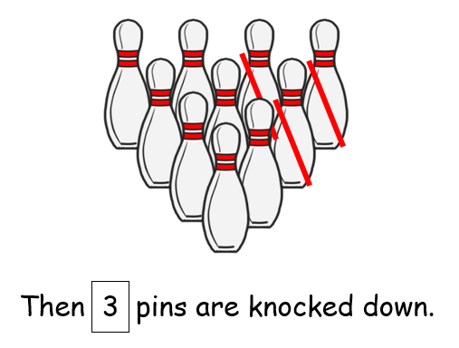

Slide 10
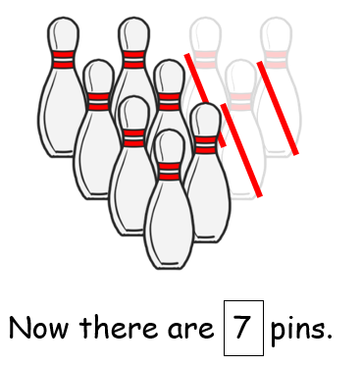

Slide 11
Can you write the corresponding number sentence?

Slide 13
You try

Slide 14
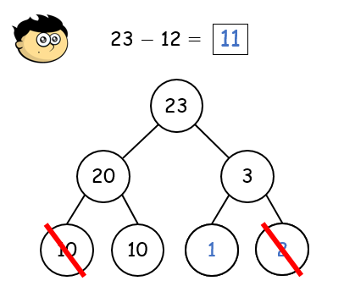

Slide 15
Let’s try together

Slide 16
You try

Slide 17
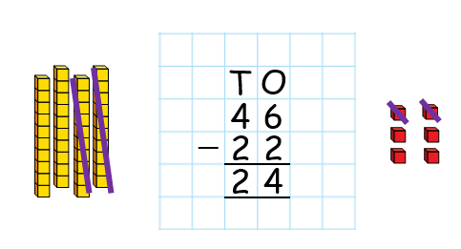

Slide 18
You try

Slide 19
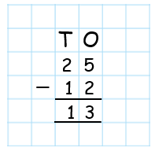

Slide 20
LO: Subtract a two digit number from two digit number - Use a part-whole model to partition the numbers to subtract more easily - Line up the tens and ones using the column method - Subtract the ones, subtract the tens
5.3.21
White Rose Resources

Slide 21
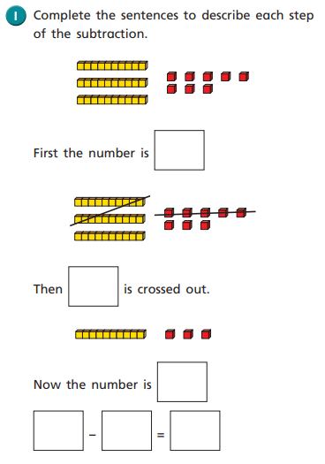
Work 4
1.

Slide 22
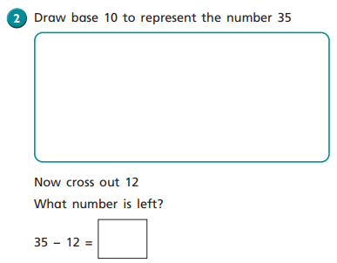
2.

Slide 23
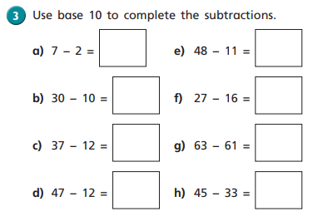
3.

Slide 24
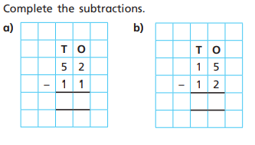
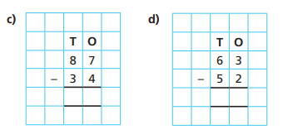
4.

Slide 25
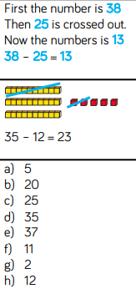
Work 4 ANSWERS
1. 4.
2.
3.

Slide 26
Remote Learning Tracking
https://forms.office.com/Pages/ResponsePage.aspx?id=eCY4lN73r0G0KV1rDWITzRhTQ2IZqpBOsW8cFVoooF9UNVlMS1dCVkdaM0k0WlhFTE9WVFBTWEg1Ti4u

