Slide 1
English 12.02.21

Slide 2
LO: Use conjunctions to develop the flow of writing.
Success Criteria:
Identify the clauses.
Choose an appropriate word to link the clauses.
Identify conjunctions in the sentence.
Write subordinating conjunctions at the start or middle of the sentence.

Slide 3
Co-ordinating conjunctions

Slide 4
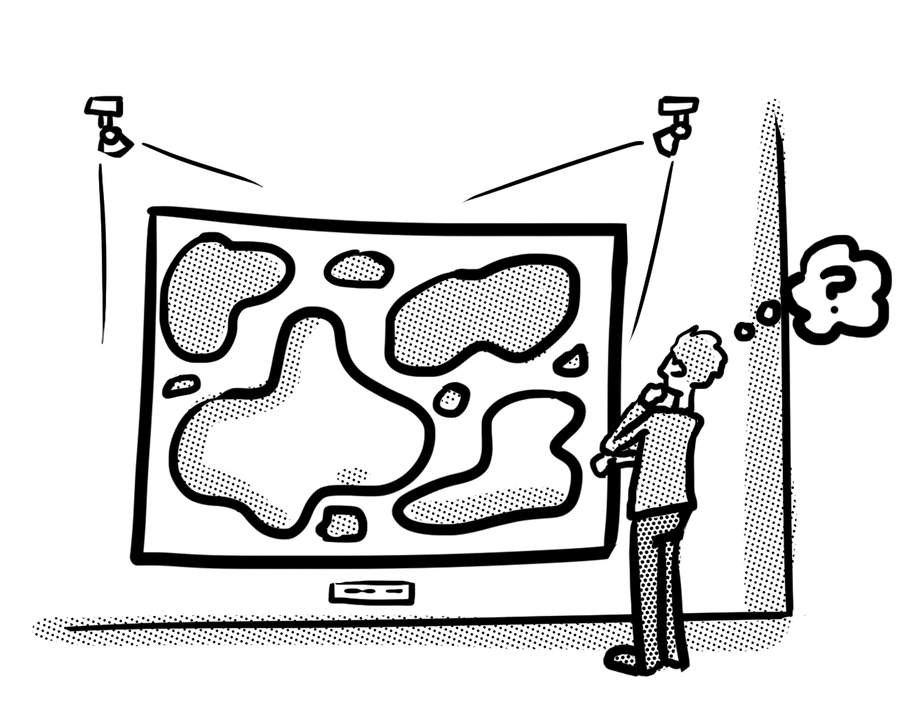
Co-ordinating conjunctions
We use co-ordinating conjunctions to join two words, phrases or clauses as an equal pair. This can help our writing flow better for the reader. Here is an example.
I like visiting museums. I like visiting art galleries.
There are two main clauses here – two sentences that make sense by themselves.

Slide 5
Co-ordinating conjunctions
If we use a co-ordinating conjunction to link these two main clauses, it makes the sentence less repetitive for the reader. We can remove ‘I like visiting’ from the second sentence.
I like visiting museums and art galleries.
The co-ordinating conjunction helps our writing to flow.

Slide 6
Co-ordinating conjunctions
To help you remember the co-ordinating conjunctions, use FANBOYS!
F
A
N
B
O
Y
S
for
and
nor
but
or
yet
so

Slide 7
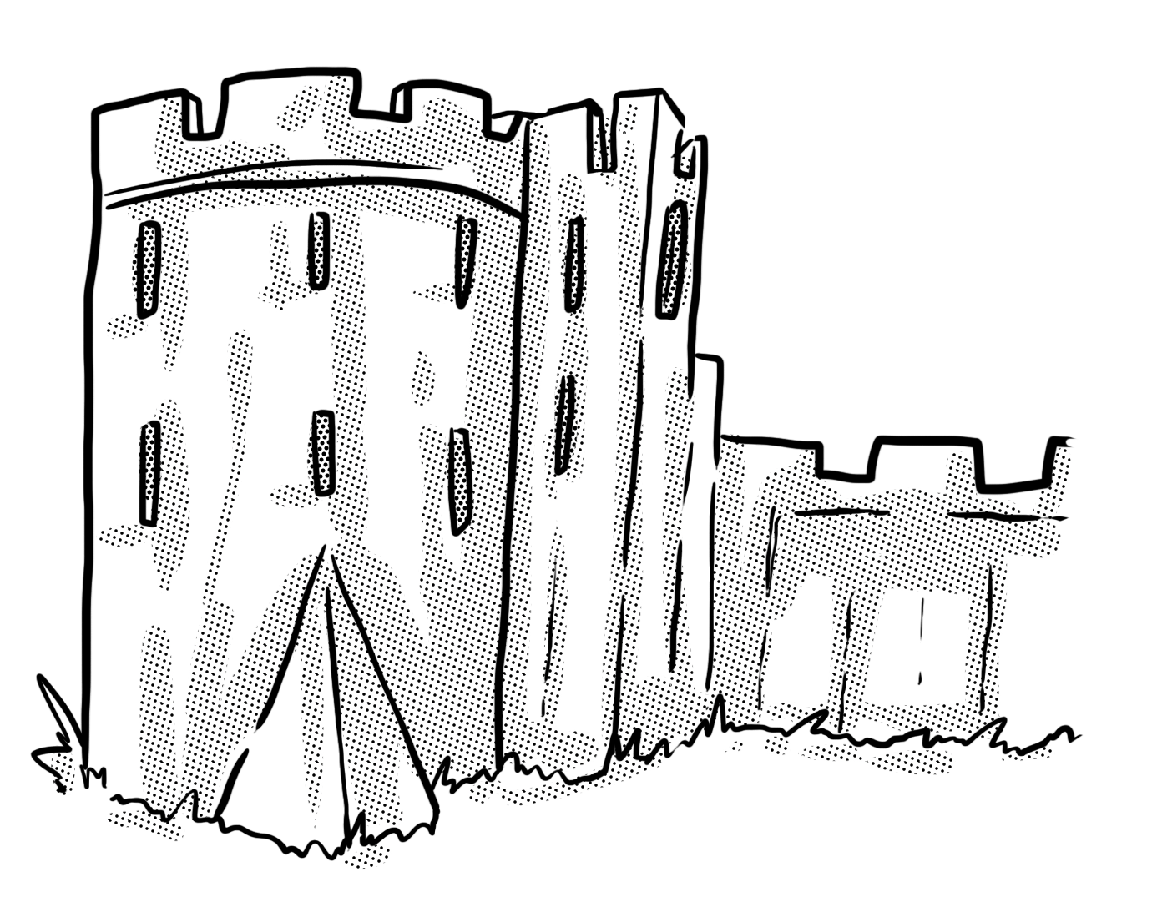
Your turn
Complete the sentences below by writing the co-ordinating conjunctions from the box in the correct place. Use each conjunction only once.
so but and
The strange sounds coming from the castle terrified her _______ she retreated into the shadows _______ quickly realised that someone else was there with her.

Slide 8
How did you do?
Complete the sentences below by writing the co-ordinating conjunctions from the box in the correct place. Use each conjunction only once.
so but and
The strange sounds coming from the castle terrified her so she retreated into the shadows but quickly realised that someone else was there with her.

Slide 9
Your turn
Rewrite the sentences below, linking them with the most suitable co-ordinating conjunction.
I love looking after my rabbit. I love looking after my cat.
The boat docked in the harbour. The passengers could get off.
We needed to find out about the Egyptians. The library was shut.
Top tip: use FANBOYS!

Slide 10
How did you do?
Rewrite the sentences below, linking them with the most suitable co-ordinating conjunction.
I love looking after my rabbit and my cat.
The boat docked in the harbour so the passengers could get off.
We needed to find out about the Egyptians but the library was shut.
Top tip: use FANBOYS!

Slide 11
Subordinating conjunctions

Slide 12
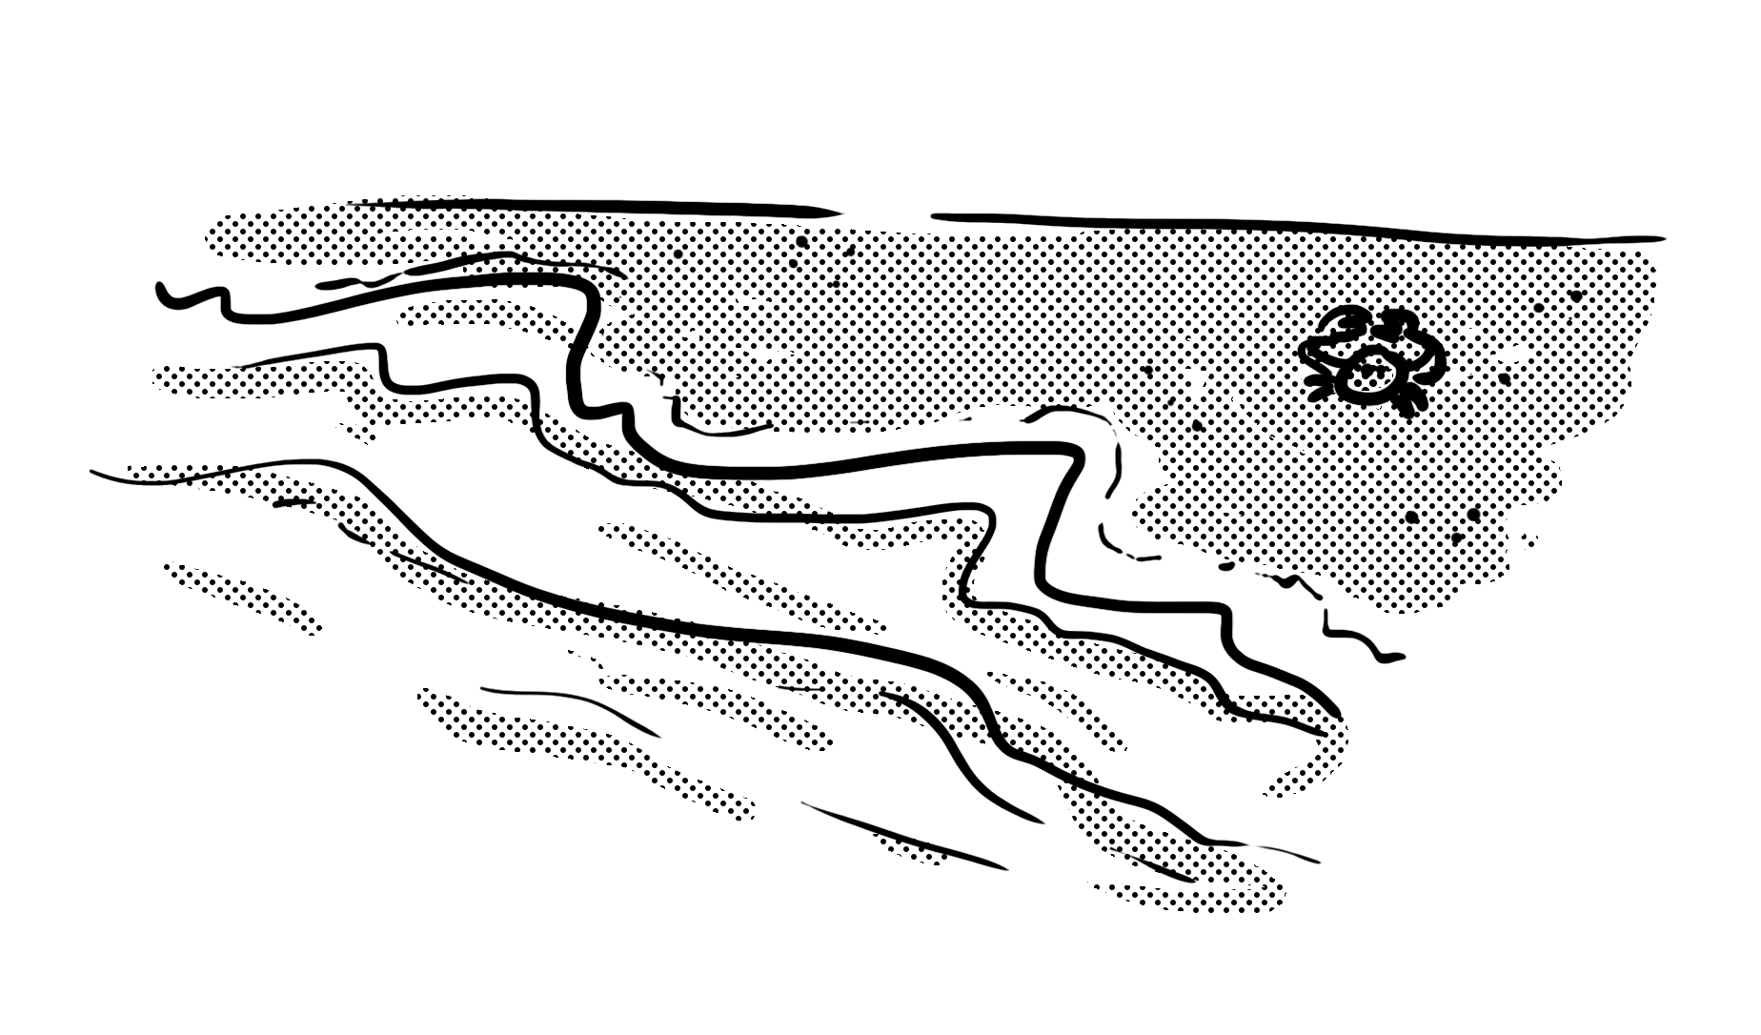
Subordinating conjunctions
Subordinating conjunctions introduce a subordinate clause (a group of words containing a verb that depends on the main clause to make sense). We use them to show the reader how ideas and events relate to each other.
subordinating conjunction
We visited the coast
even though it was miles away.
main clause – makes sense on its own
subordinate clause – does not make sense by itself

Slide 13
Subordinating conjunctions
A subordinate clause can appear before or after a main clause. This means that a subordinating conjunction can be at the start of a sentence or in the middle.
subordinating conjunction
Even though it was miles away,
we visited the coast.
subordinate clause
main clause

Slide 14
Separating the clauses
When the subordinate clause comes at the beginning of the sentence, a comma is used to separate the clauses.
Even though it was miles away,
we visited the coast.
When the subordinate clause comes at the end of the sentence, the subordinating conjunction separates the clauses.
We visited the coast
even though it was miles away.

Slide 15
Subordinating conjunctions
To help you remember the subordinating conjunctions, use A WHITE BUS!
A
WH
I
T
E
B
U
S
as
after
although
while
whilst
when
if
though
even though
because
before
until
unless
since
These are some of the most commonly used subordinating conjunctions… there are others!

Slide 16
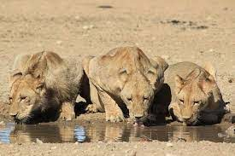
Your turn
Underline the subordinating conjunction in each sentence below.
As the sun sets, the animals come to the water hole to drink.
The giraffes take their fill before the lions arrive.
Once they are refreshed, they return to the bush to hunt.
The pride will starve unless the lionesses find food.
Remember: subordinating conjunctions introduce a subordinate clause. Top tip: use A WHITE BUS!

Slide 17
How did you do?
Underline the subordinating conjunction in each sentence below.
As the sun sets, the animals come to the water hole to drink.
The giraffes take their fill before the lions arrive.
Once they are refreshed, they return to the bush to hunt.
The pride will starve unless the lionesses find food.
Remember: subordinating conjunctions introduce a subordinate clause. Top tip: use A WHITE BUS!

Slide 18
Your turn
Insert a suitable subordinating conjunction into each sentence below.
We will listen to music _______ you complete your sketches.
_______ water is heated, it changes to a gas.
The doctor gave me some medicine _______ I had an infection.
_______ it was exhausting, we enjoyed the cross country run.
Remember: subordinating conjunctions introduce a subordinate clause. Top tip: use A WHITE BUS!

Slide 19
How did you do?
There are several possibilities for each answer. You might have something like this.
We will listen to music while you complete your sketches.
When water is heated, it changes to a gas.
The doctor gave me some medicine because I had an infection.
Although it was exhausting, we enjoyed the cross country run.
Remember: subordinating conjunctions introduce a subordinate clause. Top tip: use A WHITE BUS!

Slide 20
Your turn
Add a subordinate clause to each main clause below. You may add it on before or after the main clause. Remember to punctuate your sentences correctly.
The sunflower seeds needed watering.
He whistled a tune.
The friends sat in the park.
Remember: subordinating conjunctions introduce a subordinate clause. Top tip: use A WHITE BUS!

Slide 21
How did you do?
There are several possibilities for each answer. You might have something like this.
The sunflower seeds needed watering because the soil was very dry.
As he strolled down the lane, he whistled a tune.
The friends sat in the park until the light began to fade.
Remember: subordinating conjunctions introduce a subordinate clause. Top tip: use A WHITE BUS!

Slide 22
Your turn…
Choose one of the challenges on the next slides to complete.
There is a mild, medium and spicy challenge.

Slide 23
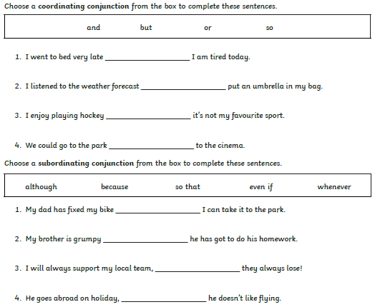
Mild

Slide 24
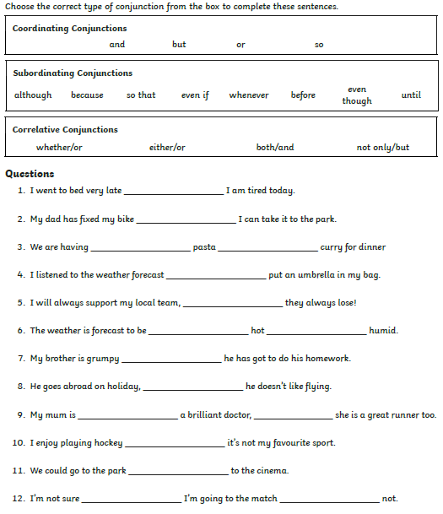
Medium

Slide 25
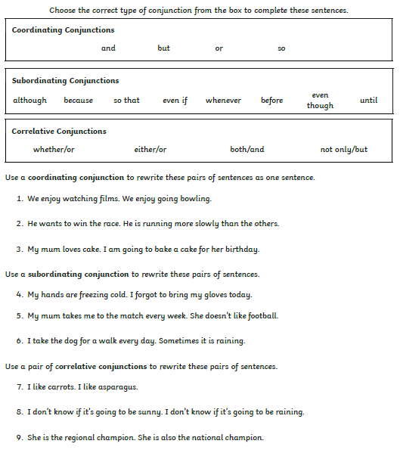
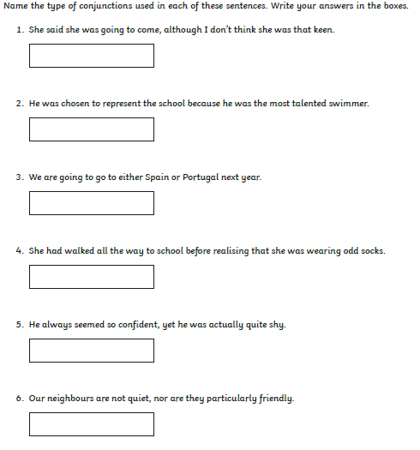
Spicy

Slide 26
Mild Answers
so
and
but
or
so that
because
even if
although

Slide 27
Medium Answers
so
so that
either
or
and
even if
either
or
because
even though
not only
but
but
or
whether
or

Slide 28
Spicy Answers
Children have rewritten the sentences with
appropriate conjunctions.
subordinating
subordinating
coordinating
subordinating
coordinating
coordinating

Slide 29
Remote Learning Tracking
Click on the link to let us know that you have completed the lesson:
https://forms.office.com/Pages/ResponsePage.aspx?id=eCY4lN73r0G0KV1rDWITzRhTQ2IZqpBOsW8cFVoooF9UNVlMS1dCVkdaM0k0WlhFTE9WVFBTWEg1Ti4u

