Slide 1
English 21.01.21

Slide 2
Writing a non-chronological report
Razvani the fire fiend

Slide 3
LO: Use appropriate features to write a non-chronological report.
Success Criteria:
Use sub-headings to sort the information.
Write in the present tense.
Write in the third person.
Use paragraphs.
Finish with a summary.

Slide 4
Introduction
Opening Statement – Introduce the information.
Who are you writing about?
What is it?
Where is it found?
When is it found?

Slide 5
The Report
Use sub-headings – these can be questions.
Use simple clear titles.
Write using short sentences that makes it clear.
Use third person and the present tense.
Use diagrams and captions to help explain.

Slide 6
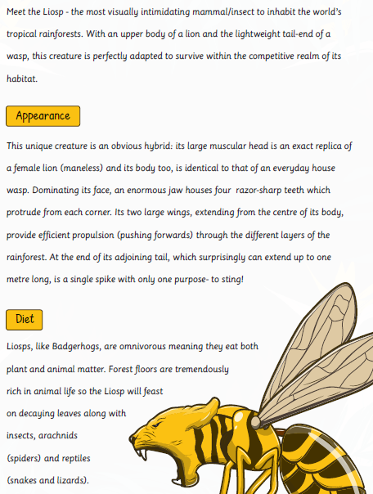
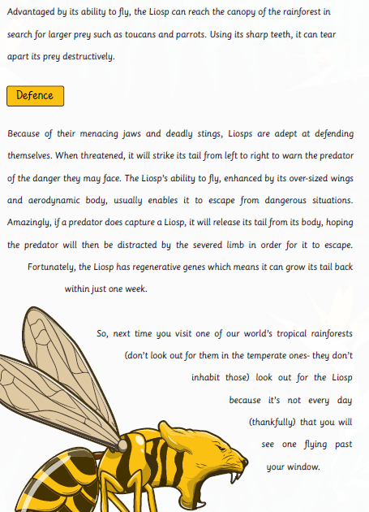
Example Non-chronological report

Slide 8
Your turn…
Use your plan from yesterday to write your non-chronological report on Razvani. Remember he is a fictional (made up) character so be as creative as you want!
Mild – use sub-headings to sort the information.
Medium – include paragraphs and diagrams.
Spicy – include questions, paragraphs and diagrams.

