Slide 1
English 22.02.21

Slide 2
The Dragon’s Hoard
Stories from the Viking sagas

Slide 3
LO: Decode, infer and interpret.
Success Criteria:
Identify key information from a text.
Infer meaning using clues from the text.
Predict what might happen next.

Slide 4
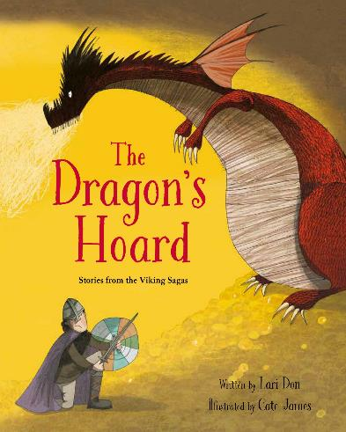
The Dragon’s Hoard
The next few slides will have the text for the first short story that we are focussing on today.

Slide 5
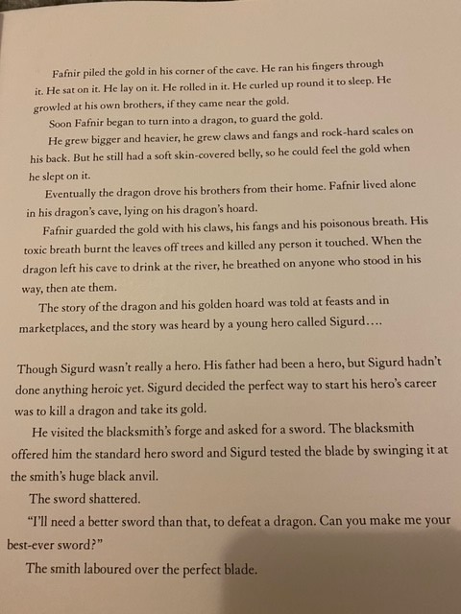

Slide 6
What do you think is going to happen next?

Slide 7
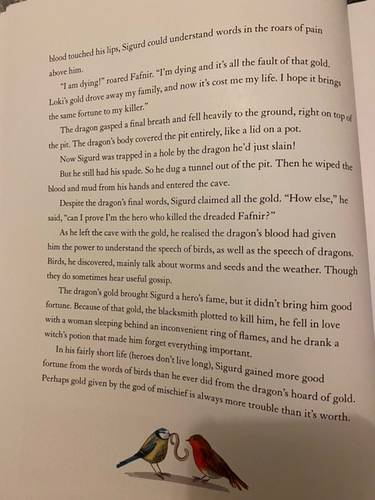

Slide 8
Questions
Answer the following questions using the text to help you.
What was Loki the Viking God of?
Name 3 things that happened to Fafnir as he turned into a dragon.
Why did Loki agree to pay the Shape-shifter’s family?
What does the word ‘mischief’ tell us about Loki?
Why is the gold described as a ‘hoard’?
Why do you think Sigurd wanted to be a hero?
Explain how Sigurd is made to seem brave.
What do you think is the genre of this story?
Mild – questions 1 - 4
Medium – questions 1 - 6
Spicy – questions 1 - 8

Slide 9
Answers
Mischief
Fafnir grew bigger, grew claws, fangs and scales.
Loki killed one of the brothers thinking they were an otter.
He often causes harm or trouble/ That he often got up to ‘no good’/ He was a bit of a troublemaker etc.
A hoard is a stock or store of money which is usually guarded.
Sigurd’s father was a hero so he might want to follow in his footsteps/ Sigurd might have wanted to be liked by the people/ To make his family proud etc.
He isn’t afraid to kill the dragon all by himself/ He waits in the cold damp pit for the dragon to awaken/ He makes a clever plan on his own etc.
A myth

Slide 10
Remote Learning Tracking
Click on the link to let us know that you have completed the lesson:
https://forms.office.com/Pages/ResponsePage.aspx?id=eCY4lN73r0G0KV1rDWITzRhTQ2IZqpBOsW8cFVoooF9UNVlMS1dCVkdaM0k0WlhFTE9WVFBTWEg1Ti4u

