Slide 1
English 05.02.21

Slide 2
LO: Use modal verbs.
Success Criteria:
Identify if the verb is a possibility or is certainly going to happen.
Choose an appropriate modal verb to go with the main verb.

Slide 3
Modal verbs

Slide 4
Modal verbs are auxiliary verbs which cannot usually work alone.
They are used with a main verb.
These are modal verbs:
might
will
should
may
would
can
could
must
shall
ought to

Slide 5
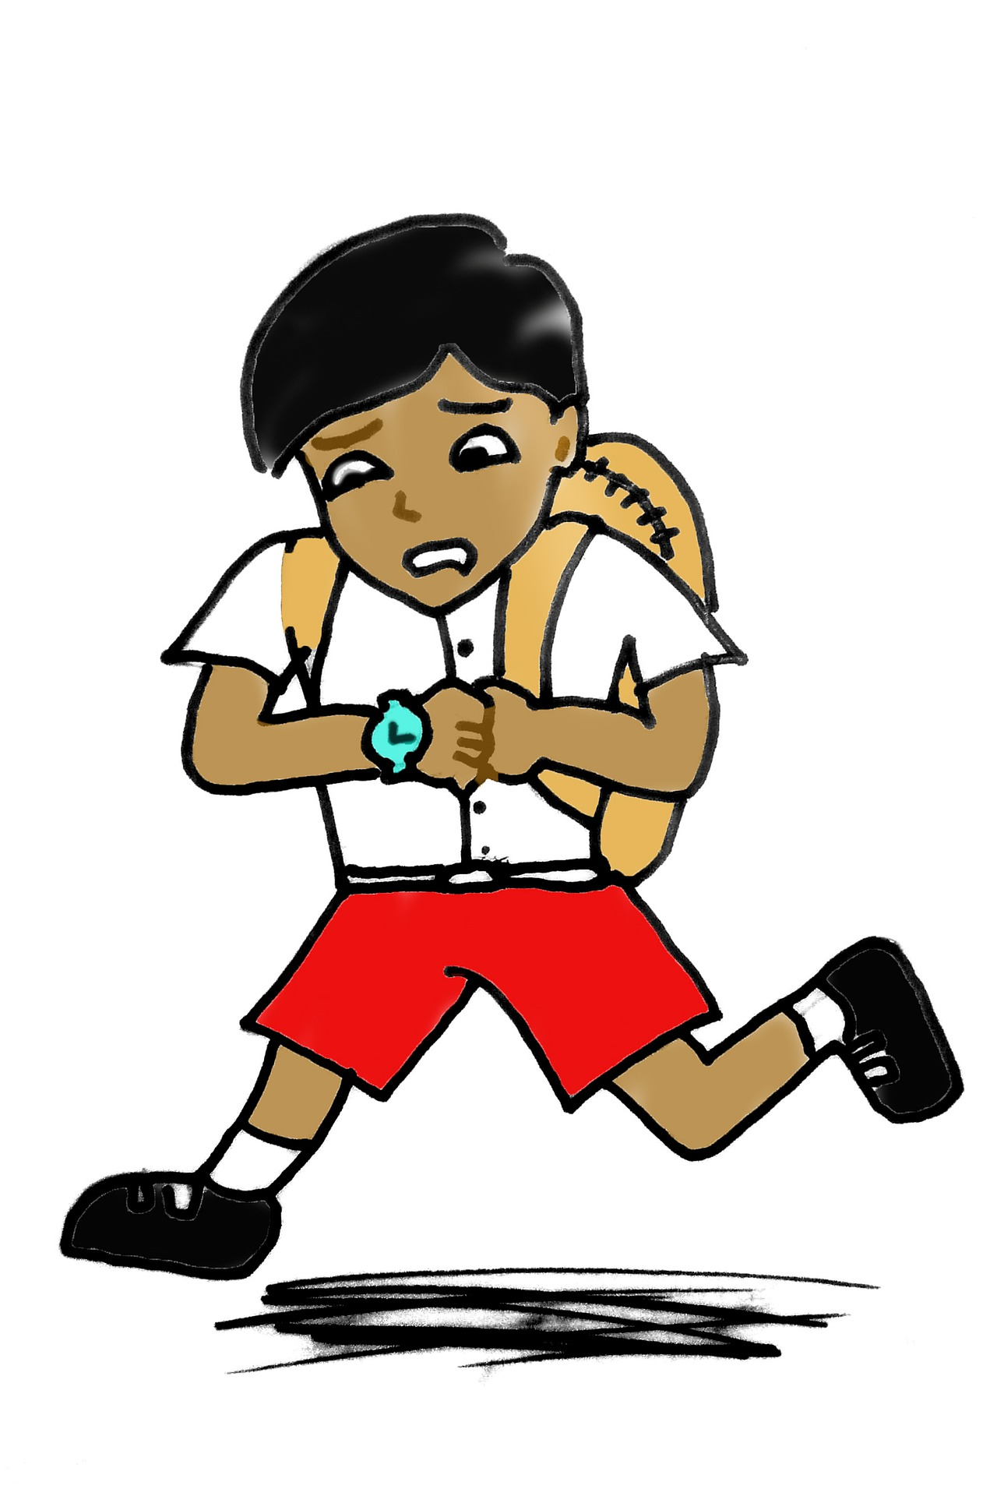
Modal verbs
Modal verbs express certainty or possibility, e.g. must, may.
Some modal verbs are used to tell us that something is certain.
You need to run or you will be late.
We must drive home before dark.
When shall I collect you later?

Slide 6
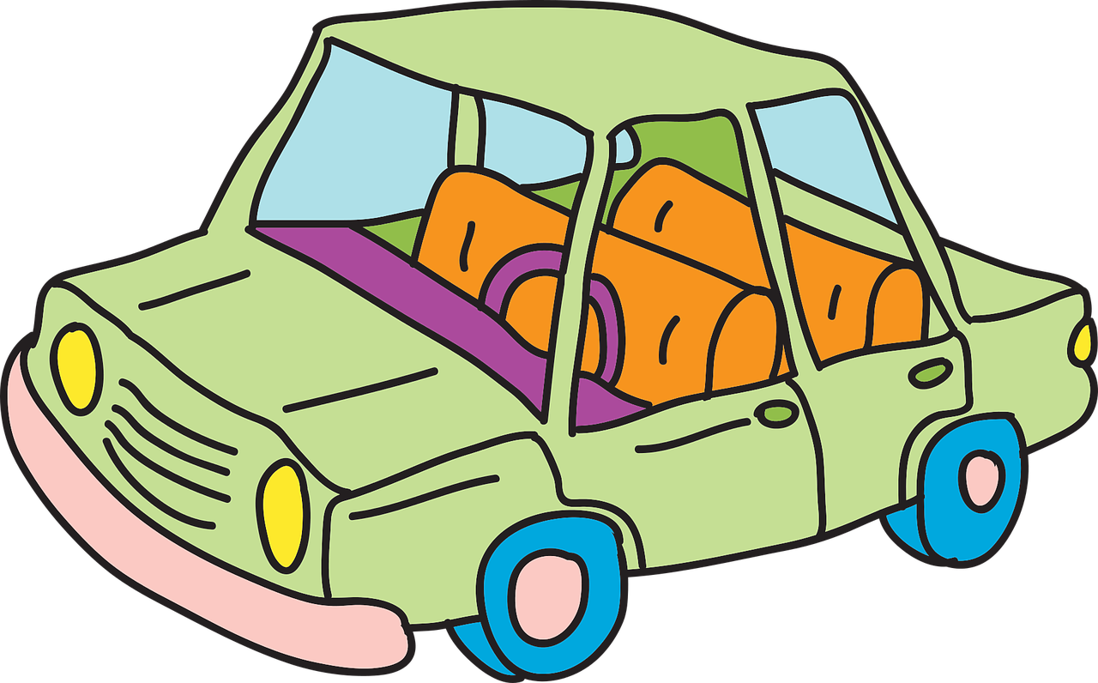
Modal verbs
Modal verbs express certainty or possibility, e.g. must, may.
Some modal verbs are used to tell us that something is possible.
I might need more petrol.
When you arrive, Jo should meet you.
We ought to finish the cleaning.

Slide 7
Modal verbs
The choice of modal verb can change the meaning of the sentence.
1. You can use a pen.
2. You must use a pen.
In the second sentence, it is certain that you have to use a pen. The first sentence means it is possible to use a pen but you have a choice.
Remember: modal verbs express certainty or possibility.

Slide 8
Modal verbs
The choice of modal verb can change the meaning of the sentence.
1. You will need an umbrella.
2. You might need an umbrella.
In the second sentence, it is possible that you need an umbrella. The first sentence means it is certain that you need an umbrella.
Remember: modal verbs express certainty or possibility.

Slide 9
Modal verbs
One way of checking if a word is a modal verb is to replace it with a word that you know definitely is, e.g. may, must.
The word should can be replaced with may.
You should bring a coat.
The word will can be replaced with must.
They will help us.
Try replacing the other words in these sentences with may, must. Does the sentence still make sense?

Slide 10
Practise
Sort the modal verbs below into the correct column.
Indicates certainty | Indicates possibility
shall may
can could
will ought to
might must
Remember: modal verbs express certainty or possibility.

Slide 11
How did you do?
Sort the modal verbs below into the correct column.
Indicates certainty | Indicates possibility
shall | may
will | can
must | could
 | ought to
 | might
Remember: modal verbs express certainty or possibility.

Slide 12
Practise
Underline the modal verbs in the sentence below.
He probably thought that he could win the race.
Circle both modal verbs in the sentence below.
If you want to, you can start getting the ingredients ready but we will not start cooking until 7pm.
Remember: modal verbs express certainty or possibility.

Slide 13
How did you do?
Underline the modal verbs in the sentence below.
He probably thought that he could win the race..
Circle both modal verbs in the sentence below.
If you want to, you can start getting the ingredients ready but we will not start cooking until 7pm.
Remember: modal verbs express certainty or possibility.

Slide 14
Practise
Insert a modal verb that indicates certainty.
We _______________ hand our project in tomorrow.
Insert a modal verb that indicates possibility.
You _______________ meet me at the park.
Remember: modal verbs express certainty or possibility.

Slide 15
How did you do?
Insert a modal verb that indicates certainty.
We must/shall/will hand our project in tomorrow.
Insert a modal verb that indicates possibility.
You may/can/could etc. meet me at the park.
Remember: modal verbs express certainty or possibility.

Slide 16
Practise
Explain how the choice of modal verb changes the meaning in the second sentence.
After lunch, we shall play rugby.
After lunch, we might play rugby.
_____________________________________
_____________________________________

Slide 17
How did you do?
Explain how the choice of modal verb changes the meaning in the second sentence.
After lunch, we shall play rugby.
After lunch, we might play rugby.
E.g. In the first sentence, it is certain that they will play rugby. In the second sentence, it is possible but they won’t definitely play rugby.

Slide 18
Practise
Rewrite the sentence below, using a modal verb that indicates certainty.
They ought to visit the new museum.
_____________________________________
_____________________________________

Slide 19
How did you do?
Rewrite the sentence below, using a modal verb that indicates certainty.
They ought to visit the new museum.
They must/shall/will visit the new museum.

Slide 20
Modal verbs can also be used to show:
advice or obligation
habits
I will often have cereal for
my breakfast.
We shall always enjoy a
walk in the park.
Pupils must wear a uniform.
You should not smoke.
permission
ability
May I leave a few minutes early?
Could we go to the post
box on the way?
Please can we have an
ice cream?
I can drive a tractor.
My grandfather could
draw very well.

Slide 21
Your turn…
Choose one of the challenges on the next slides to complete.
There is a mild, medium and spicy challenge.

Slide 22
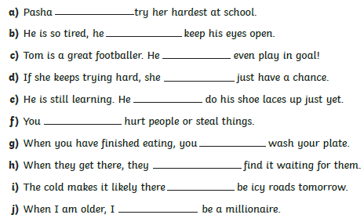
Mild
Use the modal verbs in the word bank to complete the sentences.

Slide 23
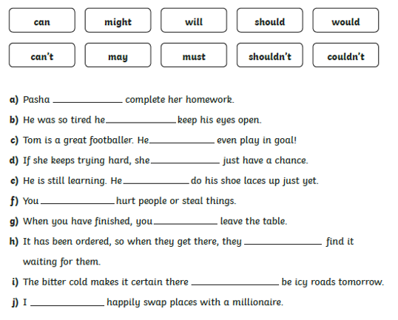
Medium
Use the modal verbs in the word bank to complete the sentences.

Slide 24
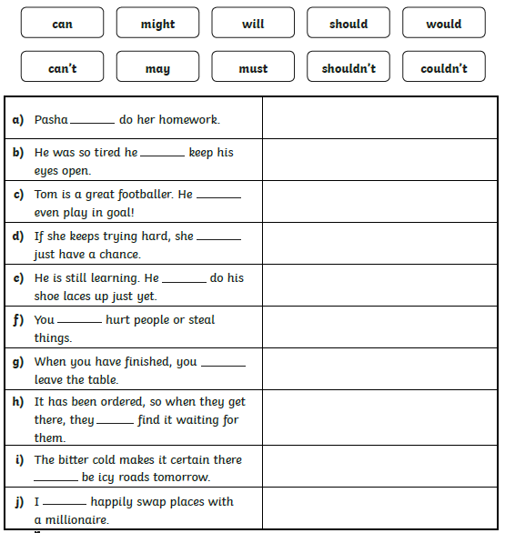
Spicy
Write all the possible
modal verbs that
could be used to
complete each of the
sentences.

Slide 25
Answers
Mild | Medium | Spicy
should can’t can might can’t shouldn’t should should will might | must couldn’t can might can’t shouldn’t may should will would | can, may, might, will, must couldn’t, wouldn’t can, may, might, will, would, must, should may, might, will, must, should can’t will, can’t, shouldn’t may, can, must, might, should, can’t, shouldn’t may, might, will, must, should may, might, will would, wouldn’t, might, will

Slide 26
Please click on the link below to let us know that you have accessed this lesson.
https://forms.office.com/Pages/ResponsePage.aspx?id=eCY4lN73r0G0KV1rDWITzRhTQ2IZqpBOsW8cFVoooF9UNVlMS1dCVkdaM0k0WlhFTE9WVFBTWEg1Ti4u

