Slide 1
Maths 21.01.21

Slide 2
L.O: Calculate the perimeter of rectangles.
Starter: True or false?
Success Criteria:
-Describe what ‘perimeter’ is.
-Understand how to work out the perimeter.
-Identify the unit of measurement needed when finding the perimeter.
-Calculate missing lengths.

Slide 4
Perimeter is the length around a closed 2-D shape.
1 cm
1 cm
5 cm
4 cm
4 cm
5 cm
5 cm
+ 4 cm
+ 5 cm
+ 4 cm
= 18 cm

Slide 5
2 cm
2-D shape
4 sides
All sides are straight
2 pairs of parallel sides
2 cm
6 cm
6 cm
Opposite sides are equal
16 cm
Perimeter =
8 cm ?
6 cm
+ 2 cm
+ 6 cm
+ 2 cm
= 16 cm

Slide 6
6 cm
2 cm
6 cm
+ 2 cm
+ 6 cm
+ 2 cm
= 16 cm
6 cm $×$ 2
+
2 cm × 2
= 16 cm
8 cm
× 2
= 16 cm

Slide 7
Match the rectangles with the correct calculation to find the perimeter.
Have a think
4 cm
5 cm
3 cm
2 cm
5 cm
5 $×$ 2 $=$ 10
9 $×$ 2 $=$ 18
5 $×$ 4 $=$ 20

Slide 8
Perimeter = 18 cm
4 cm
5 cm
5 cm
4
cm
5 $×$ 2 $=$ 10
18 $−$ 10 $=$ 8
8 $÷$ 2 $=$ 4

Slide 9
Questions

Slide 10
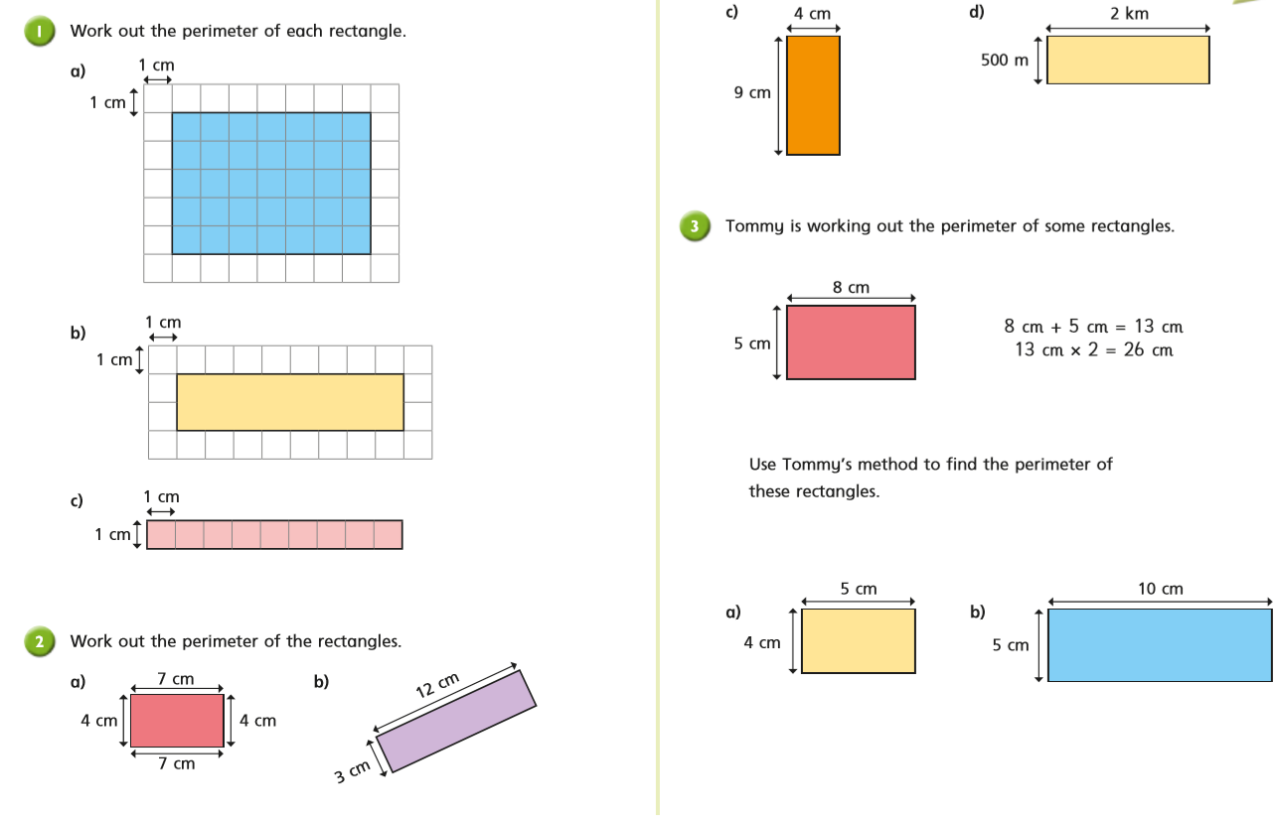
Questions

Slide 11
Challenge

Slide 12
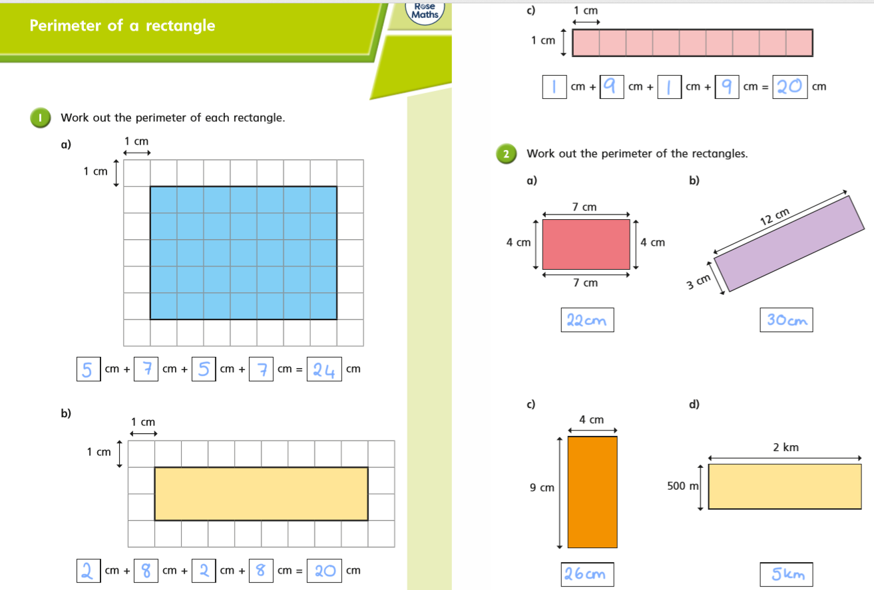
Answers

Slide 13
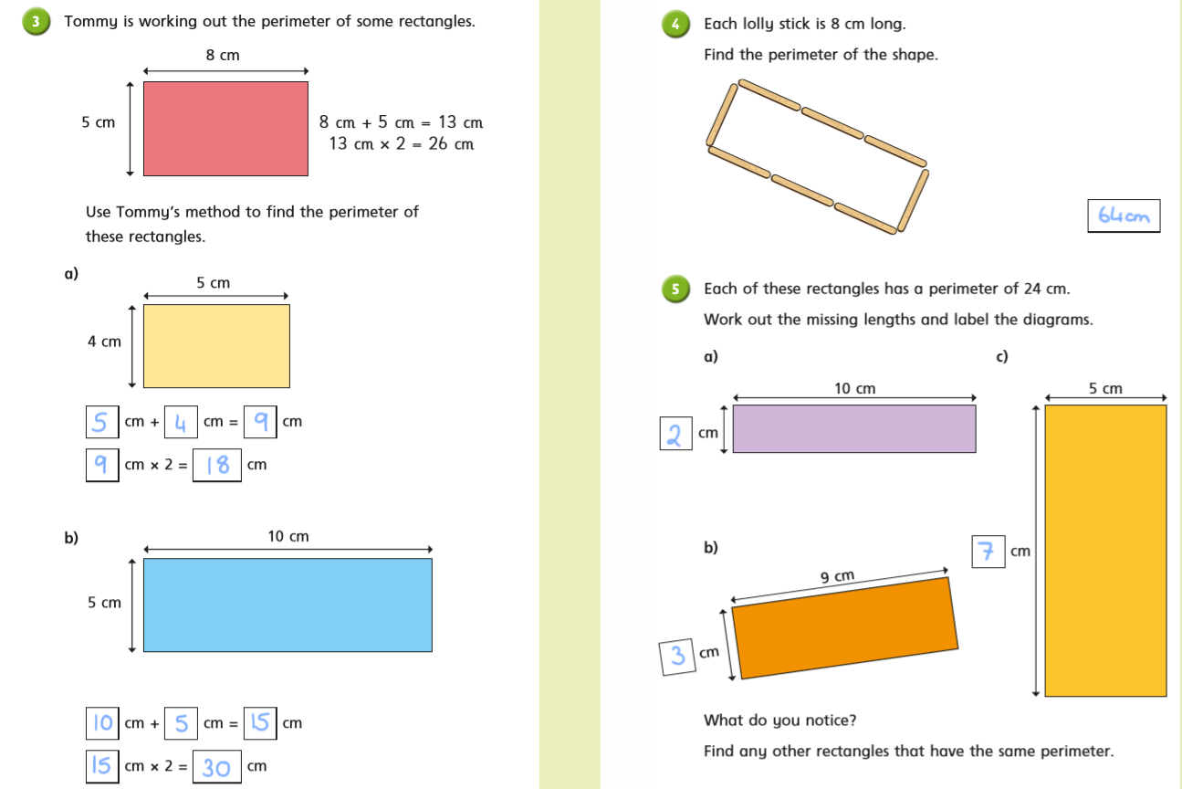
Challenge

