Slide 1
Maths 23.02.21

Slide 2
Fractions

Slide 3
LO: Add two or more fractions.
Success Criteria:
Add the numerators together.
Keep the same denominator.
Use a bar model to represent fractions.
Use a bar model to find missing fractions.

Slide 4
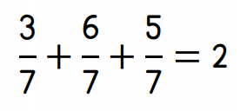

Slide 5
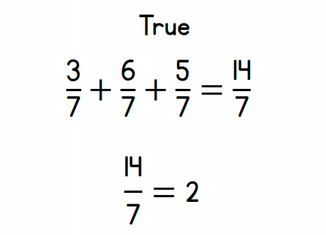

Slide 6
4 $+$ $=$ 9
4 $+$ $=$ 13
4 $+$ $+$5 $=$ 15
$\frac{\text{13}}{\text{7}}$ $=$ whole $+$ sevenths
$\frac{\text{3}}{\text{5}}$ $+$ $\frac{\text{1}}{\text{5}}$ $=$

Slide 7
5
4 $+$ $=$ 9
4 $+$ $=$ 13
4 $+$ $+$ 5 $=$ 15
$\frac{\text{13}}{\text{7}}$ $=$ whole $+$ sevenths
$\frac{\text{3}}{\text{5}}$ $+$ $\frac{\text{1}}{\text{5}}$ $=$
9
$\frac{\text{7}}{\text{7}}$
6
$\frac{\text{6}}{\text{7}}$
1
6
$\frac{\text{4}}{\text{5}}$

Slide 8
$\frac{\text{3}}{\text{5}}$ $+$ $\frac{\text{2}}{\text{5}}$ $=$
$\frac{\text{5}}{\text{5}}$
$=$ 1
Have a think

Slide 9
$\frac{\text{3}}{\text{5}}$ $+$ $\frac{\text{2}}{\text{5}}$ $=$
$\frac{\text{5}}{\text{5}}$
$=$ 1
$\frac{\text{3}}{\text{5}}$ $+$ $\frac{\text{3}}{\text{5}}$ $=$
$\frac{\text{6}}{\text{5}}$
$=$ 1 $\frac{\text{1}}{\text{5}}$
Have a think

Slide 10
$\frac{\text{3}}{\text{5}}$ $+$ $\frac{\text{3}}{\text{5}}$ $+$ $\frac{\text{2}}{\text{5}}$ $=$
$\frac{\text{8}}{\text{5}}$
$=$ 1 $\frac{\text{3}}{\text{5}}$
Have a think

Slide 11
$\frac{\text{3}}{\text{5}}$ $+$ $\frac{\text{3}}{\text{5}}$ $+$ $\frac{\text{2}}{\text{5}}$ $=$
$\frac{\text{8}}{\text{5}}$
$=$ 1 $\frac{\text{3}}{\text{5}}$
Method A
Method B

Slide 12
$\frac{\text{3}}{\text{5}}$ $+$ $\frac{\text{4}}{\text{5}}$ $+$ $\frac{\text{4}}{\text{5}}$ $=$
$\frac{\text{11}}{\text{5}}$
$=$ 2 $\frac{\text{1}}{\text{5}}$
Have a think

Slide 13
2
$\frac{\text{4}}{\text{7}}$ $+$ $\frac{\text{2}}{\text{7}}$ $=$ $\frac{\text{6}}{\text{7}}$

Slide 14
2
$\frac{\text{4}}{\text{7}}$ $+$ $\frac{\text{2}}{\text{7}}$ $=$ $\frac{\text{6}}{\text{7}}$
5
$\frac{\text{4}}{\text{7}}$ $+$ $\frac{\text{2}}{\text{7}}$ $=$ $\frac{\text{9}}{\text{7}}$
Have a think

Slide 15
6
$\frac{\text{4}}{\text{7}}$ $+$ $\frac{\text{2}}{\text{7}}$ $=$ 1 $\frac{\text{3}}{\text{7}}$

Slide 16
6
15
$\frac{\text{4}}{\text{7}}$ $+$ $\frac{\text{2}}{\text{7}}$ $+$ $\frac{\text{5}}{\text{7}}$ $=$ $\frac{\text{1}}{\text{7}}$ $=$ 2 $\frac{\text{1}}{\text{7}}$
Have a think

Slide 17
Your turn…
Mild – questions 1 – 4
Medium – questions 1 – 7
Spicy – questions 1 – 7 and the challenge

Slide 18
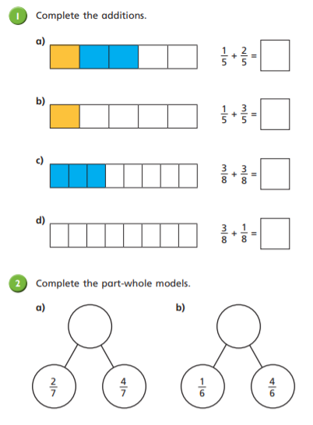
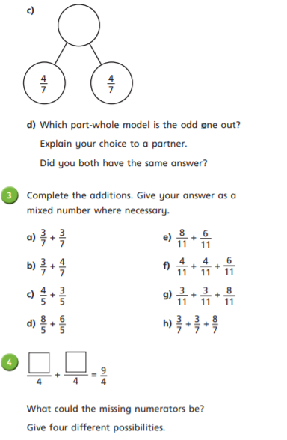

Slide 19
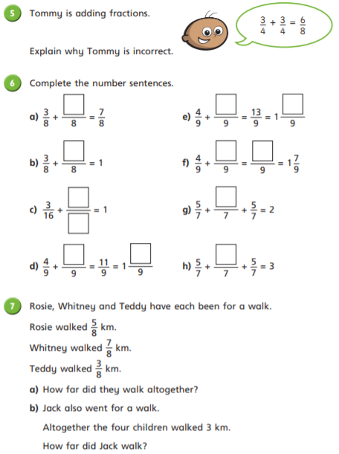
CHALLENGE

Slide 20
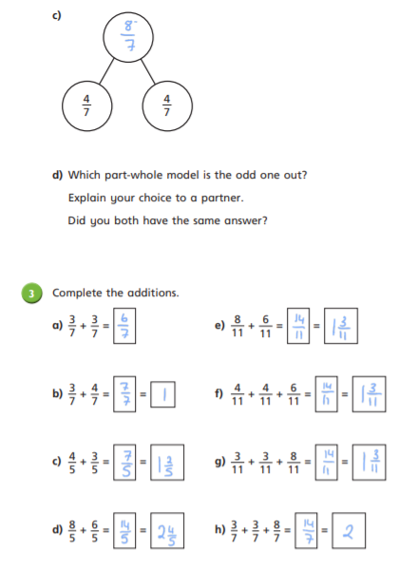
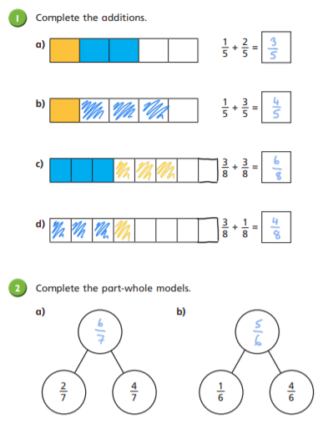
Answers

Slide 21
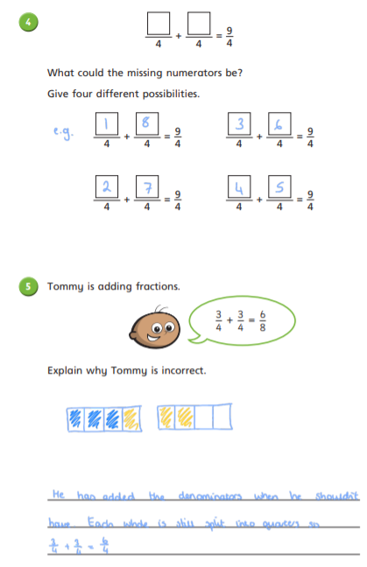
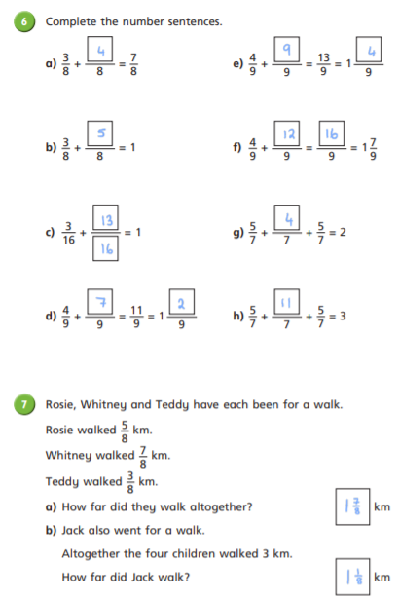
Answers

Slide 22
Challenge Answer
They are both right because is the same
as

Slide 23
Remote Learning Tracking
Click on the link to let us know that you have completed the lesson:
https://forms.office.com/Pages/ResponsePage.aspx?id=eCY4lN73r0G0KV1rDWITzRhTQ2IZqpBOsW8cFVoooF9UNVlMS1dCVkdaM0k0WlhFTE9WVFBTWEg1Ti4u

