Slide 1
Maths 24.02.21

Slide 2
Fractions

Slide 3
LO: Subtract fractions.
Success Criteria:
Subtract the smaller numerator from the larger numerator.
Keep the denominators the same.
Use bar models to represent fractions.

Slide 6
1) 5 $−$ 3 $=$
5 thousands $−$ 3 thousands $=$
2) What is the difference between 9 and 3?
3) When adding fractions, add the
and keep the the same.
4) $\frac{\text{3}}{\text{9}}$ $=$ $\frac{}{\text{3}}$ $\frac{\text{6}}{\text{10}}$ $=$

Slide 7
1) 5 $−$ 3 $=$
5 thousands $−$ 3 thousands $=$
2) What is the difference between 9 and 3?
3) When adding fractions, add the
and keep the the same.
4) $\frac{\text{3}}{\text{9}}$ $=$ $\frac{}{\text{3}}$ $\frac{\text{6}}{\text{10}}$ $=$
2
2 thousands
6
numerators
denominators
1
3
5

Slide 8
$\frac{\text{5}}{\text{7}}$ $−$ $\frac{\text{3}}{\text{7}}$ $=$
$\frac{\text{2}}{\text{7}}$
Have a think
Reduction – when something is being removed or taken away.

Slide 9
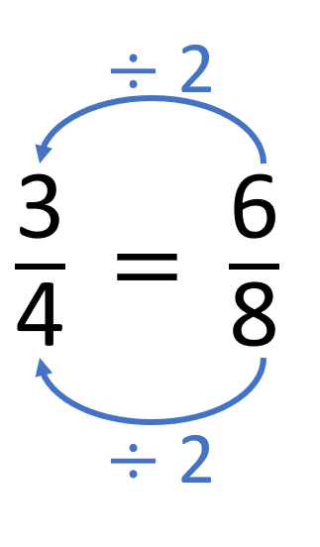
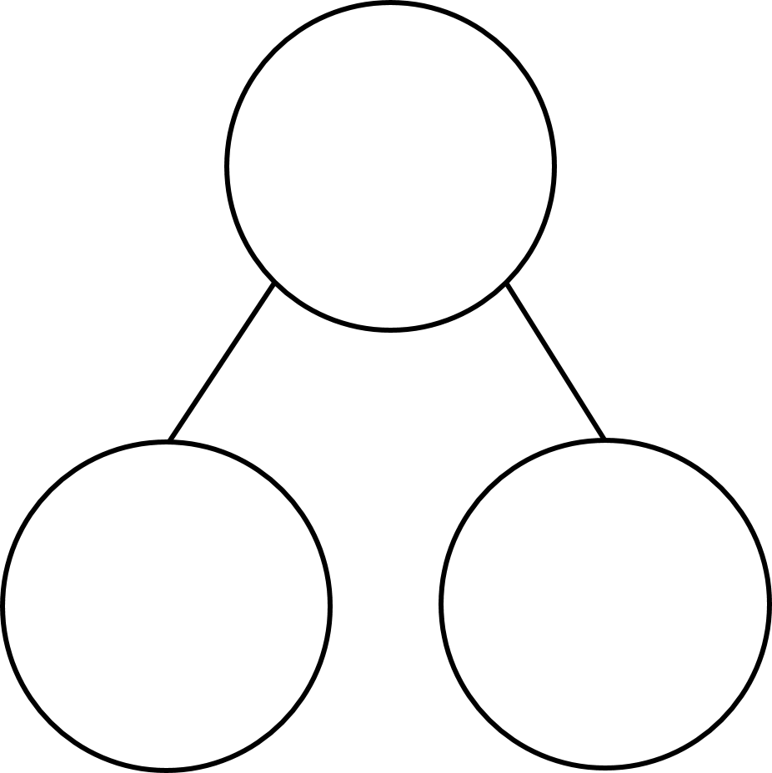
$\frac{\text{8}}{\text{9}}$ $−$ $\frac{\text{5}}{\text{9}}$ $=$
$\frac{\text{3}}{\text{9}}$
$=$ $\frac{\text{1}}{\text{3}}$
Have a think
$\frac{\text{8}}{\text{9}}$
Partitioning – splitting the whole into two or more parts
$\frac{\text{5}}{\text{9}}$
$\frac{\text{3}}{\text{9}}$

Slide 10
$\frac{\text{9}}{\text{10}}$ $−$ $\frac{\text{3}}{\text{10}}$ $=$
$\frac{\text{6}}{\text{10}}$
$=$ $\frac{\text{3}}{\text{5}}$
Have a think
Difference – a comparison between two sets - how much more or less/fewer

Slide 11
5
$\frac{\text{7}}{\text{11}}$ $−$ $\frac{\text{5}}{\text{11}}$ $=$ $\frac{\text{2}}{\text{11}}$
Have a think

Slide 12
10
$\frac{\text{10}}{\text{11}}$ $−$ $\frac{\text{3}}{\text{11}}$ $=$ $\frac{\text{2}}{\text{11}}$ $+$ $\frac{\text{5}}{\text{11}}$
Have a think

Slide 13
Your turn…
Mild – questions 1 – 5
Medium – questions 1 – 8
Spicy – questions 1 – 8 and the challenge

Slide 14
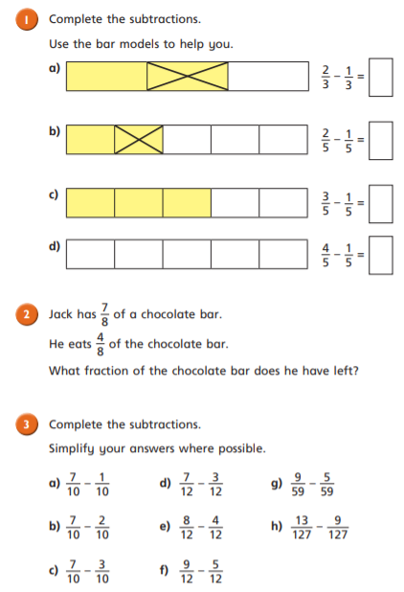
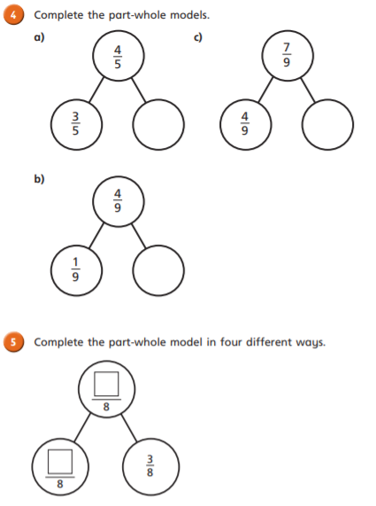

Slide 15
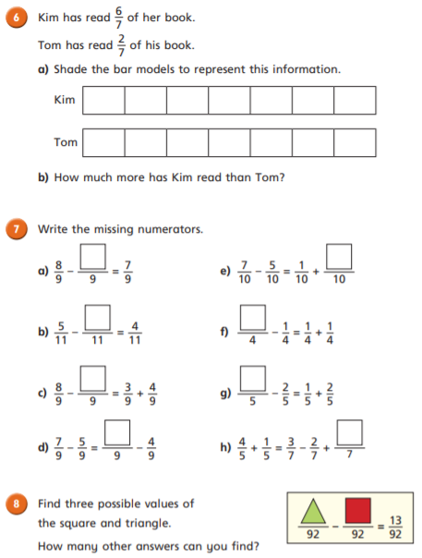
CHALLENGE

Slide 16
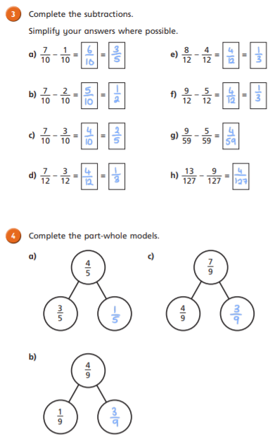
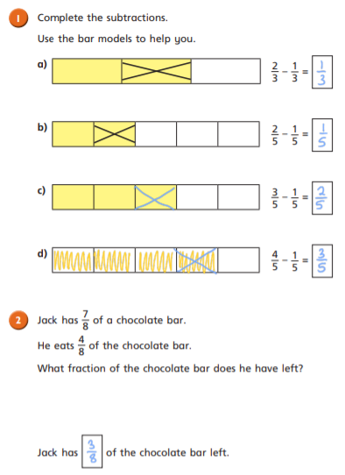
Answers

Slide 17
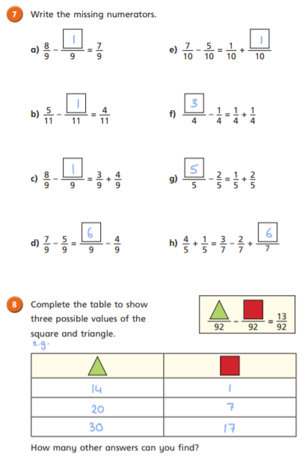
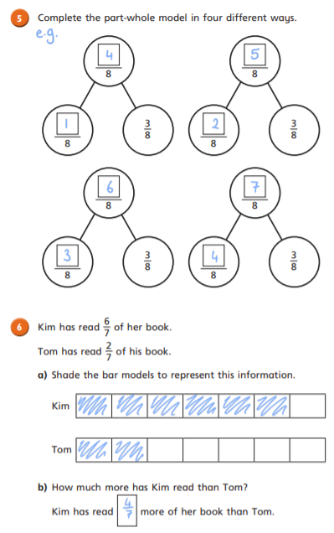
Answers

Slide 18
Challenge Answer
Both are correct. Annie has used the difference method and Amir has used the reduction method

Slide 19
Remote Learning Tracking
Click on the link to let us know that you have completed the lesson:
https://forms.office.com/Pages/ResponsePage.aspx?id=eCY4lN73r0G0KV1rDWITzRhTQ2IZqpBOsW8cFVoooF9UNVlMS1dCVkdaM0k0WlhFTE9WVFBTWEg1Ti4u

