Slide 1
Pshe-25.02.21

Slide 2
PSHE
L.O: Know that there are different ways to gain money, including paid work, and different ways to keep it safe.
Success Criteria:
- Begin to understand some of the advantages of regular income.
- Know people can receive money in many different ways, including paid work.
- Begin to understand that there are a number of things we can do with our money, some involving risk.
- Know that it is possible to keep money safe by putting it into an ‘account’ in a Building Society or bank.

Slide 3
How do adults get money?
Does everyone work?
If not, how do these people get money?
Does everyone earn the same amount?

Slide 4
How do adults get money?
Does everyone work?
No, some may be retired or students or too ill or unable to get a job.
How do these people get money?
Through pensions, benefits and planned borrowing.
Does everyone earn the same amount?
No, different jobs have different wages or salaries.

Slide 5
Activity
Write down a list of as many jobs as you can.
Challenge yourself- Can you think of more than 30?
e.g. Policeman, teacher…

Slide 6
Your task-Mild
Draw a picture of yourself doing the job that you would like in the future.
Write beneath it:
-Why you would like this job.
-What qualities you will need.
-How much do you think you will earn.
(As an extra task you could research to find the actual salary)

Slide 7
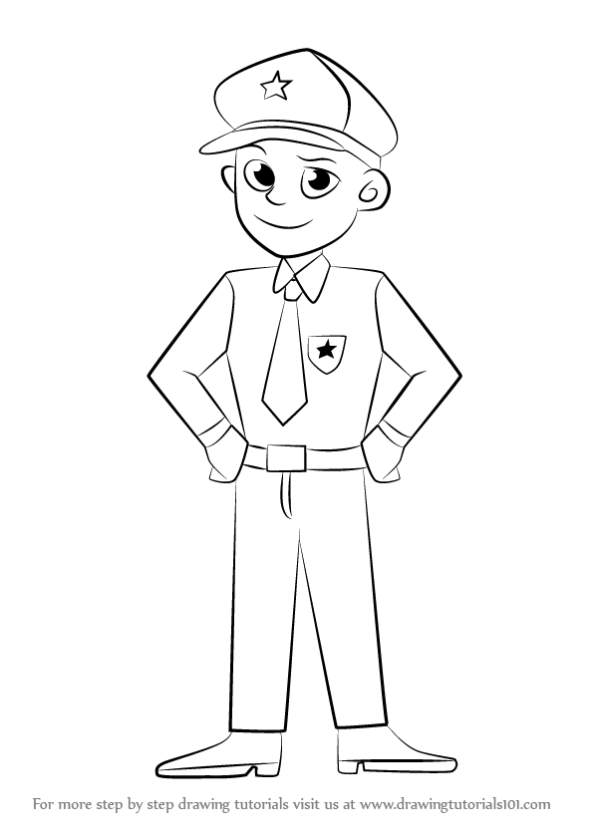
Model
Why you would like this job?
I would like this job because…
What qualities will you need?
To have this job I need to be…
How much do you think you will earn?
I think I will earn…
Extra challenge:
In this job the average annual salary is…

Slide 8
Your task- Medium
For this task you need to read the statements on the following slides. Write down whether you agree or disagree with each of the statements and why.
Spicy- Do both the mild and medium tasks.

Slide 9
Statements
Do you agree or disagree and why?

Slide 10
Remote Learning Tracking
Click on the link to let us know that you have completed the lesson:
https://forms.office.com/Pages/ResponsePage.aspx?id=eCY4lN73r0G0KV1rDWITzRhTQ2IZqpBOsW8cFVoooF9UNVlMS1dCVkdaM0k0WlhFTE9WVFBTWEg1Ti4u

