Slide 1
R.E.
24.02.21

Slide 2
Hinduism
Lesson 6

Slide 3
LO: Understand why puja is important for Hindus and how it is practised at home.
What is puja?
Success Criteria:
Identify the items used for puja.
Explain how the items are used.
Explain why Hindus give offerings.

Slide 11
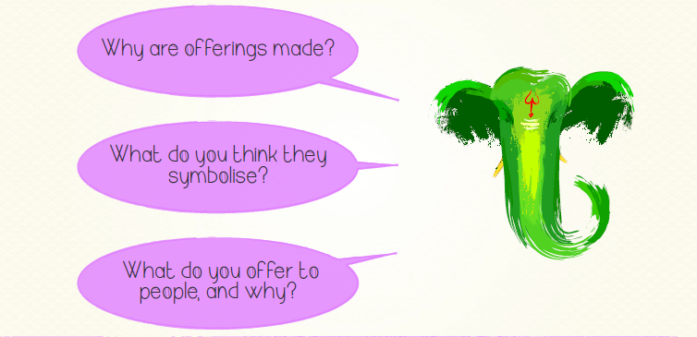

Slide 12
Click the picture to watch a video on a Hindu home shrine.

Slide 13
Now it’s your turn…
Mild – draw and label a puja tray. Use the word bank on the next slide to support you. Describe how some of the items are used.
Medium – draw and label a puja tray and describe what each item is for.
Spicy – describe what happens at Hindu puja and then explain how this is related to your own experiences of offerings.

Slide 14
WORD BANK
puja
incense holder
diva lamp
water container and spoon
Kum Kum powder
offerings
bell

Slide 15
Example Answers

Slide 16
Remote Learning Tracking
Click on the link to let us know that you have completed the lesson:
https://forms.office.com/Pages/ResponsePage.aspx?id=eCY4lN73r0G0KV1rDWITzRhTQ2IZqpBOsW8cFVoooF9UNVlMS1dCVkdaM0k0WlhFTE9WVFBTWEg1Ti4u

