Slide 1
Science 01.02.21

Slide 2
Living Things and their Habitats
Lesson 5

Slide 3
LO: Identify and classify a variety of British plants.
Success Criteria:
Observe the characteristics of plants.
Group the plants based on their characteristics.
Use key characteristics to identify what a plant is.

Slide 6
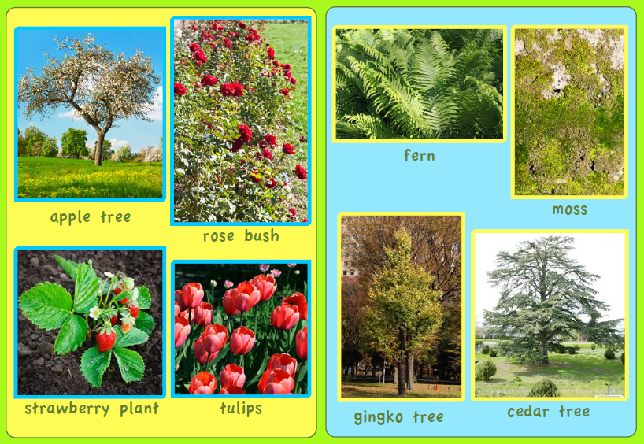

Slide 8
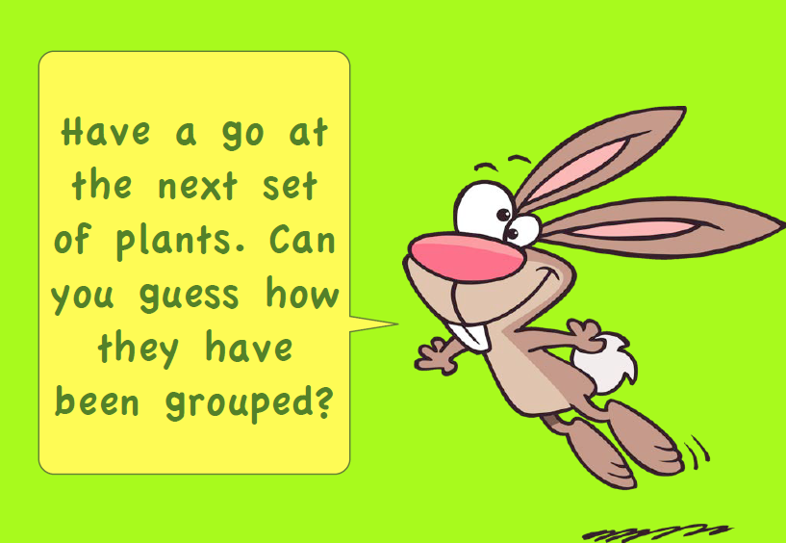

Slide 9
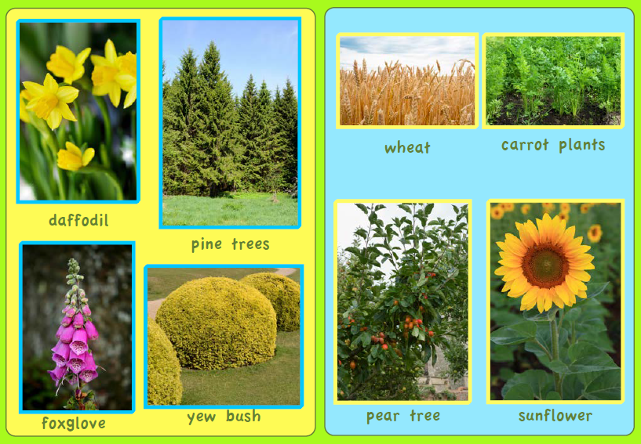

Slide 11
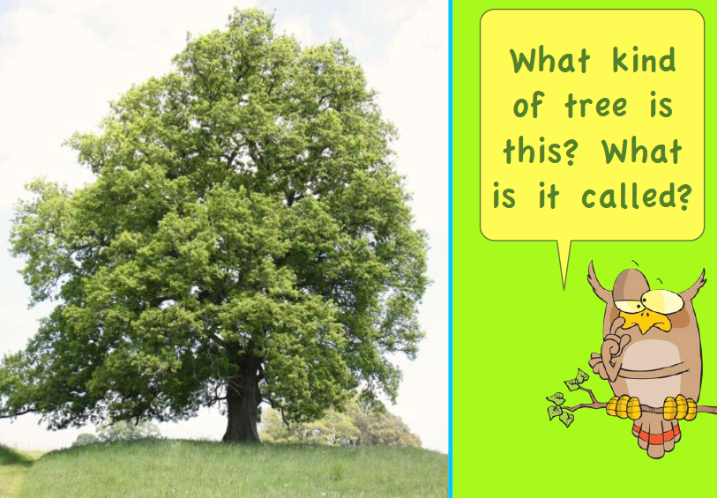

Slide 15
Now over to you…
Take a walk (with an adult) around the local area. Take pictures of the plants you see. Use the following slide to see if you can identify any of the plants you found.
Mild – Create a poster on one of the plants in the local area.
Medium – Create a poster about the plants in the local area.
Spicy – Create a guidebook about the plants in the local area.

Slide 16
