Slide 1
Year Five
Art
Friday 29th January

Slide 2
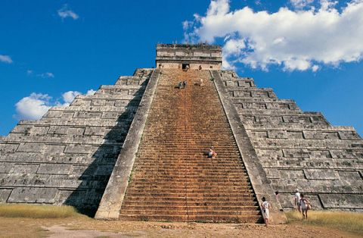
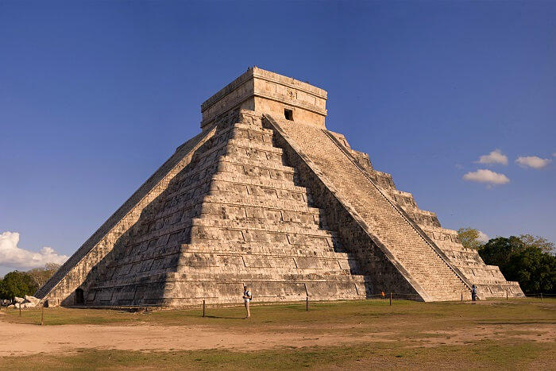
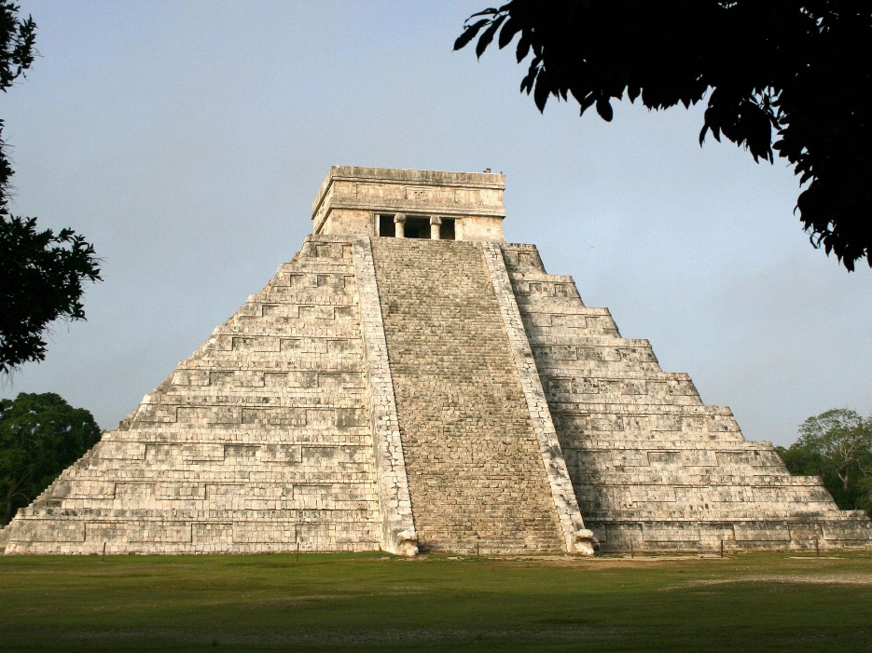
Maya Temples
Pyramids were used as temples and focal points for Maya religious practices where offerings were made to the gods. They were also used as gigantic tombs for deceased rulers, their partners, sacrificial victims, and precious goods.

Slide 3
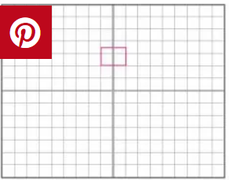
Step One:

Slide 4
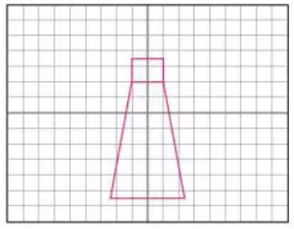
Step Two:

Slide 5
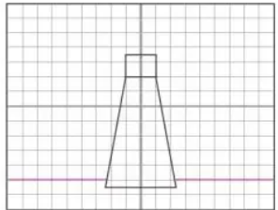
Step Three:

Slide 6
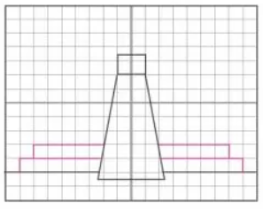
Step Four:

Slide 7
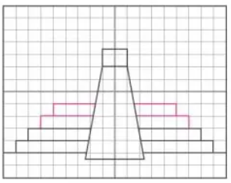
Step Five:

Slide 8
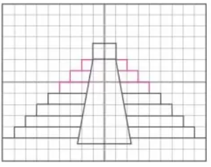
Step Six:

Slide 9
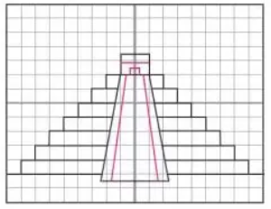
Step Eight:

Slide 10
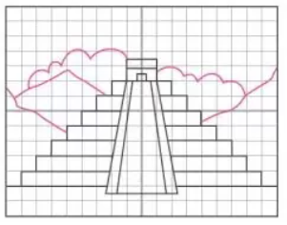
Step Nine:

Slide 11
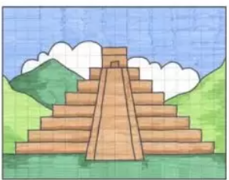
Step Ten:

