Slide 1
English
Tuesday 26th January 2021

Slide 2
LO: Plan to include specific features in my writing.
Success Criteria:
Recap features
Inverted Commas
Superlatives/ Modal Verbs
Rhetorical Questions
Suspense
Plan for features on story map.

Slide 3
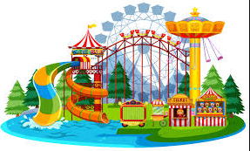

Slide 4
Inverted Commas
Speech Rules:
Spoken words enclosed in inverted commas
Punctuation inside inverted commas
Commas
New speaker, new line
‘Split’ direct speech.

Slide 5
Inverted Commas
Example:
‘Did you hear the exciting news?’ whispered Olivia.
‘No, what news?’ Liam and Noah asked together, ‘What did we miss?’

Slide 6
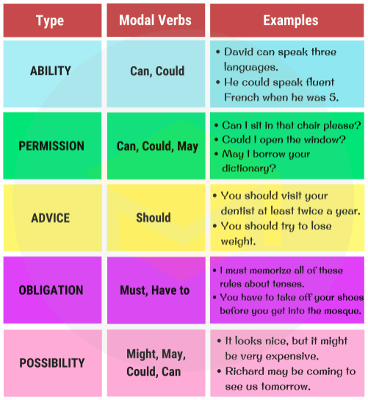
Superlatives
Modal Verbs

Slide 7
Superlatives / Modal Verbs
Example:
It was the most bonkers idea ever. A theme park on an iceberg!
To be able to visit the busiest theme park in the world, with no one else around would be incredible.
I might have a chance to win a ticket too.

Slide 8
Rhetorical Questions

Slide 9
Suspense
We can build suspense by using:
Questions
Short sentences
Short paragraphs
A range of punctuation

Slide 10
Suspense
Example:
With trembling hands, I ran into out into the corridor and towards my friends. Their eyes sparkled with excitement as they asked me what was so urgent. All I could do was nod and hold out the scrap of paper in my hand.
I couldn’t get my words out. They were all staring at me. I felt like my heart was going to jump out of my chest.

