Slide 1
English
Monday 8th February 2021

Slide 2
LO: Use inverted commas for direct speech.
Success Criteria:
Use inverted commas around speech.
Punctuate inside the inverted commas.
Start a new line for each new speaker.
Split direct speech.

Slide 3
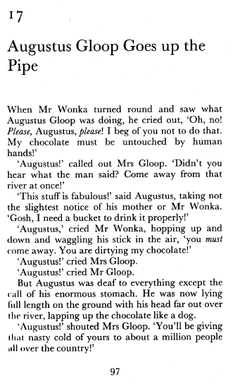
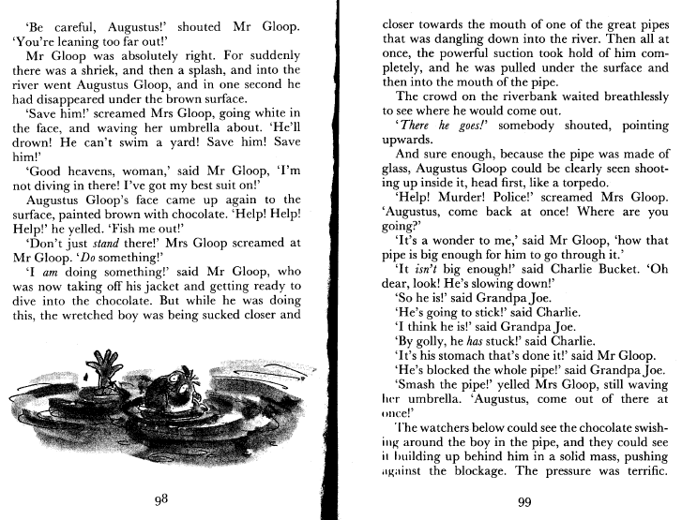

Slide 4
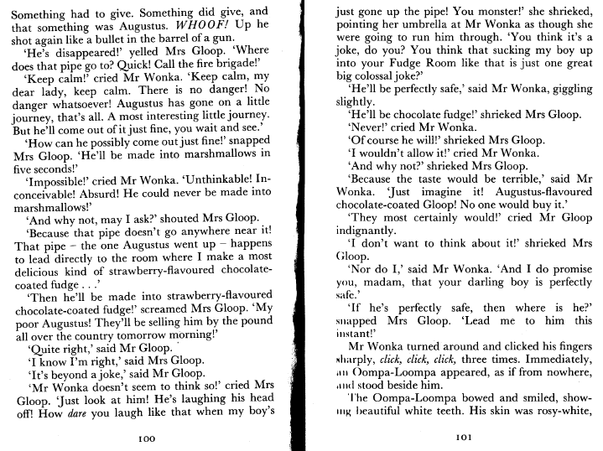

Slide 5
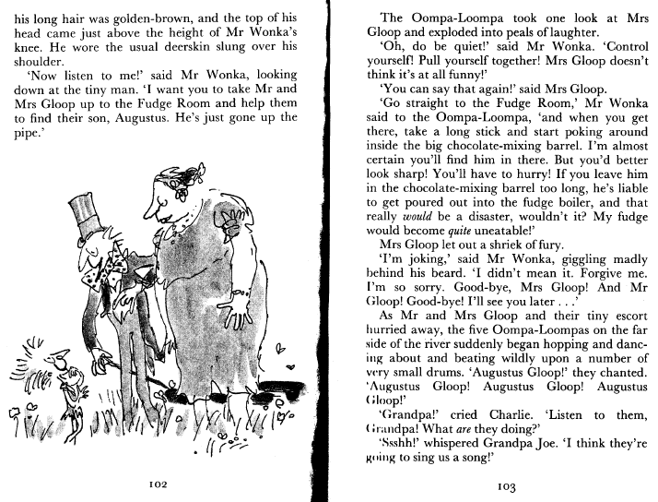

Slide 6
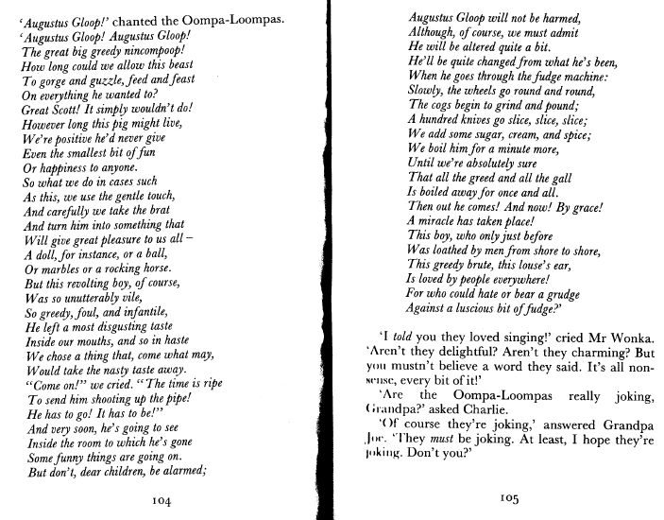

Slide 7
Speech Rules
Spoken words enclosed in inverted commas
Punctuation inside inverted commas
Commas
New speaker, new line
‘Split’ direct speech.

Slide 8
‘said’
said
whispered
muttered
shouted
questioned

Slide 9
Practise
Speech Rules:
Spoken words enclosed in inverted commas
Punctuation inside inverted commas
Commas
New speaker, new line
‘Split’ direct speech.
be careful augustus shouted mr gloop
“Be careful, Augustus!” shouted Mr Gloop.
help help help he yelled
“Help! Help! Help!” he yelled.
save him screamed mrs gloop he’ll drown
“Save him!” screamed Mrs Gloop, “He’ll drown!”

Slide 10
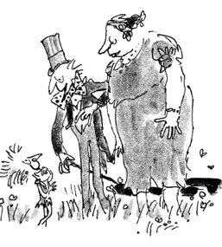
Your Task…
Speech Rules:
Spoken words enclosed in inverted commas
Punctuation inside inverted commas
Commas
New speaker, new line
‘Split’ direct speech.

Slide 11
Challenge
Think about the Oompa Loompa Song – can you compose your own song for the Oompa Loompa’s to sing while working in the factory?

Slide 12
Remote Learning Tracking
https://forms.office.com/Pages/ResponsePage.aspx?id=eCY4lN73r0G0KV1rDWITzRhTQ2IZqpBOsW8cFVoooF9UNVlMS1dCVkdaM0k0WlhFTE9WVFBTWEg1Ti4u

