Slide 1
Geography
Tuesday 2nd February 2021

Slide 2
LO: Identify and know the main physical geographical features of the Maya Northern Lowlands.
Success Criteria:
Locate key geographical features.
Research a specific feature.
Record information clearly.

Slide 3
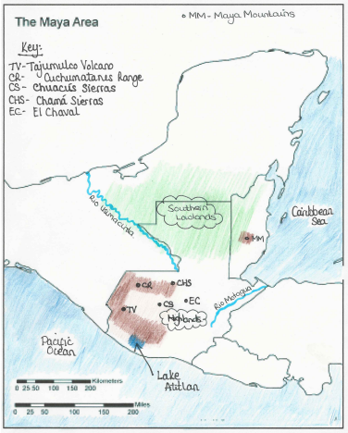

Slide 4
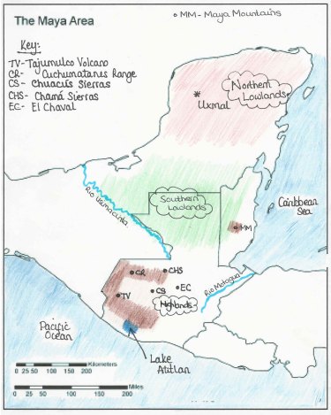

Slide 5
Northern Lowlands – More Information
The Northern Lowlands rest on the same limestone plateau, but are a dryer environment than the Southern lowlands. The surface is relatively flat, except for a zone of hills called the Puuc hills, and the soil is extremely thin but very fertile in some areas. It is mainly in the Yucatan peninsula of Mexico.
The only freshwater sources are underground. There are natural wells, called cenotes, that preserve rainwater. There are also underground rivers and lakes in caves. The vegetation is low but dense and composed of a brush forest of bushes and small trees, like the bay cedar.
The animals are composed of a few large mammals, small mammals, birds like the oriole and the motmot, reptiles and an abundance of insects. The coast, on the other hand, has beaches, lagoons and mangrove swamps with lots of marine mammals, fish like stingray, shellfish and molluscs. The Northern Lowlands are home to a later style of monumental architecture including the site of Uxmal.

Slide 6
Uxmal
Use the following site to help you with your research:
https://kids.britannica.com/kids/article/Uxmal/476571

Slide 7
Why did the Mayan’s choose the northern lowlands to build on?

Slide 8
Why did the Mayan’s choose the northern lowlands to build on?

Slide 9
Possible Answers
Mainly flat lands
Fertile soil
No rivers

