Slide 1
Geography
Tuesday 26th January 2021

Slide 2
LO: Identify and know the main physical geographical features of the Maya Southern Lowlands.
Success Criteria:
Identify key geographical features.
Research a specific feature.
Record information clearly.

Slide 3
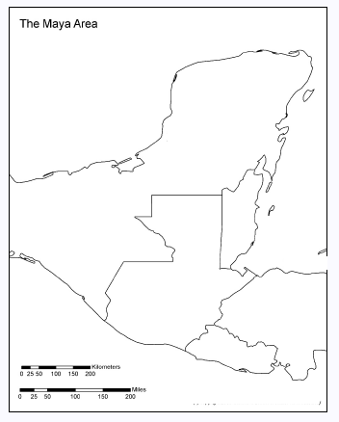
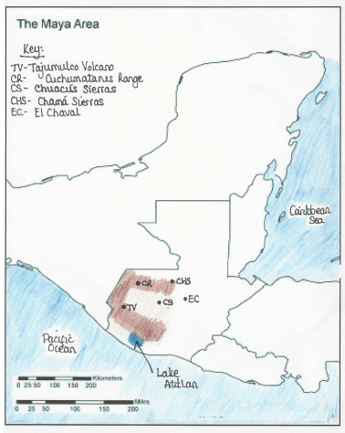

Slide 4
Southern Lowlands
Shade the southern lowlands on your map.
Mark:
Maya Mountains
Motagua River
Usimacinta River

Slide 5
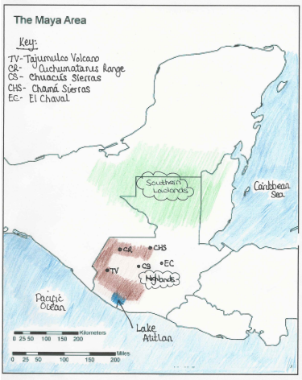
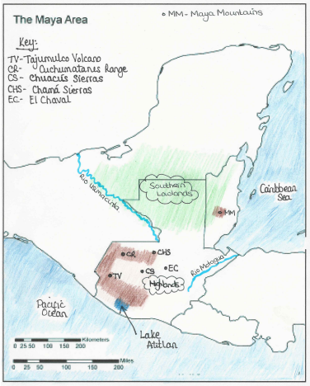

Slide 6
Southern Lowlands (more info)

Slide 7
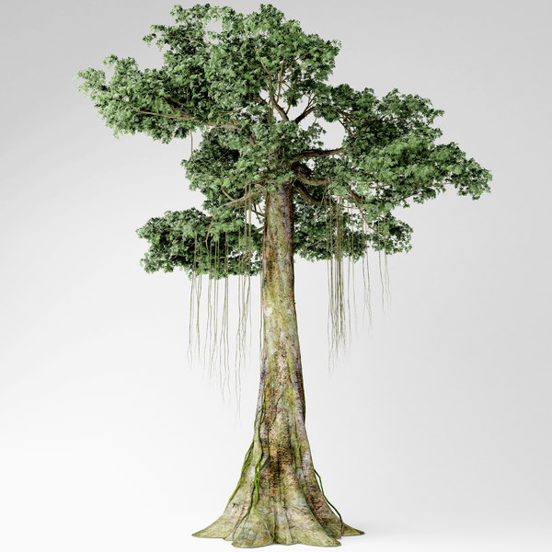
Ceiba (Kapok) - a sacred tree
https://www.softschools.com/facts/plants/kapok_tree_facts/1858/
Ceiba (Kapok) Tree
deciduous tree that belongs to the mallow family
originates from Central and South America
CHALLENGE: Can you order your facts into different
sections, using subheadings?

Slide 8
What differences do you notice between the Highlands and the Southern Lowlands?

