Slide 1
Geography
Tuesday 8th February 2021

Slide 2
LO: Compare the regions of ancient Maya civilisation.
Success Criteria:
Consider key features of each region.
Compare 3 regions.
Write a comparison.

Slide 3
Highlands
Southern Lowlands
Northern Lowlands
City of Copan
Volcanic mountains - Tajumulco volcano
Near the Caribbean Sea
Low low-lying land at the coast of the Pacific Ocean
Motagua River / Atitlan Lake
Tsunamis, volcanoes and earthquakes
Fertile soil
Cooler climate
Rainy season May-November, peak rain in June and October
Source of obsidian, jade and other precious metals from quarries
Animals; jaguar, caiman, bull shark, poisonous snakes, deer, turkey, tapirs, rabbits, monkeys and quetzal
Maya monumental architecture - Tikal
Mainly flat
Maya mountains
Rivers Motagua and Usimacinta
Lakes and bajos/ swamps in rainy season
Small areas of savannah
High, dense and humid tropical forest called the Petén forest of Guatemala
Sacred ceiba (Kapok) tree
Limestone plateau with flint (used for buildings/ tools)
Animals; jaguar, quetzal, macaw, reptiles, amphibians, fish and insects, fish, shell fish, mulluscs
Later monumental architecture - Uxmal
Dryer environment
Mainly flat
Puuc hills
Coast with beaches, lagoons and mangrove swamps
Freshwater underground only – underground rivers and lakes in caves
Natural wells for rainwater
Thin, fertile soil (mainly Yucatan)
Low, dense vegetation like the bay cedar
Limestone plateau
Animals; oriole, motmot, inscts, stingray, shellfish and molluscs

Slide 4
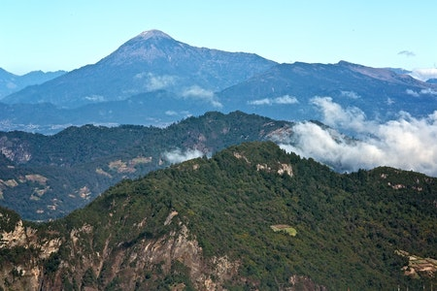
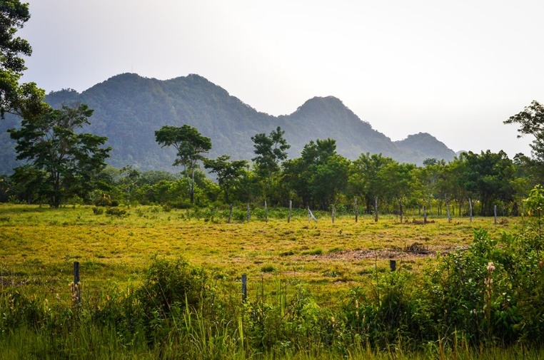
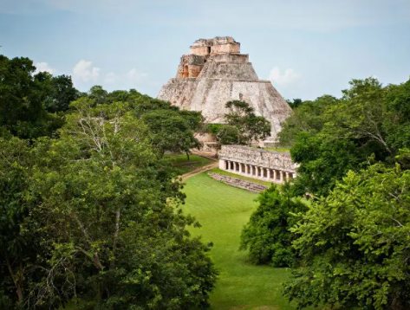
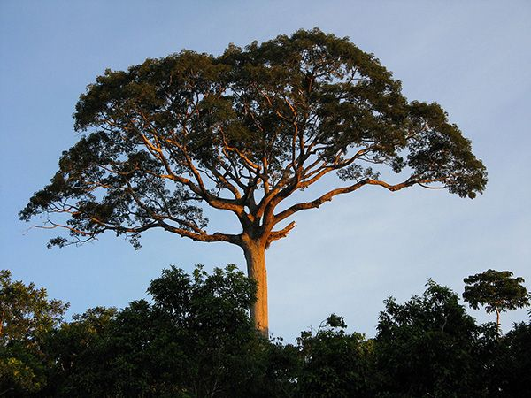
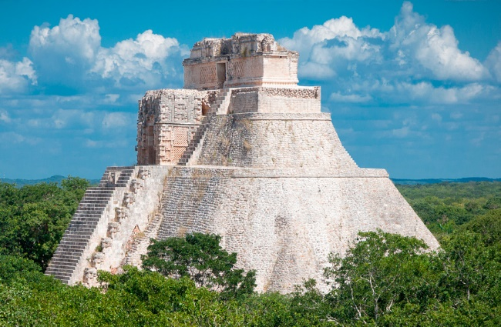
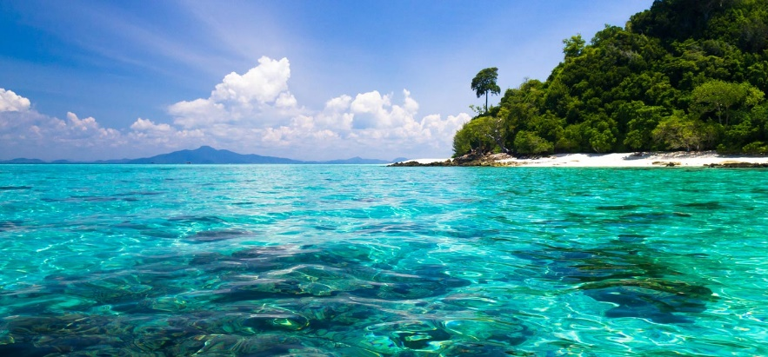
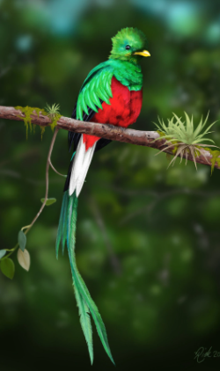
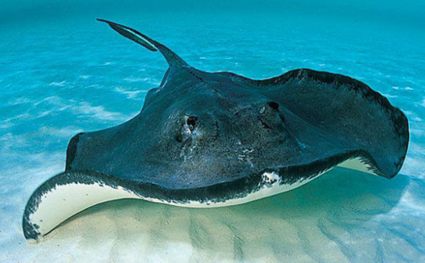
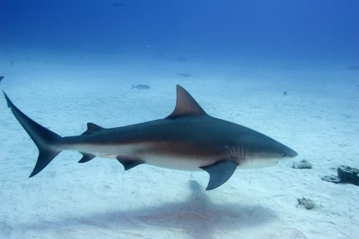
Highlands
Southern Lowlands
Northern Lowlands

Slide 5
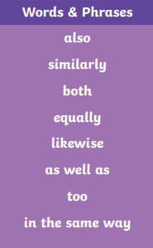
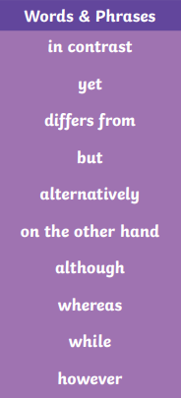
Write a comparison…
Similar/ Alike
Different/ Opposite
Both the northern and southern lowlands are adjacent to the Caribbean Sea, whereas the Highlands region next to the Pacific Ocean.
In contrast to the Highland region, the lowland areas are mainly flat with remains from Ancient Maya architecture and civilisation.

Slide 6
Which of the regions would you most like to visit? Explain why.

Slide 7
Remote Learning Tracking
https://forms.office.com/Pages/ResponsePage.aspx?id=eCY4lN73r0G0KV1rDWITzRhTQ2IZqpBOsW8cFVoooF9UNVlMS1dCVkdaM0k0WlhFTE9WVFBTWEg1Ti4u

