Slide 1
Monday 1st February
Maths Challenge 1

Slide 2
Multiply by a single digit
Use images to represent multiplication
Make equal groups
Use arrays to solve multiplication problems
Use times tables knowledge to solve multiplication problems

Slide 3
1) How many cookies?
2) How many pencils?
3) Here is an array.
How many groups of 3 are there?

Slide 4
1) How many cookies?
2) How many pencils?
3) Here is an array.
How many groups of 3 are there
9
18
4

Slide 5
What do you see?
5
3
There are ____ equal groups of ____
3
3
15
$+ + + + =$
3
3
3
$× =$
5
3
15
$× =$
3
5
15

Slide 6
What do you see?
8 groups of 4 spots
4 $+$ 4 $+$ 4 $+$ 4 $+$ 4 $+$ 4 $+$ 4 $+$ 4 $=$ 32
8 $×$ 4 $=$ 32
4 $×$8 $=$ 32

Slide 7
Which number story matches the picture?
2 $×$ 3 $=$ 6 or 3 $×$ 2 $=$ 6
Whitney plants 2 pots of flowers with 3 flowers in each pot.
She plants 6 flowers altogether.
Whitney plants 3 pots of flowers with 2 flowers in each pot.
She plants 6 flowers altogether.

Slide 8
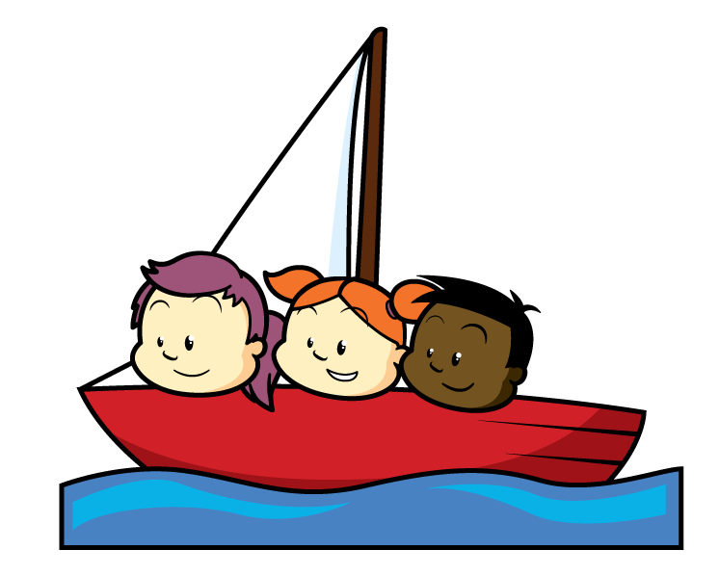
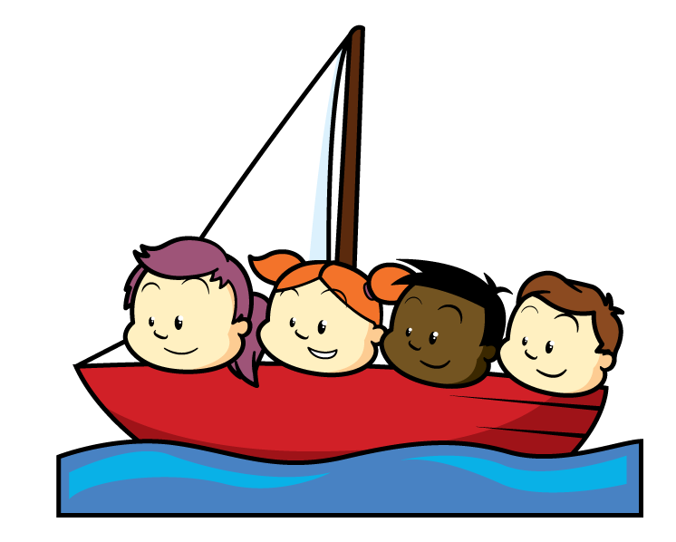
Which number story matches the picture?
3 $×$ 4 $=$ 12 or 4 $×$ 3 $=$ 12
There are 3 boats.
Each boat has 4 children.
There are 12 children altogether.
There are 4 boats.
Each boat has 3 children.
There are 12 children altogether.

Slide 9
4
1 $×$ 4 $=$ 4
4 $×$ 1 $=$ 4
0
4
4
4
2 $×$ 4 $=$ 8
4 $×$ 2 $=$ 8
0
4
8
4
4
4
3 $×$ 4 $=$ 12
4 $×$ 3 $=$ 12
0
4
8
12

Slide 10
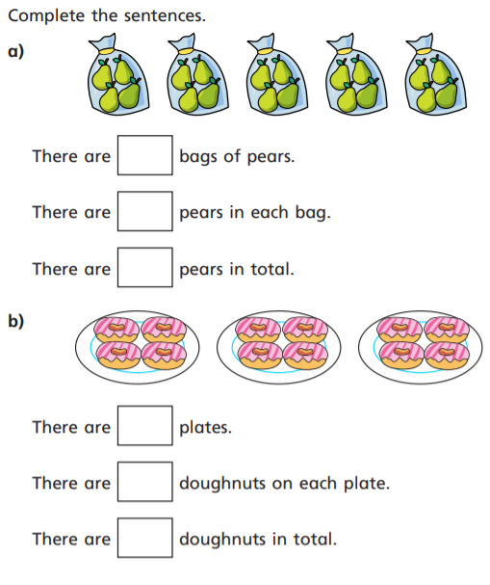
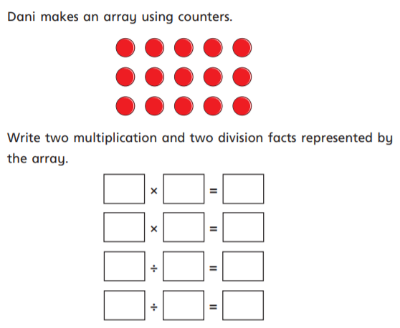
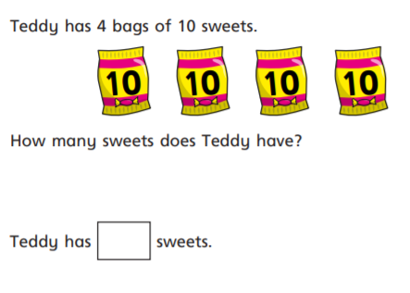
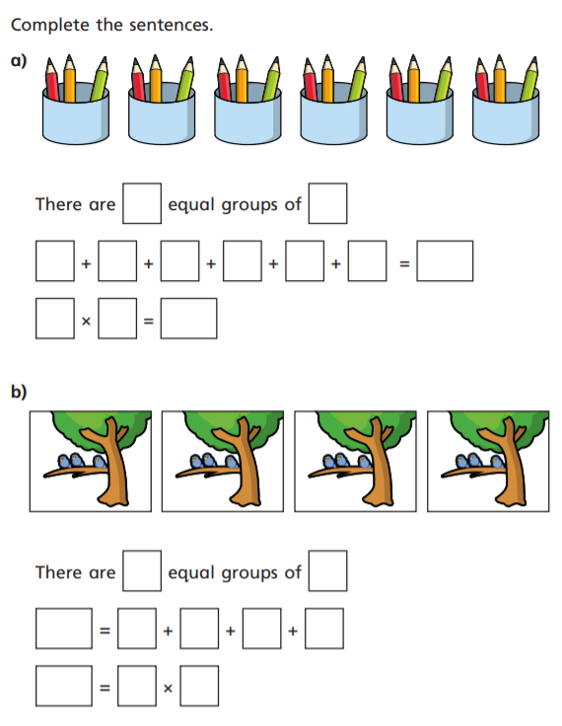
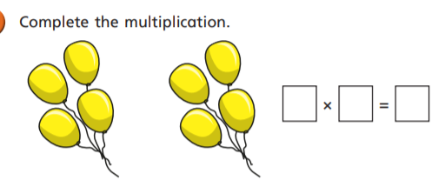
1)
3)
4)
2)
5)

Slide 11
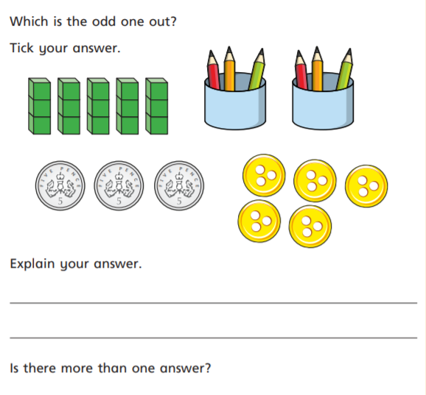
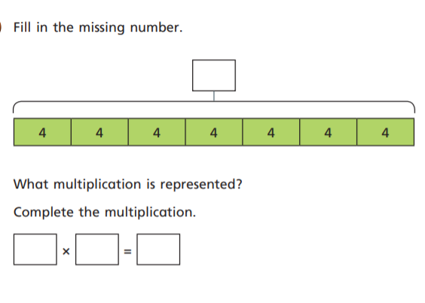
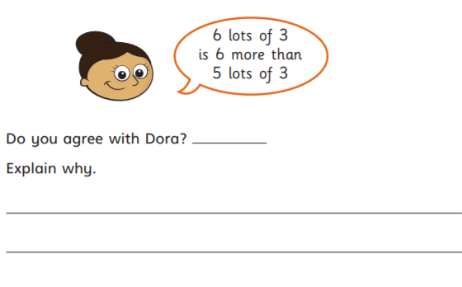
Further challenge:

Slide 12
1)
3)
5
4
20
5
3
15
3
5
15
15
3
5
3
15
5
3
4
4)
12
2)
6
3
40
3
3
3
3
3
3
18
6
3
18
5)
2
4
8
4
3
12
3
3
3
3
12
4
3

Slide 13
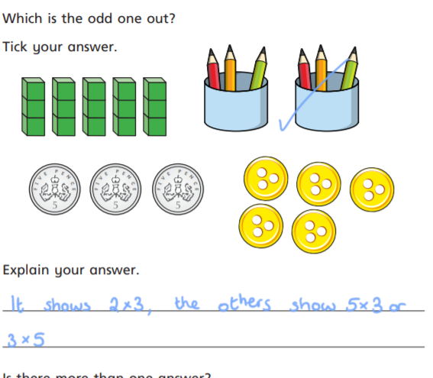
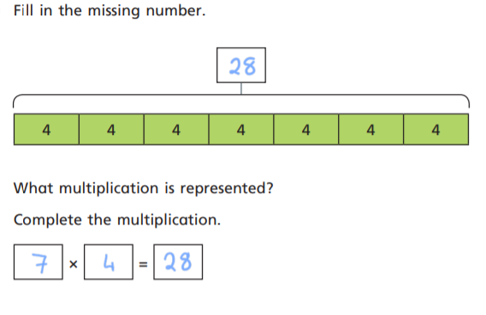
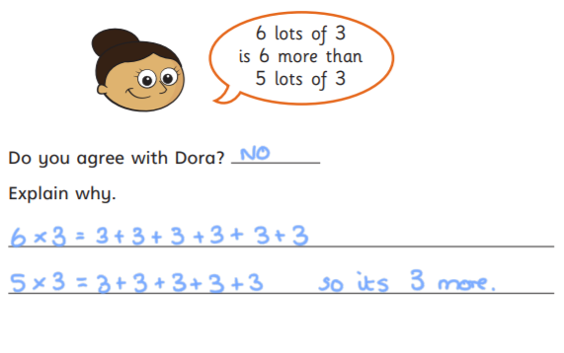
Further challenge:

