Slide 1
Thursday 25th February
Maths Challenge 1

Slide 2
Multiply by 1 and 0
Use images to represent multiplication
Explain that when you multiply by 1, you have “one lot” so your total stays the same
Explain that when you multiply by 0, you have “lots of” nothing, so your total is zero

Slide 3
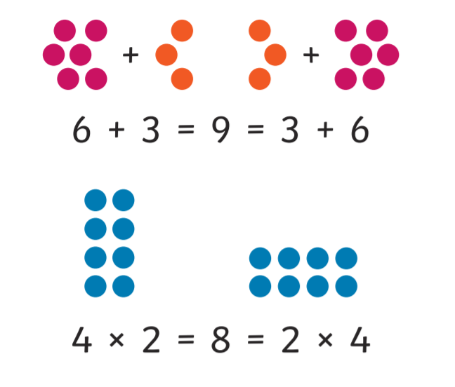
Word of the week: commutative
A calculation where the order of the numbers
doesn’t affect the answer.
Addition and multiplication are commutative
but division and subtraction are not.
Can you explain what commutative means to someone else?
Can you use commutative in a sentence?
Can you write a guide for younger children to explain what commutative means?

Slide 4
12 $+$ 0 $=$
2) 12 $−$ 0 $=$
12 $+$ 1 $=$
12 $−$ 1 $=$

Slide 5
12 $+$ 0 $=$
2) 12 $−$ 0 $=$
12 $+$ 1 $=$
12 $−$ 1 $=$
12
12
13
11

Slide 6
There are 4 plates.
1 $×$ 4 $=$ 4
Each plate has 1 doughnut on it.
4 $×$ 1 $=$ 4
There are 4 doughnuts altogether.
There is 1 plate.
1 $×$ 4 $=$ 4
The plate has 4 doughnuts on it.
4 $×$ 1 $=$ 4
There are 4 doughnuts altogether.

Slide 7
There are 4 plates.
0 $×$ 4 $=$ 0
Each plate has 0 doughnuts on it.
4 $×$ 0 $=$ 0
There are 0 doughnuts altogether.
There are 3 plates.
0 $×$ 3 $=$ 0
Each plate has 0 doughnuts on it.
3 $×$ 0 $=$ 0
There are 0 doughnuts altogether.

Slide 8
factor $×$ factor $=$ product
2-times table | 4-times table | 8-times table
2 $×$ 0 $=$ 0 | 4 $×$ 0 $=$ 0 | 8 $×$ 0 $=$ 0
2 $×$ 1 $=$ 2 | 4 $×$ 1 $=$ 4 | 8 $×$ 1 $=$ 8
2 $×$ 2 $=$ 4 | 4 $×$ 2 $=$ 8 | 8 $×$ 2 $=$ 16
2 $×$ 3 $=$ 6 | 4 $×$ 3 $=$ 12 | 8 $×$ 3 $=$ 24
What’s the same?
What’s different?
When one of the factors is 0,
the product is 0
One of the factors is 0
The factor that is not 0
One of the factors is not 0
The product is 0

Slide 9
factor $×$ factor $=$ product
2-times table | 4-times table | 8-times table
2 $×$ 0 $=$ 0 | 4 $×$ 0 $=$ 0 | 8 $×$ 0 $=$ 0
2 $×$ 1 $=$ 2 | 4 $×$ 1 $=$ 4 | 8 $×$ 1 $=$ 8
2 $×$ 2 $=$ 4 | 4 $×$ 2 $=$ 8 | 8 $×$ 2 $=$ 16
2 $×$ 3 $=$ 6 | 4 $×$ 3 $=$ 12 | 8 $×$ 3 $=$ 24
What’s the same?
What’s different?
One of the factors is 1
The factor that is not 1
When one of the factors is 1, the product is equal to the other factor.
One of the factors is not 1
The product
The product is the same as one of the factors.

Slide 10
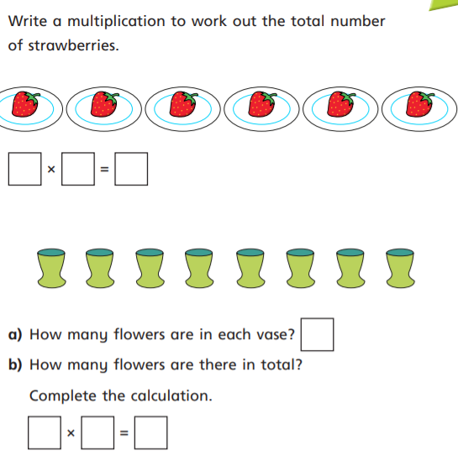
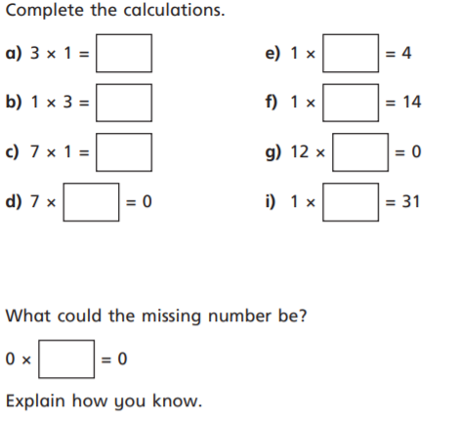
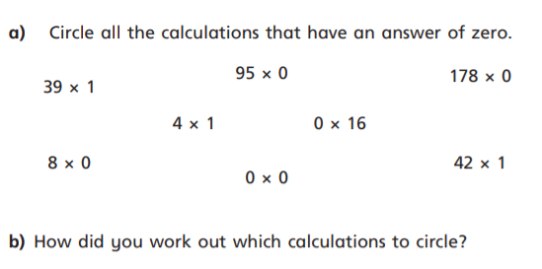
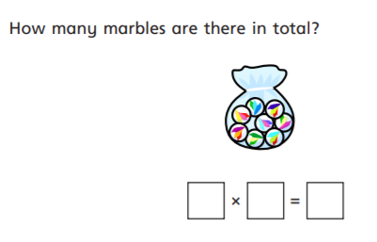
1)
4)
2)
5)
6)
3)

Slide 11
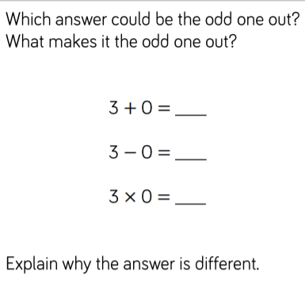
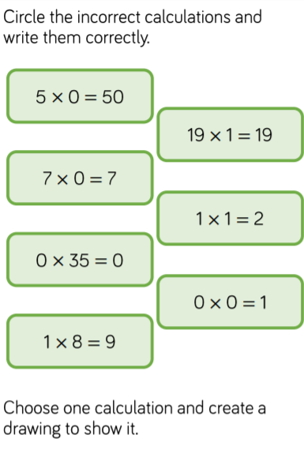
Further Challenge:

Slide 12
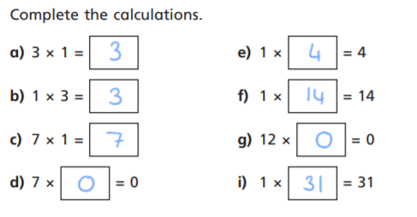
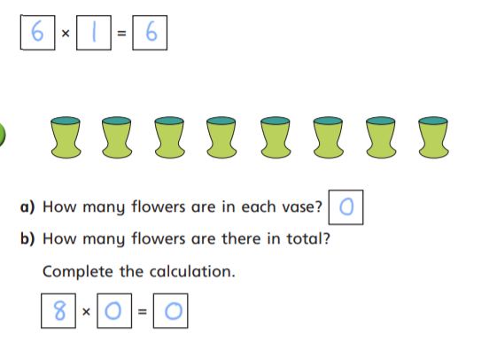
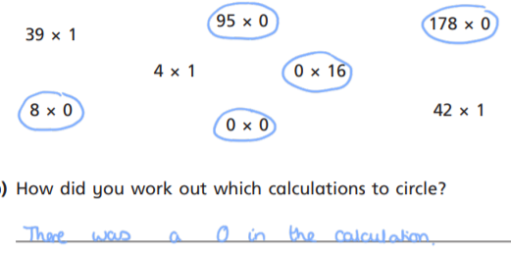
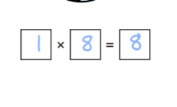
1)
4)
2)
5)
6)
3)

Slide 13
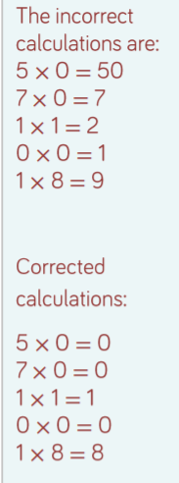
Further Challenge:

Slide 14
Remote Learning Tracking
Click on the link below to let us know you have completed the lesson.
https://forms.office.com/Pages/ResponsePage.aspx?id=eCY4lN73r0G0KV1rDWITzRhTQ2IZqpBOsW8cFVoooF9UNVlMS1dCVkdaM0k0WlhFTE9WVFBTWEg1Ti4u

