Slide 1
Maths
Monday 1st February 2021

Slide 2
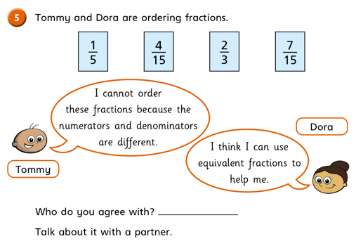
Challenge Question

Slide 4
LO: compare and order fractions less than 1.
Success Criteria:
Represent fractions using a bar model.
Recognise equivalent fractions.
Use < and > symbols to compare.

Slide 5
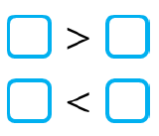

Slide 9
When the numerator is the same, the greater the denominator, the smaller the fraction.

Slide 10
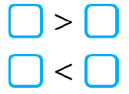
When the numerator is the same, the greater the denominator, the smaller the fraction.
Order the fractions from smallest to greatest.

Slide 11
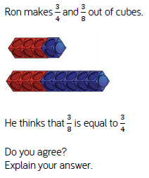
Challenge

Slide 12
ANSWERS: When the numerator is the same, the greater the denominator, the smaller the fraction.
Order the fractions from smallest to greatest.

Slide 13
ANSWERS: Challenge
DISAGREE
The two wholes are not equal.
He could have compared using numerators or converted to a common denominator.

