Slide 1
Maths
Monday 22nd February 2021

Slide 2
LO: read and write decimals (tenths and hundredths).
Success Criteria:
Make decimals with up to two decimal places.
Read and write numbers with decimals.
Understand the value of digits.
Partition numbers with decimals in different ways.

Slide 3
There are ____ ones, ____ tenths and ____ hundredths.
The number is ____
0
1
3
0.13

Slide 4
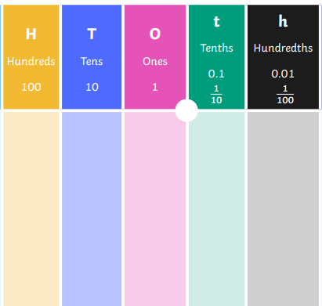
100
10
1
0.1
0.01

Slide 5
100
four tenths
10
1
1
0.1
0.01
0.01
1
0.1
0.01
0.01
0.1
1
0.1
0.01
0.01
0.01
0.1
0.01

Slide 6
100
five hundredths
10
1
0.1
0.01
0.01
1
0.01
1
0.1
0.01
0.01
0.01

Slide 7
100
six tenths
10
1
0.1
0.1
0.1
0.1
0.1
0.01
0.1
0.1

Slide 8
100
two tens
10
1
10
1
1
0.01
1
1
0.1
10
0.01
1
0.01
0.01

Slide 9
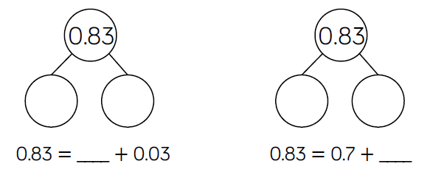
0.8
0.03
0.7
0.13
0.8
0.13

Slide 10
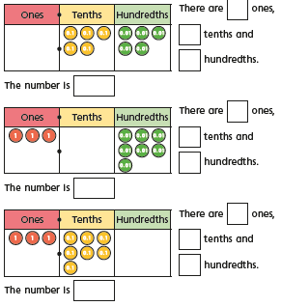
Question 1

Slide 11
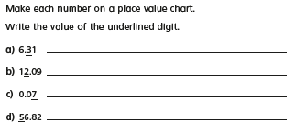
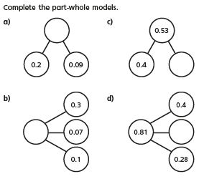
Question 2
Question 3
Question 4

Slide 12
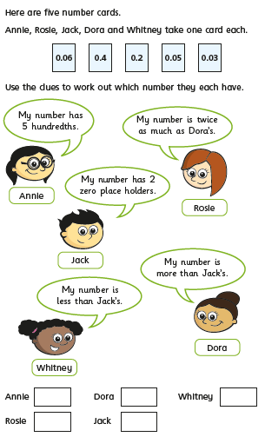
Challenge

Slide 13
Question 1 ANSWERS
0
5
5
0.55
3
0
7
3.07
3
7
0
3.70

Slide 14
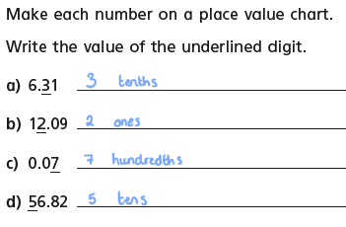
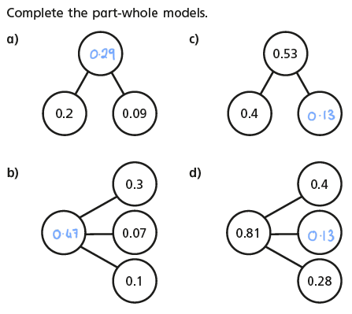
Question 2
Question 3
Question 4
ANSWERS

Slide 15
Challenge ANSWERS

Slide 16
Remote Learning Tracking
Please click on the link below to let us know that you have accessed the lesson.
https://forms.office.com/Pages/ResponsePage.aspx?id=eCY4lN73r0G0KV1rDWITzRhTQ2IZqpBOsW8cFVoooF9UNVlMS1dCVkdaM0k0WlhFTE9WVFBTWEg1Ti4u

