Slide 1
Maths
Monday 8th February 2021

Slide 2
LO: recognise tenths and hundredths.
Success Criteria:
Recognise a whole and equal parts.
Identify tenths and hundredths.
Partition into tenths and hundredths.

Slide 3
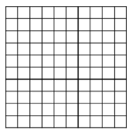
The hundred square represents one whole.
100
1 whole = ___ squares
Each square is ___ out of ___ equal squares
Each square represents
Each row is ___ out of ___ equal rows
Each row represents
1
100
1
100
1
10
1
10
10
100

Slide 4
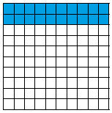
What fraction of the hundred square is shaded?
20
100
twenty hundredths
2
10
two tenths

Slide 5
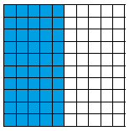
What fraction of the hundred square is shaded?
?
100
__________ hundredths
?
10
__________ tenths

Slide 6
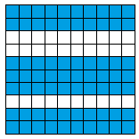
What fraction of the hundred square is shaded?
?
100
__________ hundredths
?
10
__________ tenths

Slide 7
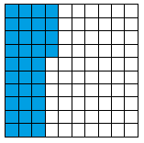
What fraction of the hundred square is shaded?
?
100
__________ hundredths
Why can we not record tenths for this question?

Slide 8
ANSWERS
50
100
fifty hundredths
5
10
five tenths
70
100
seventy hundredths
7
10
seven tenths
34
100
thirty-four hundredths

Slide 9
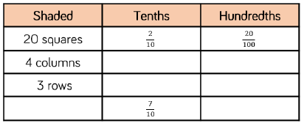
Use the hundred square to help…

Slide 10
Use the hundred square to help…
4
10
40
100
3
10
30
100
7 columns
70
100

Slide 11
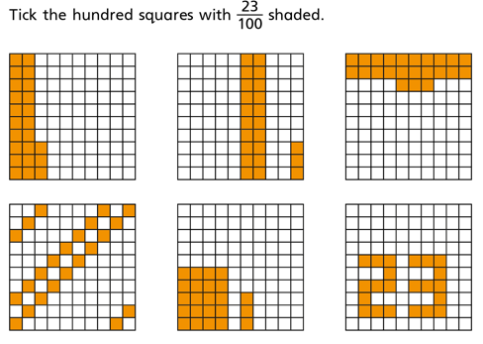
Which One?

Slide 12
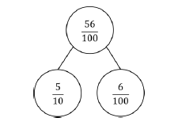
Partition into tenths and hundredths:
65 hundredths
31
100
80 hundredths

Slide 13
Partition into tenths and hundredths:
65 hundredths
31
100
80 hundredths
65
100
31
100
80
100
6
10
5
100
3
10
1
100
8
10
0
100

Slide 14
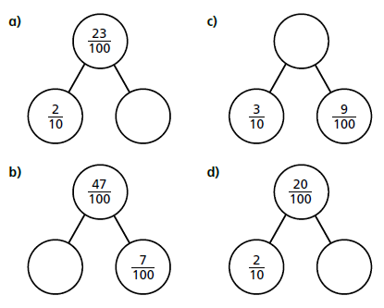
Your Turn…

Slide 15
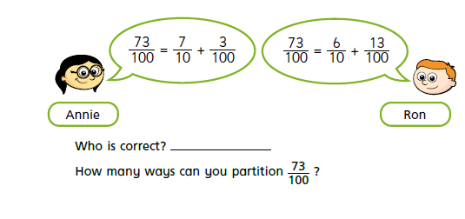
Challenge…

Slide 16
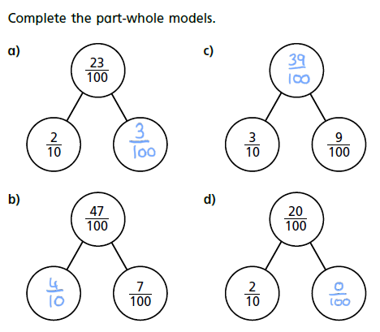
Your Turn ANSWERS

Slide 17
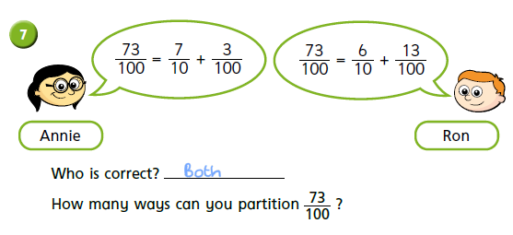
Challenge ANSWERS

Slide 18
Remote Learning Tracking
https://forms.office.com/Pages/ResponsePage.aspx?id=eCY4lN73r0G0KV1rDWITzRhTQ2IZqpBOsW8cFVoooF9UNVlMS1dCVkdaM0k0WlhFTE9WVFBTWEg1Ti4u

