Slide 1
Maths
Tuesday 9th February 2021

Slide 2
LO: recognise the relationship between 1 and 0.1. 10
Success Criteria:
Understand that a tenth is a part of a whole split into 10 equal parts.
Represent tenths as a decimal and a fraction.
Represent tenths on a place value grid.
Represent tenths on a number line.

Slide 3
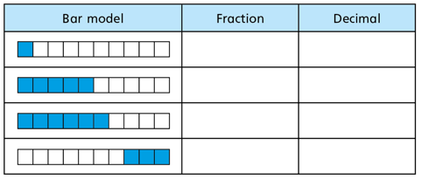
1
10
0.1
5
10
0.5
6
10
0.6
3
10
0.3

Slide 4
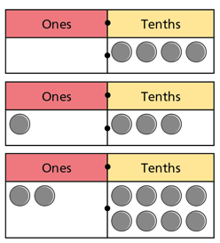
Place Value Grid
0.4
1.3
2.8

Slide 5
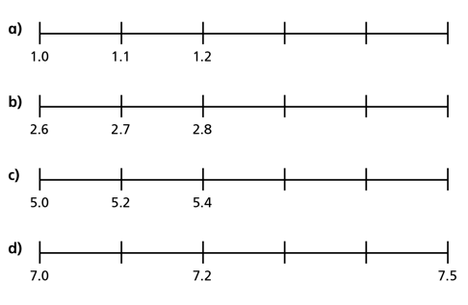
Number Line
1.3
1.4
1.5
2.9
3.0
3.1
5.6
5.8
6.0
7.1
7.3
7.4

Slide 6
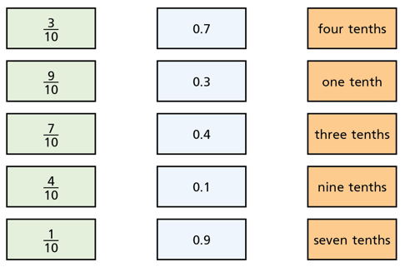
Q1. Match the equivalent fractions, decimals and words.

Slide 7
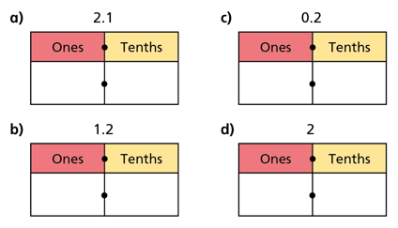
Q2. Add counters to the place value grids to show the decimals above.

Slide 8
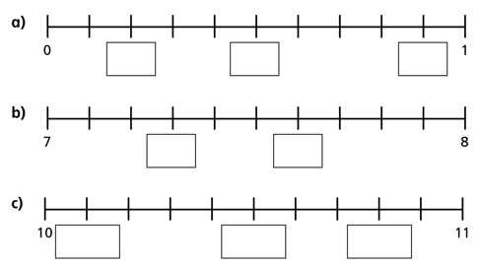
Q3. Fill in the decimal numbers on the number lines.

Slide 9
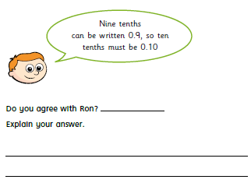
Challenge 1

Slide 10
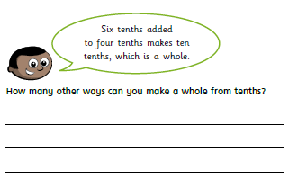
Challenge 2

Slide 11
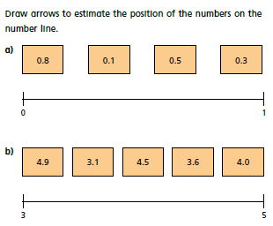
Challenge 3

Slide 12
Q1. ANSWERS

Slide 13
Q2. ANSWERS

Slide 14
Q3. ANSWERS
0.2
0.5
0.9
7.3
7.6
10.1
10.5
10.8

Slide 15
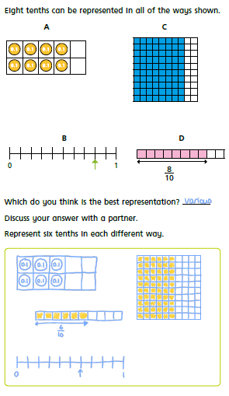
Challenge 1 - ANSWERS

Slide 16
Challenge 2 - ANSWERS

Slide 17
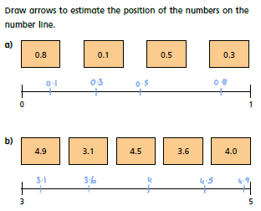
Challenge 3 - ANSWERS

Slide 18
Remote Learning Tracking
https://forms.office.com/Pages/ResponsePage.aspx?id=eCY4lN73r0G0KV1rDWITzRhTQ2IZqpBOsW8cFVoooF9UNVlMS1dCVkdaM0k0WlhFTE9WVFBTWEg1Ti4u

