Slide 1
Wednesday 20th January
Maths Challenge 3

Slide 2
Add fractions
Use images to represent fractions
Convert fractions to the same denominator
Add the numerators and keep the denominator the same
Convert from an improper fraction to a mixed number
Simplify answer if possible

Slide 3
Write each fraction as a mixed number
1)
$$\frac{13}{10}$$
= $1\frac{3}{10}$
2)
$$\frac{5}{4}$$
3)
$$\frac{11}{5}$$
4)
$$\frac{10}{8}$$

Slide 4
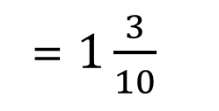
Write each fraction as a mixed number
1)
$$\frac{13}{10}$$
= $1\frac{3}{10}$
2)
$$\frac{5}{4}$$
= $1\frac{1}{4}$
$$\frac{11}{5}$$
= $2\frac{1}{5}$
3)
$$\frac{10}{8}$$
= $1\frac{2}{8}=1\frac{1}{4}$
4)

Slide 5
Add the numerators and keep
the denominator the same
There was $\frac{3}{4}$kg of rice in a container.
Find the weight of rice in the container after another $\frac{1}{2}$ kg is added.
$\frac{3}{4}$ + $\frac{1}{2}=\frac{3}{4} \text{+} \frac{2}{4}=\frac{5}{4}$
1 $\frac{1}{4}$ kg
What is the first step in solving this problem?
Convert from an improper fraction
to a mixed number
Convert the fractions to the same denominator.
x 2
2
$\frac{5}{4}$ = 1 $\frac{1}{4}$
$$\frac{1}{2}= \frac{}{4}$$
Use images to represent fractions
Convert fractions to the same denominator
Add the numerators and keep the denominator the same
Convert from an improper fraction to a mixed number
Simplify answer if possible
x 2

Slide 6
Your turn
Find the sum of $\frac{2}{3}$ and $\frac{4}{9}$
$\frac{2}{3}+\frac{4}{9}$ =
1)
$\frac{6}{9}+\frac{4}{9}$ = $\frac{10}{9}$
2) $\frac{2}{3}$ + $\frac{5}{9}$
$\frac{10}{9}$ = 1 $\frac{1}{9}$
3) $\frac{3}{4}$ + $\frac{5}{8}$
Use images to represent fractions
Convert fractions to the same denominator
Add the numerators and keep the denominator the same
Convert from an improper fraction to a mixed number
Simplify answer if possible

Slide 7
Your turn
Find the sum of $\frac{2}{3}$ and $\frac{4}{9}$
$\frac{2}{3}+\frac{4}{9}$ =
1)
$\frac{6}{9}+\frac{4}{9}$ = $\frac{10}{9}$
2) $\frac{2}{3}$ + $\frac{5}{9}$ = $\frac{6}{9}+\frac{5}{9}$ = $\frac{11}{9}$ = 1 $\frac{2}{9}$
$\frac{10}{9}$ = 1 $\frac{1}{9}$
3) $\frac{3}{4}$ + $\frac{5}{8}=\frac{6}{8}+\frac{5}{8}$ = $\frac{11}{8}$ = 1 $\frac{3}{8}$
Use images to represent fractions
Convert fractions to the same denominator
Add the numerators and keep the denominator the same
Convert from an improper fraction to a mixed number
Simplify answer if possible

Slide 8
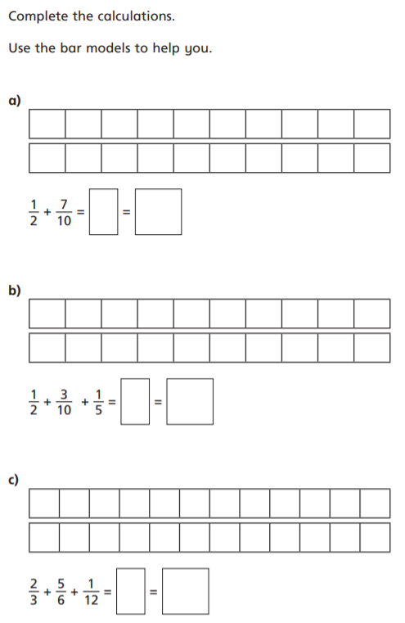
1.
2. Add and simplify
a)
$\frac{3}{4}$ + $\frac{3}{8}$
b)
$\frac{3}{5}$ + $\frac{7}{10}$
c)
$\frac{4}{5}$ + $\frac{3}{10}$
$\frac{5}{6}$ + $\frac{1}{2}$
d)
3. Add and simplify
a)
$\frac{3}{5}$ + $\frac{5}{10}$
b)
$\frac{5}{6}$ + $\frac{7}{12}$
c)
$\frac{4}{5}$ + $\frac{8}{15}$
$\frac{5}{6}$ + $\frac{2}{3}$
d)

Slide 9
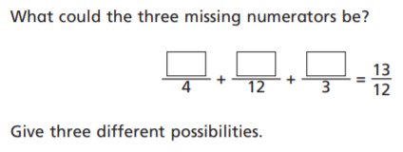
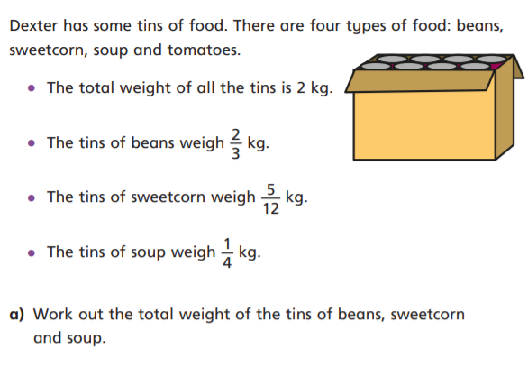
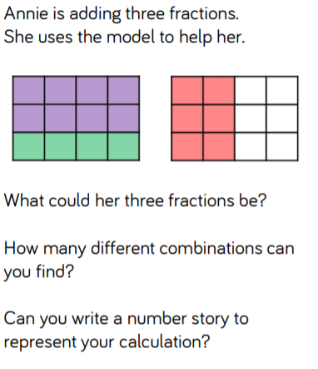
Further challenge:

Slide 10
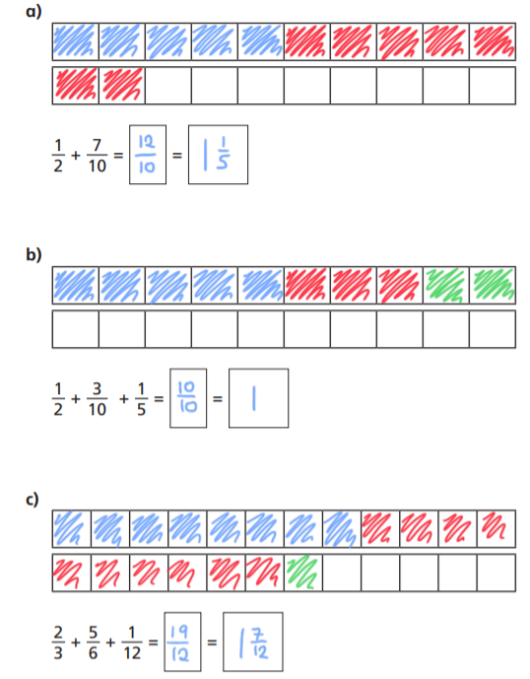
1.
2. Add and simplify
$\frac{3}{4}$ + $\frac{3}{8}$
b)
$\frac{3}{5}$ + $\frac{7}{10}$
$\frac{9}{8 }=1\frac{1}{8 }$
$\frac{13}{\begin{aligned}10 \\ \end{aligned}}= 1\frac{3}{10 }$
$\frac{11}{\begin{aligned}10 \\ \end{aligned}}=1\frac{1}{\begin{aligned}10 \\ \end{aligned}}$
$\frac{8}{\begin{aligned}6 \\ \end{aligned}}$ = 1 $\frac{2}{\begin{aligned}6 \\ \end{aligned}}=$1 $\frac{1}{\begin{aligned}3 \\ \end{aligned}}$
a)
c)
$\frac{4}{5}$ + $\frac{3}{10}$
$\frac{5}{6}$ + $\frac{1}{2}$
d)
3. Add and simplify
a)
$\frac{3}{5}$ + $\frac{5}{10}$
b)
$\frac{5}{6}$ + $\frac{7}{12}$
$\frac{11}{10}=1\frac{1}{10 }$
$\frac{17}{\begin{aligned}12 \\ \end{aligned}}= 1\frac{5}{12 }$
$\frac{20}{\begin{aligned}15 \\ \end{aligned}}=1\frac{5}{\begin{aligned}15 \\ \end{aligned}}=1\frac{1}{\begin{aligned}3 \\ \end{aligned}}$
$\frac{9}{\begin{aligned}6 \\ \end{aligned}}$ = $1\frac{3}{\begin{aligned}6 \\ \end{aligned}}= 1\frac{1}{\begin{aligned}2 \\ \end{aligned}}$
c)
$\frac{4}{5}$ + $\frac{8}{15}$
$\frac{5}{6}$ + $\frac{2}{3}$
d)

Slide 11
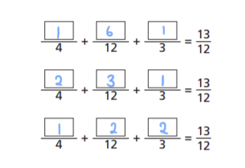
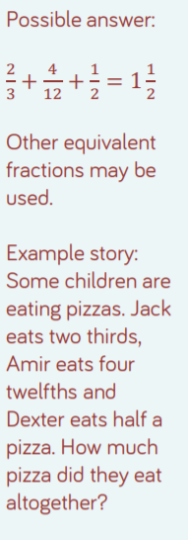
Further challenge:

