Slide 1
Thursday 21st January 2021
Maths
Challenge Two

Slide 2
Simplify fractions

Slide 3
Think back…
What do we know about equivalent fractions?
Fractions with different numerators and denominators that represent the same value or proportion of the whole.

Slide 4
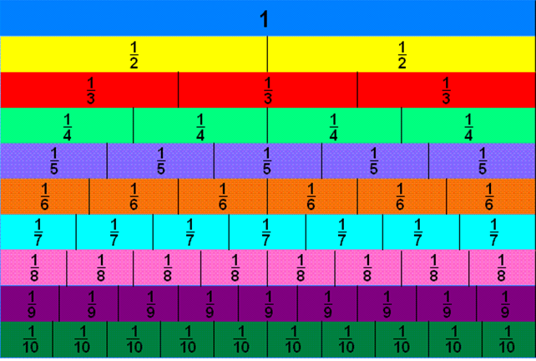
Fraction Wall
Here is a fraction wall. You can use this to help you throughout the lesson.

Slide 5
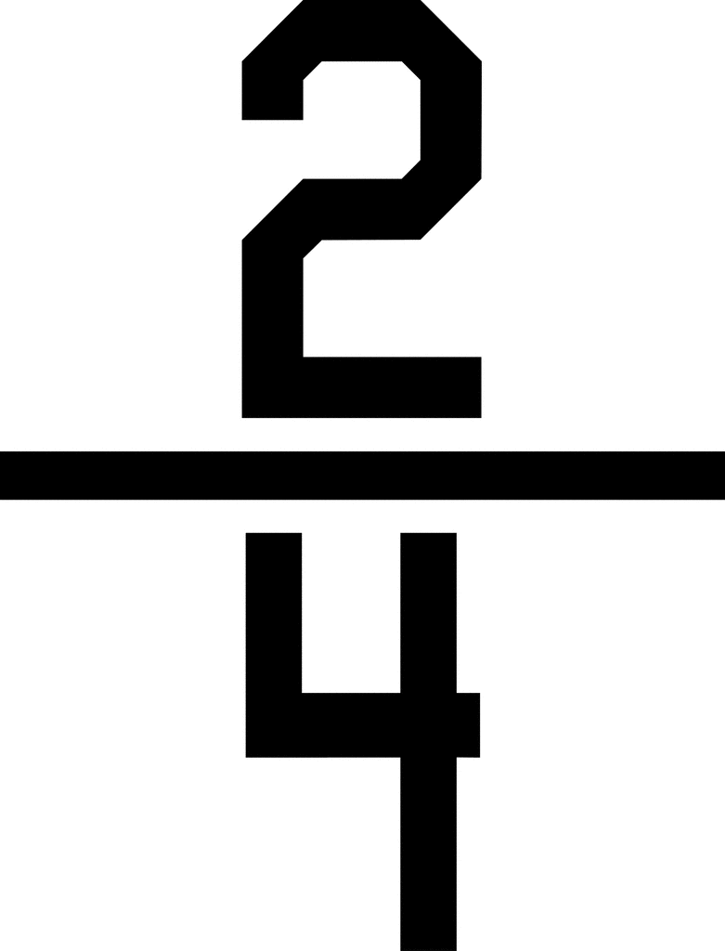
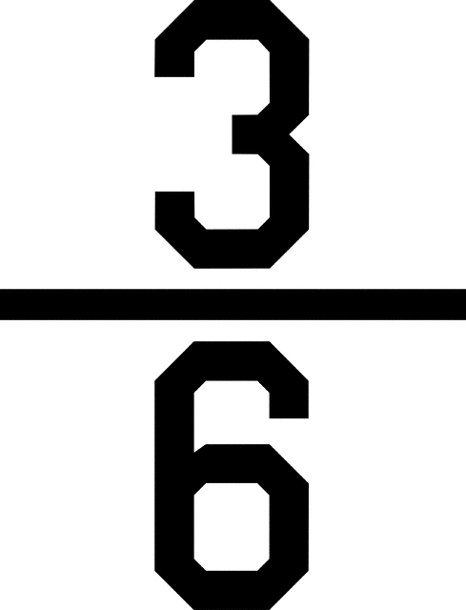
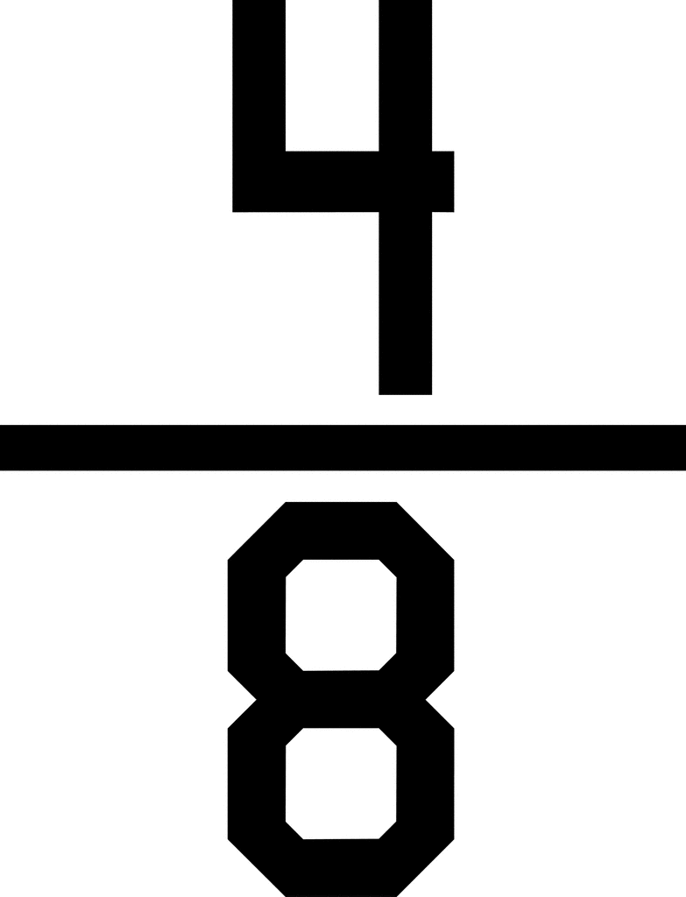
Fraction Wall

Slide 6
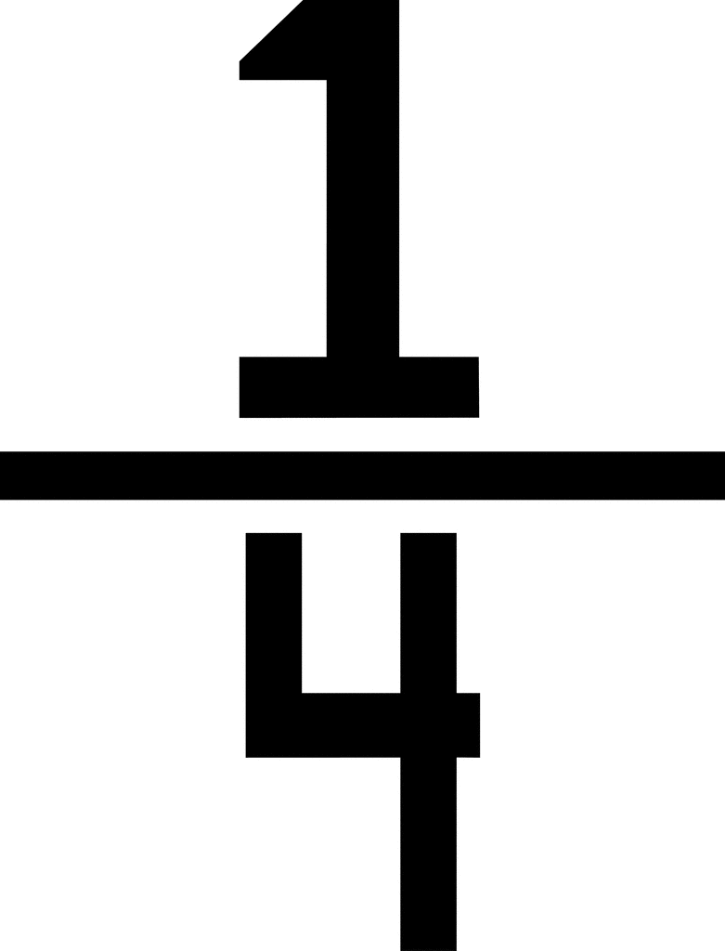
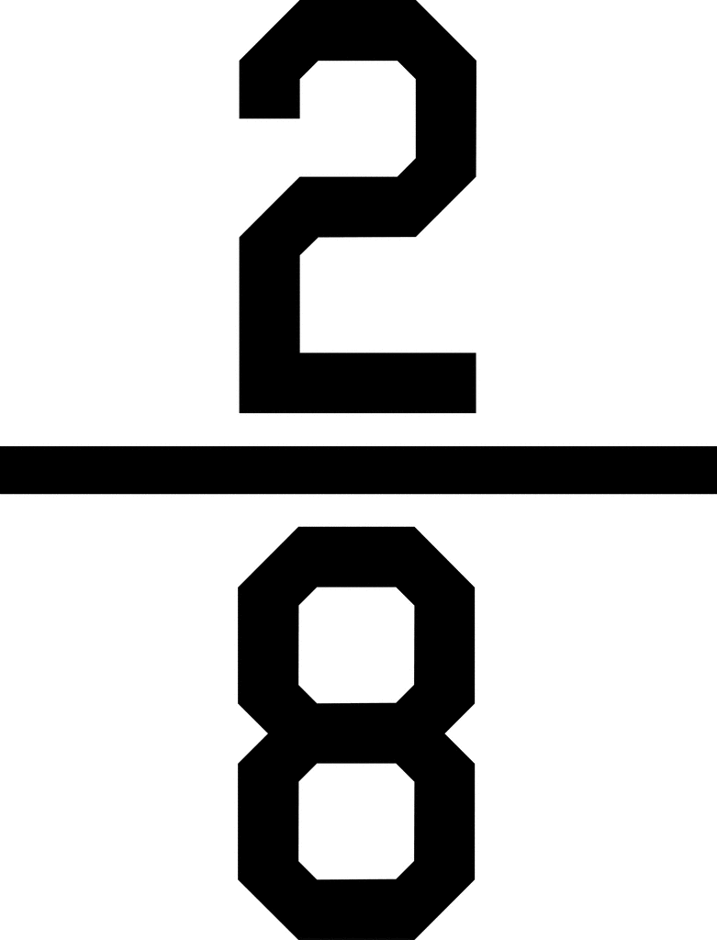
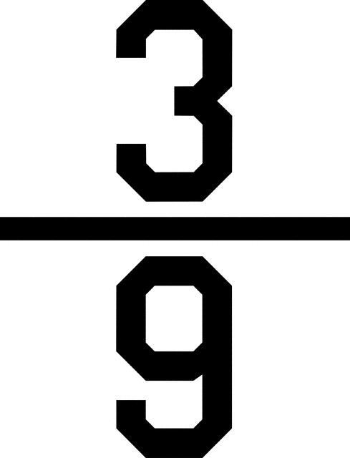
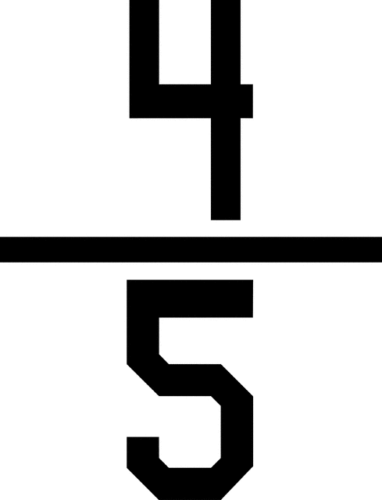
Over to you…
Using the fraction wall now, can you find me one equivalent fraction for the following fractions?
=
=

Slide 7
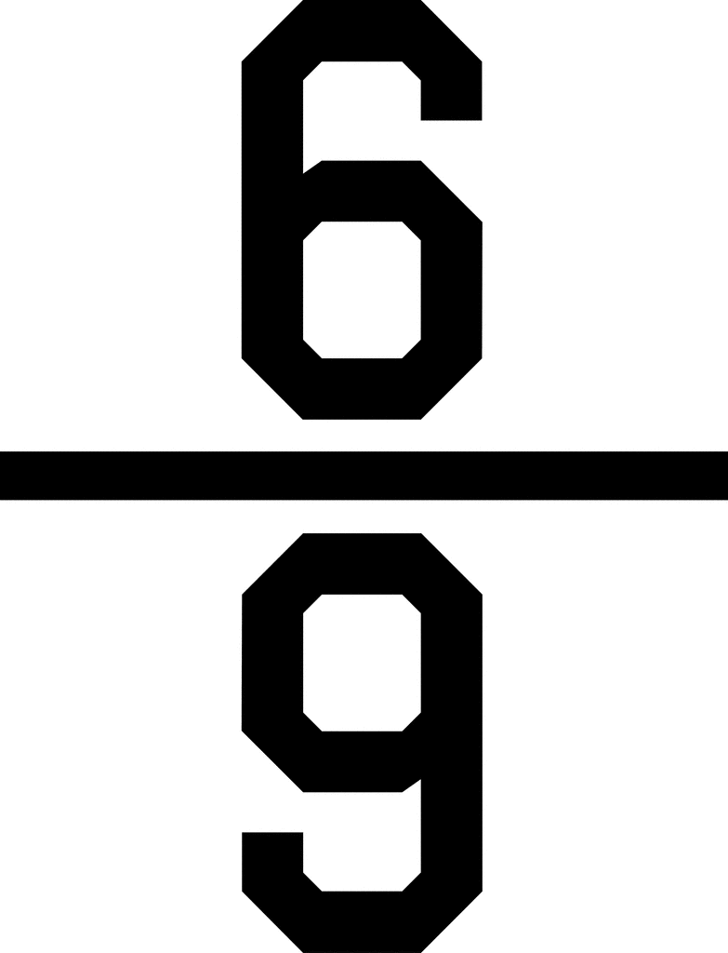
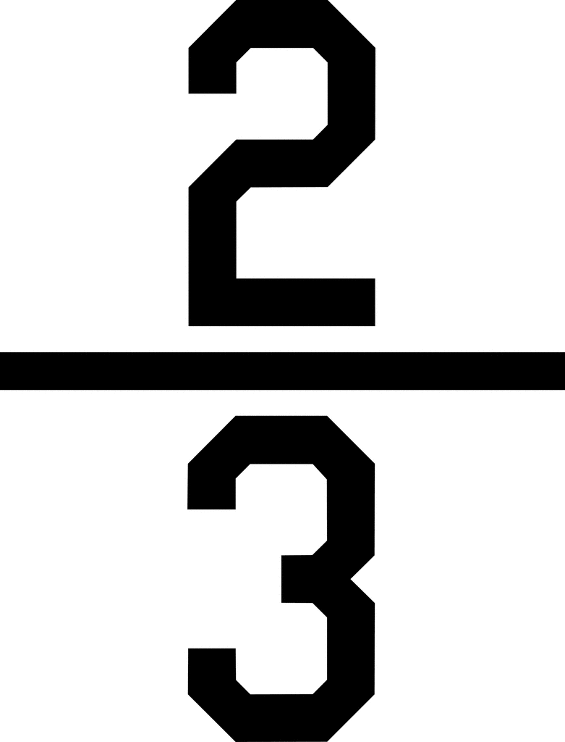
Simplifying fractions
Writing a fraction in its simplest form means that the top and bottom numbers can no longer be divided by the same whole number exactly or evenly.
÷3
÷3

Slide 8
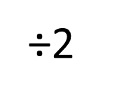
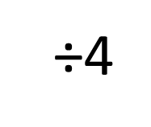
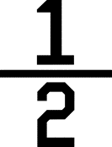
Simplifying fractions
÷2
÷2
÷4

Slide 9
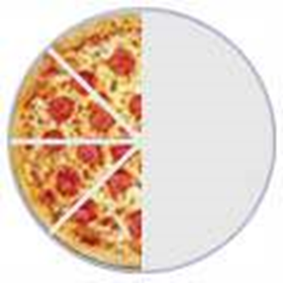
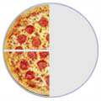
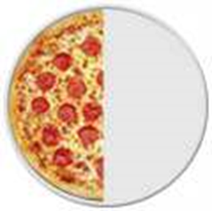
Simplifying fractions – why do we do it?
Simplifying (or reducing) fractions means to make the fraction as simple as possible. Why say four-eighths (4/8) when you really mean half (1/2) ?

Slide 10
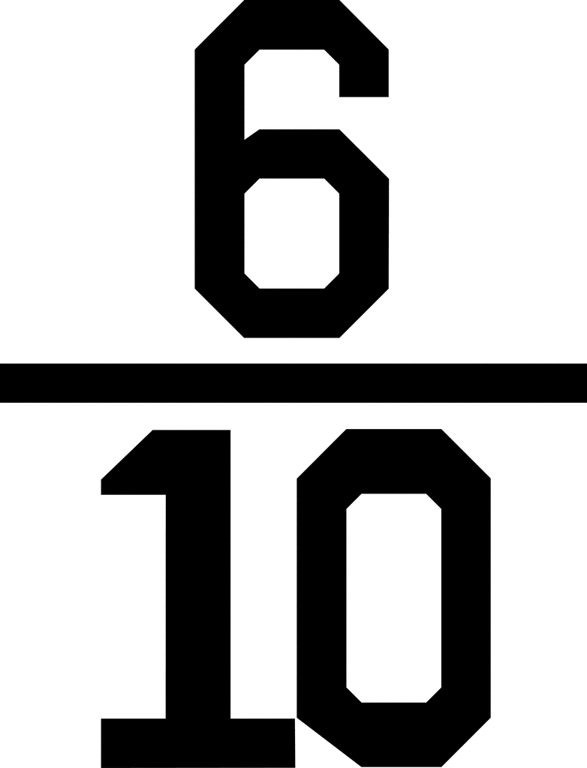
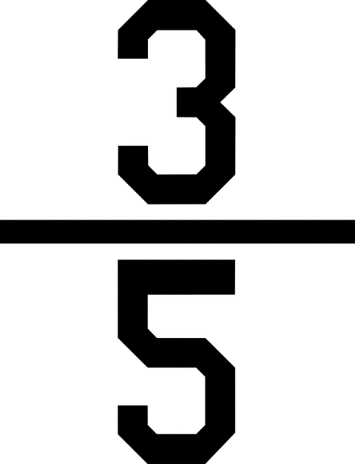
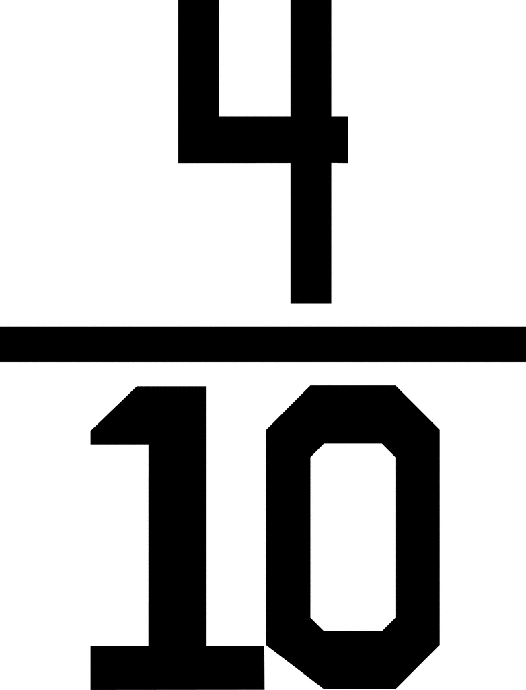
Over to you…
÷2
=
÷3
=
÷2
=

Slide 11
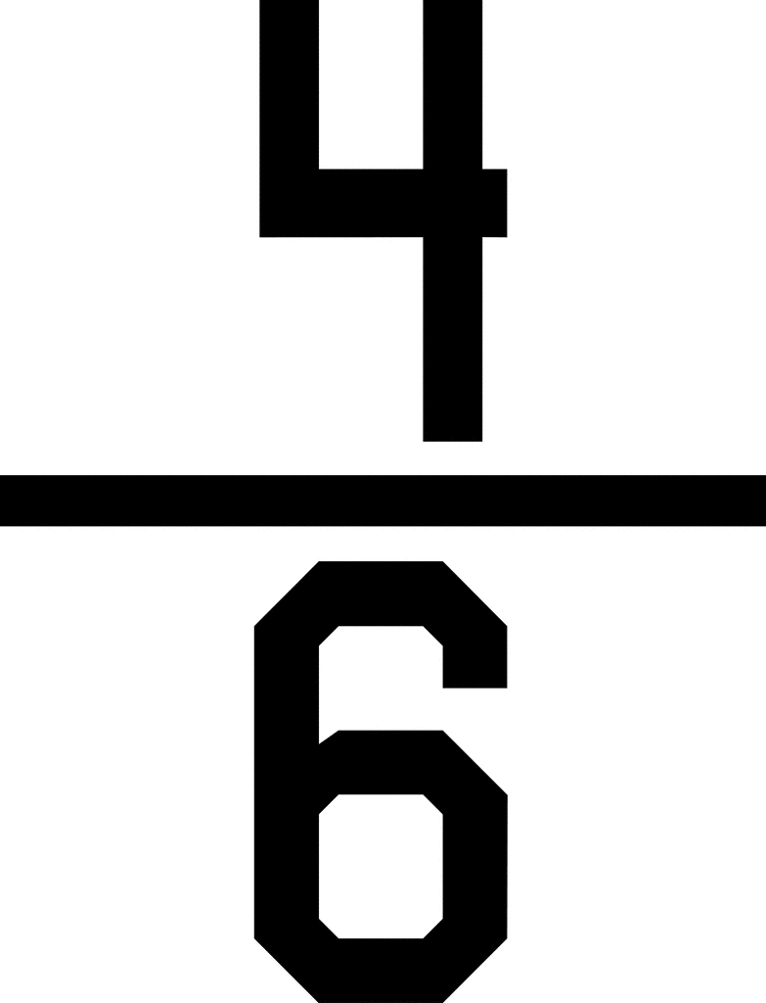
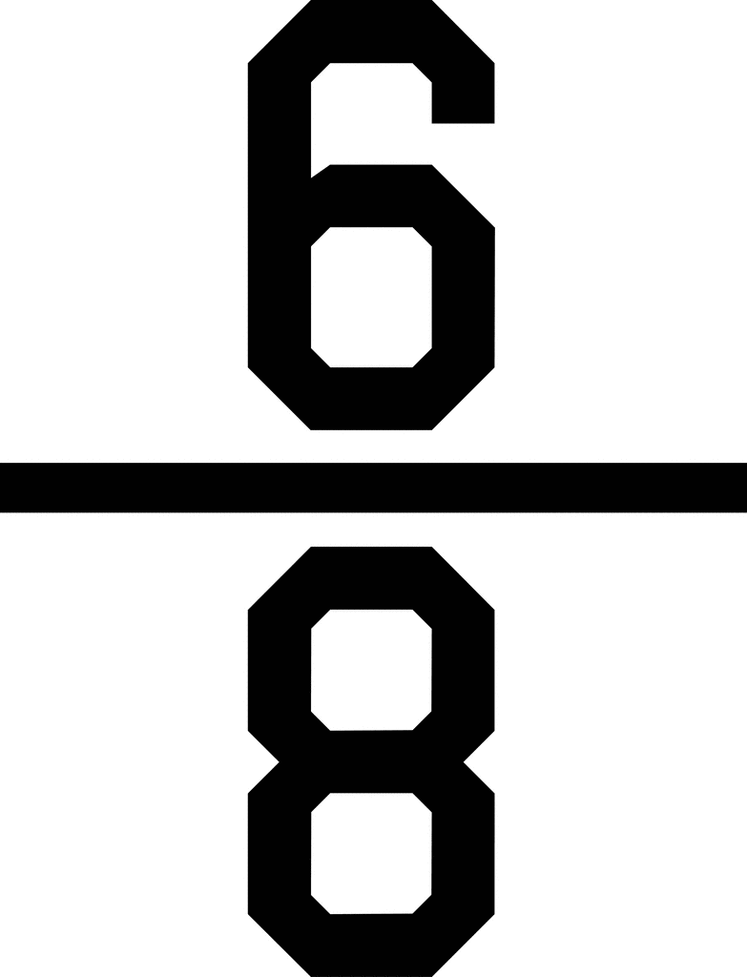
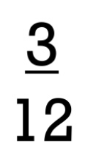
Time to try…
Challenge One:
Simplify the following fractions:
1. 6.
2. 7.
3. 8.
4. 9.
5. 10.
Challenge Two:
1. I have cancelled this fraction to its simplest form. What could it have been to start with? Give three different fractions.
2. I have changed this fraction to its simplest form. Am I correct? Convince me.
3. Martin thinks you can only simplify even numbered fractions because you keep on halving the numerator and denominator until you get an odd number. Prove Martin wrong.
4. Tom’s classroom has 10 windows in total. 4 of those windows are broken. Write the number of broken windows as a fraction in its simplest form.
5. Over the weekend, Lucy made a Pizza and she cut the pizza into 12 slices. Peyton's mom ate 4 slices, Peyton's dad ate 5 slices, and Peyton ate the rest of the pizza. What fraction of the pizza did Peyton eat? Simplify the answer.

Slide 12
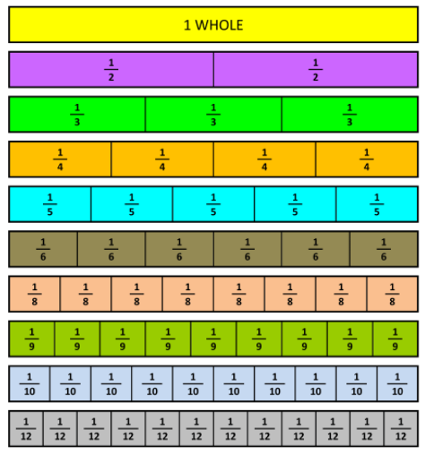
Fraction Wall

Slide 13
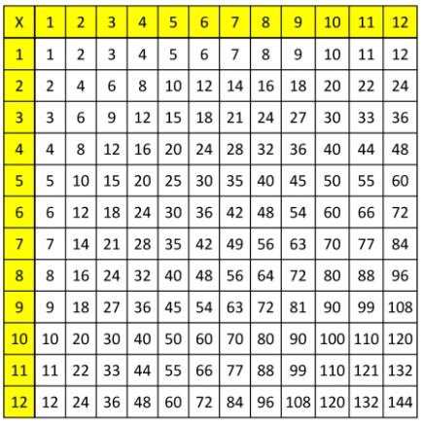
Multiplication Table

Slide 14
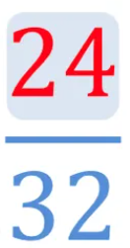
Plenary
How could I simplify this fraction?

Slide 15
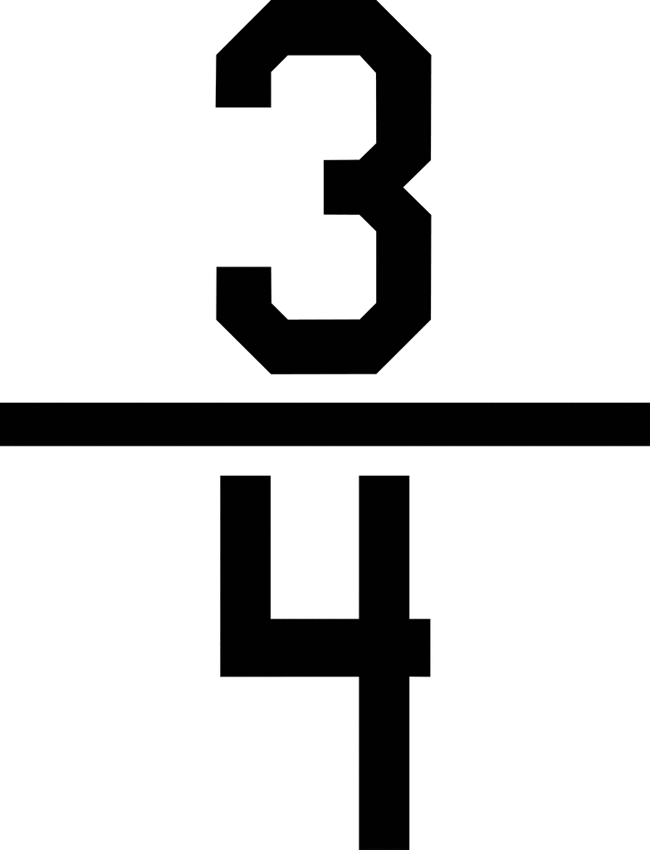
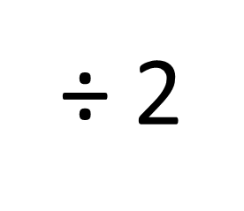
Plenary
How could I simplify this fraction?
÷ 2
÷ 8

Slide 16
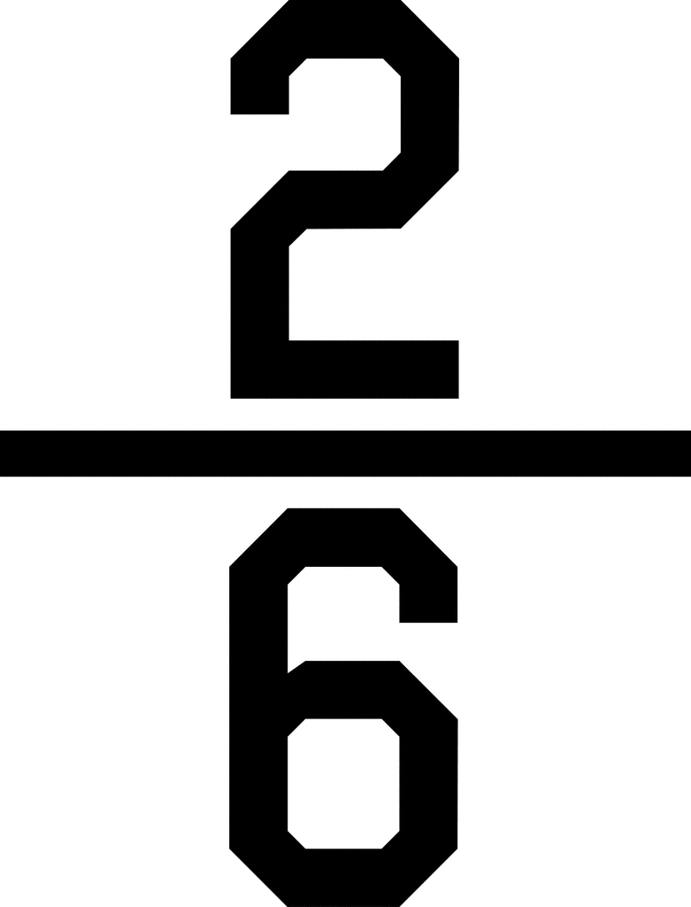
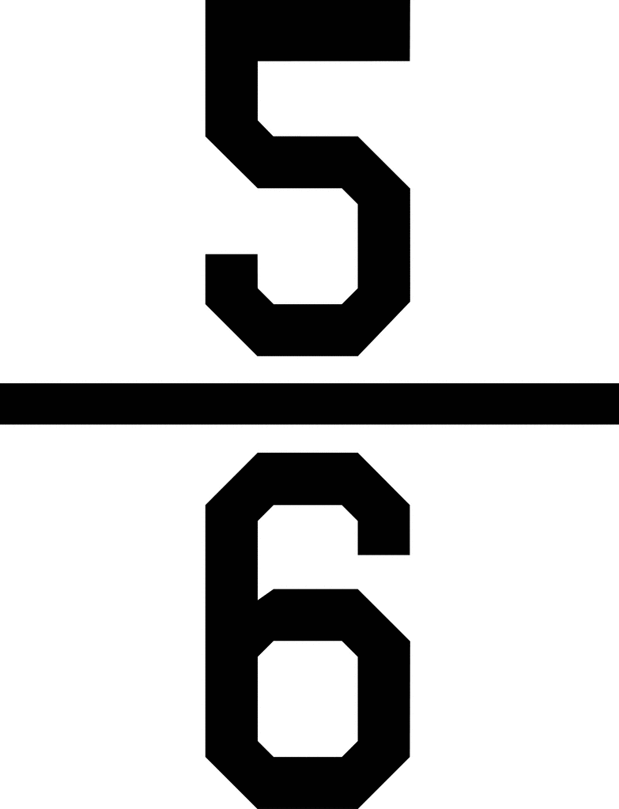
Answers
Challenge Two:
Challenge One:
Simplify the following fractions:
1. 6.
2. 7.
3. 8.
4. 9.
5. 10.
1. I have cancelled this fraction to its simplest form.
What could it have been to start with? Give three different fractions. 4/6, 6/9, 8/12
2. I have changed this fraction to its simplest form. Am I correct? Convince me. No. It can be simplified further by dividing by two
to make 3/5
3. Martin thinks you can only simplify even numbered fractions because you keep on halving the numerator and denominator until you get an odd number. Prove Martin wrong. No, because I could simplify 3/9 by dividing by 3 to make 1/3
4. Tom’s classroom has 10 windows in total. 4 of those windows are broken. Write the number of broken windows as a fraction in its simplest form. 4/10 simplified to 2/5
5. Over the weekend, Lucy made a pizza and she cut the pizza into 12 slices. Lucy's mum ate 4 slices, Lucy's dad ate 5 slices, and Lucy ate the rest of the pizza. What fraction of the pizza did Lucy eat? Simplify the answer. 3/12 simplified to 1/4.

