Slide 1
Science – Forces Lesson 4
Monday 1st February 2021

Slide 2
LO: Investigate the effects of water resistance.
Success Criteria:
Explain the effects of water resistance.
Identify streamlined shapes.
Minimise the effects of water resistance on an object.

Slide 3
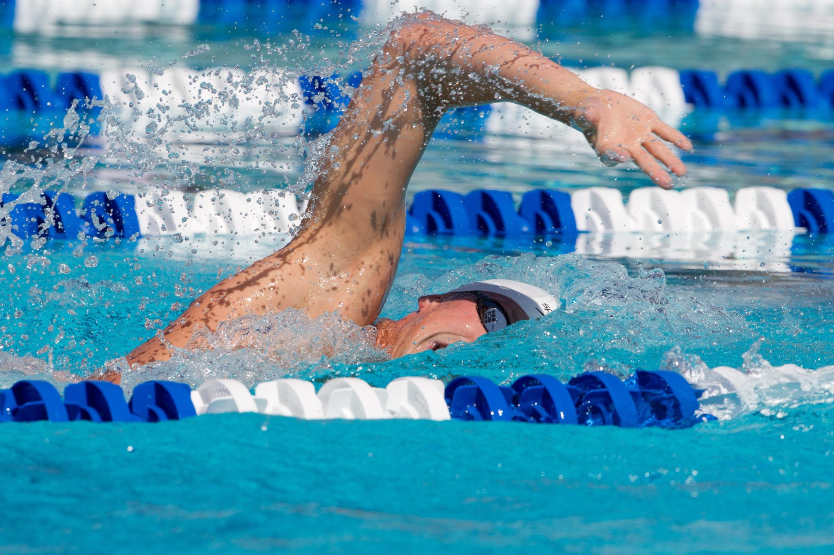
What is water resistance?
Water resistance is a type of friction when an object moves through water.
swimmer’s force
water resistance

Slide 4
Streamlined Shapes

Slide 5
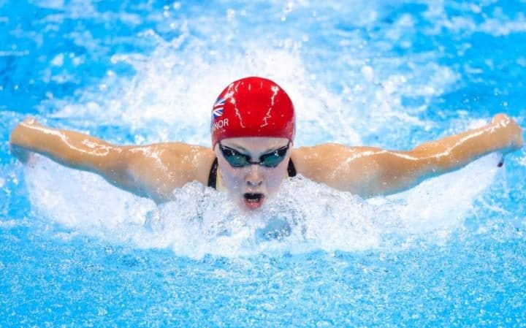
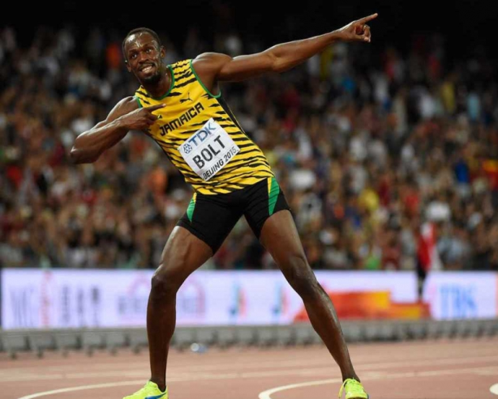
Think About It…
How do professional athletes reduce their air and water resistance when playing their sport?
How do they make themselves more streamlined so they can go faster?
Will Usain Bolt run faster in the water or on land? Why?
Is it faster to run or swim in the water? Why?

Slide 6
Think About It…
How do professional athletes reduce their air and water resistance when playing their sport?
How do they make themselves more streamlined so they can go faster?

Slide 7
Can you get your body into a streamlined shape?

Slide 8
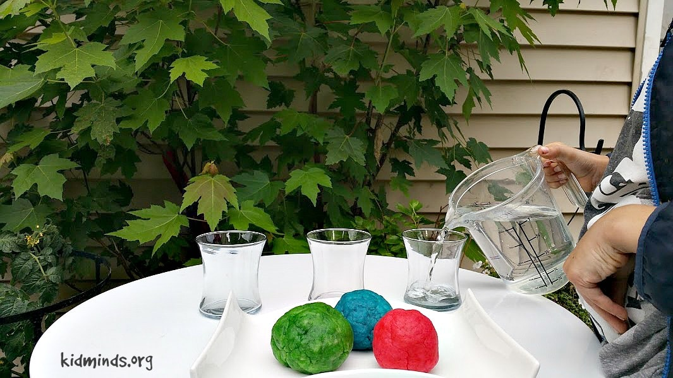
Let’s Investigate…

Slide 9
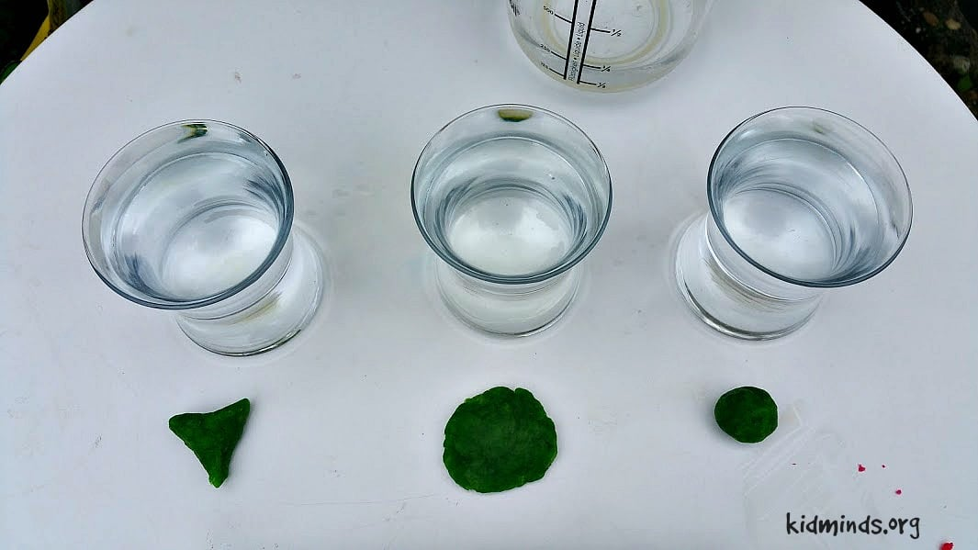
Step 1:

Slide 10
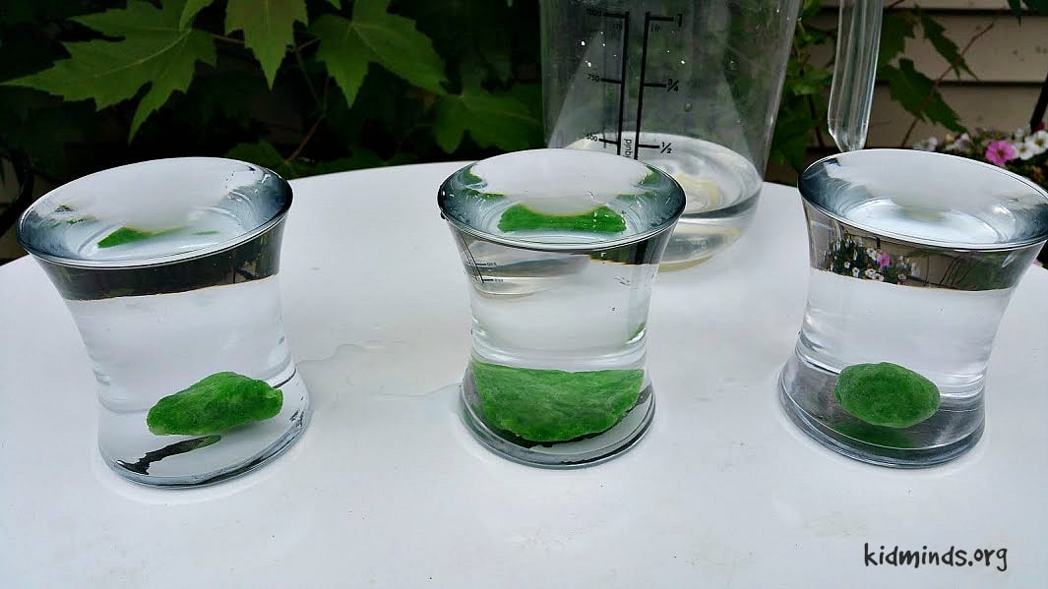
Step 2:

Slide 11
Results Table:
Shape | Time Taken (seconds)
 | Drop 1 | Drop 2 | Drop 3 | Mean Result
Ball
Pancake

Slide 12
Copy and complete these sentences…
The __________ shape took the longest time to sink.
This shape sunk slowly because __________ .
The __________ shape was the fastest to sink. It took _____ seconds. This shape sunk quickly because __________ .

Slide 13
Diagram

Slide 14
Diagram - Example
Weight
water resistance

Slide 15
Get Creative!
Which animal shape would be best to use for a sinking swimming toy?
Explain why you’ve made that choice.

Slide 16
Apply

