Slide 1
Thursday 25th February 2021
Year Six
Art

Slide 2
L.O. Replicate techniques used by notable artists. Use lines to depict perspective
.
Draw a horizontal line across the middle of the page.
Draw two diagonal lines running through the centre of the horizontal line.
Draw two diagonal lines just below the top diagonal lines which converge at the vanishing point
Draw two diagonal lines just below the top diagonal lines which converge at the vanishing point.
Divide the space between the diagonal lines into houses.
Draw in windows and doors – keep vertical lines parallel and diagonal lines converge towards the vanishing point

Slide 3
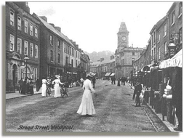
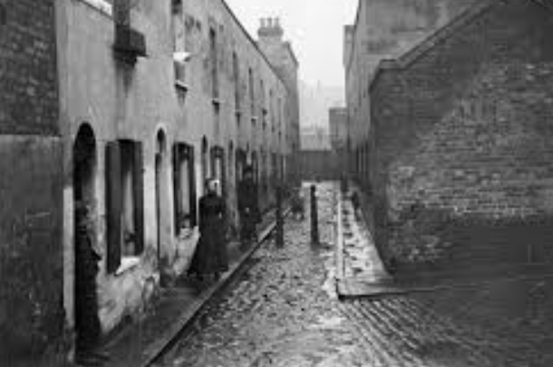

Slide 4
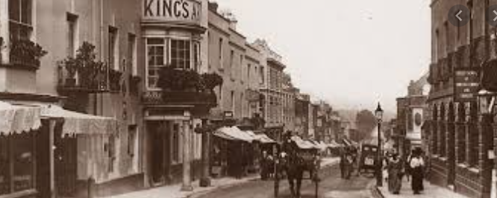
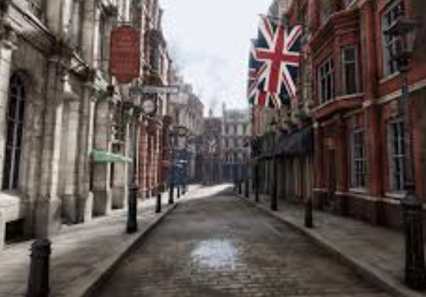

Slide 5
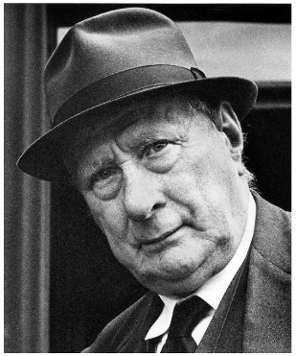
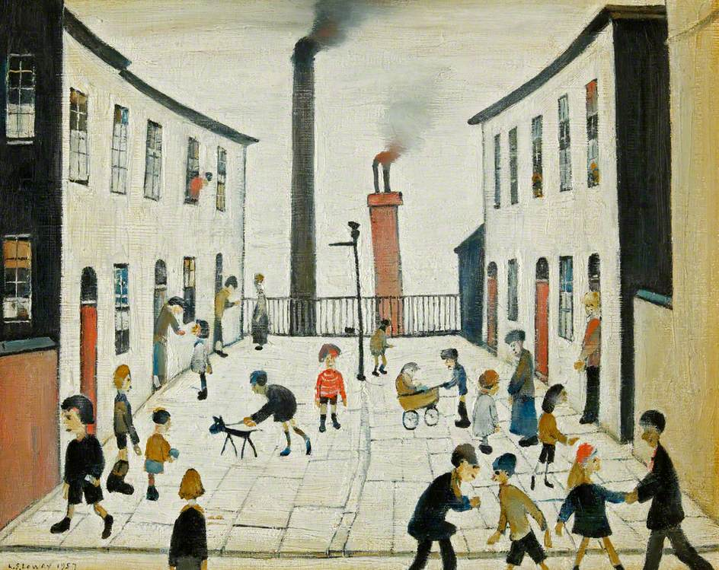
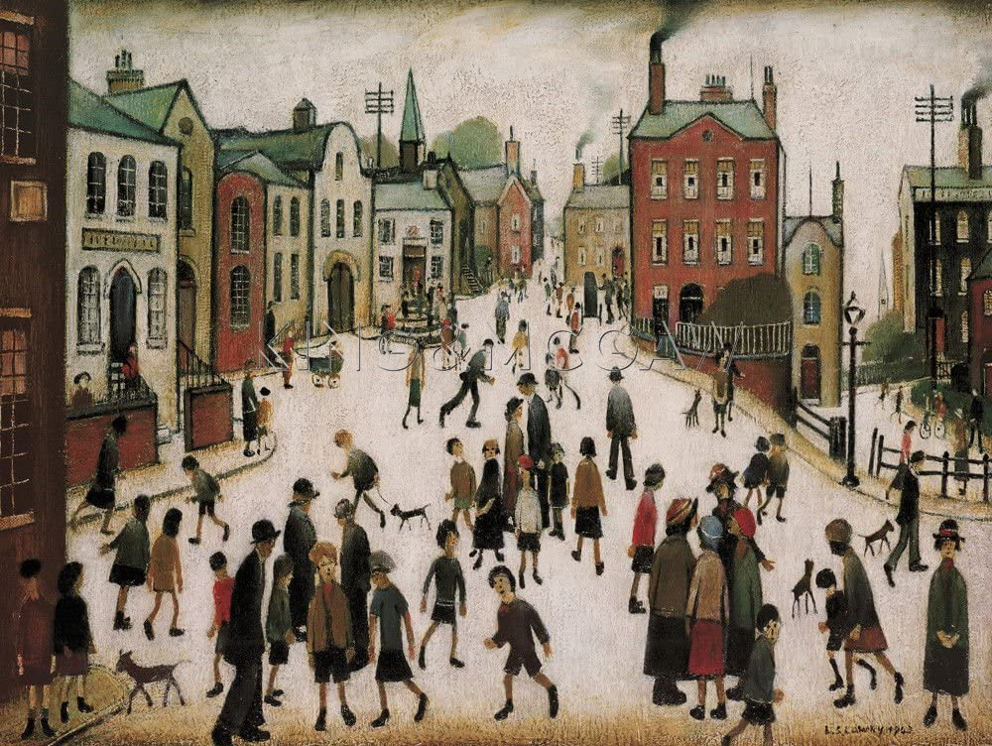
L.S. Lowry (1887 – 1976)

Slide 6
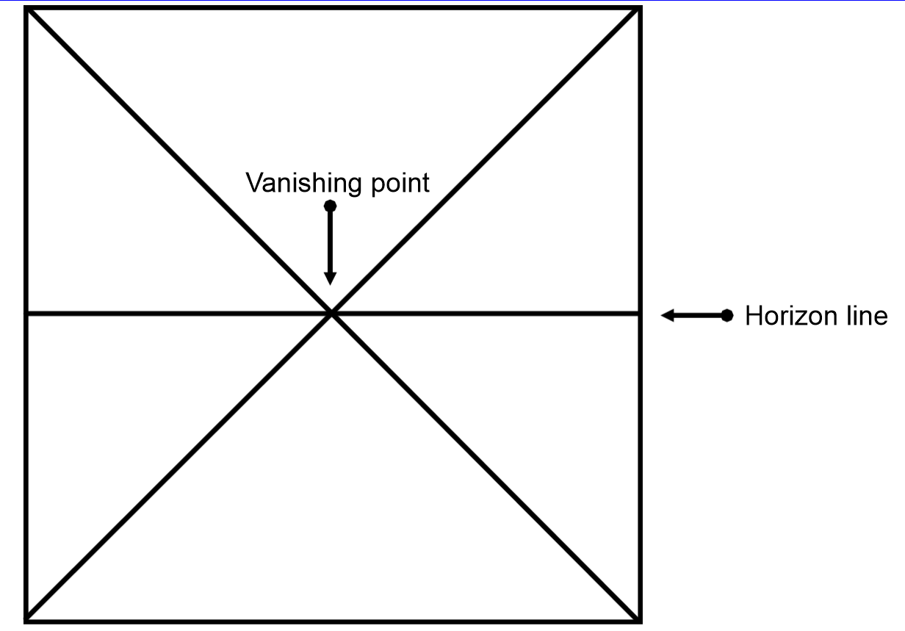

Slide 7
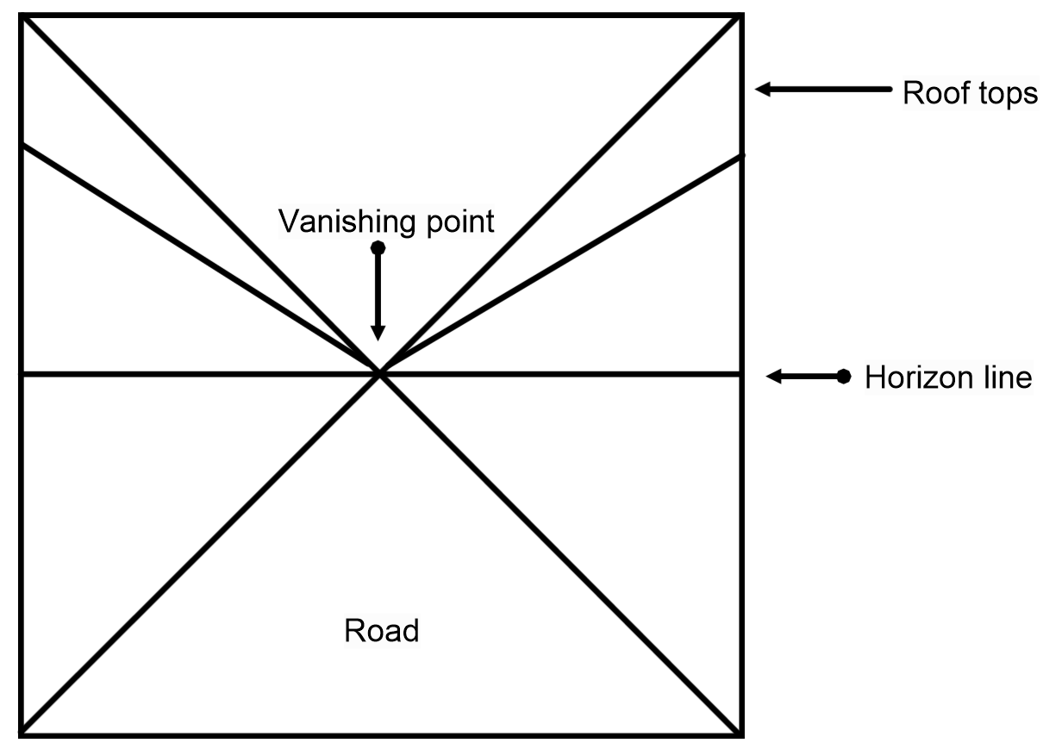

Slide 8
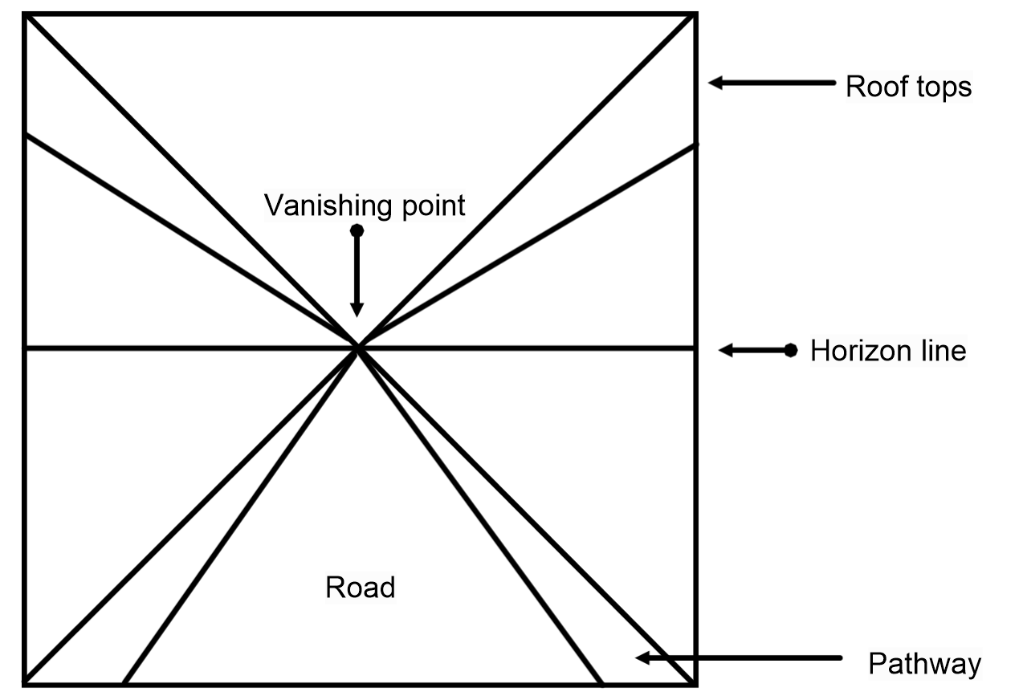

Slide 9
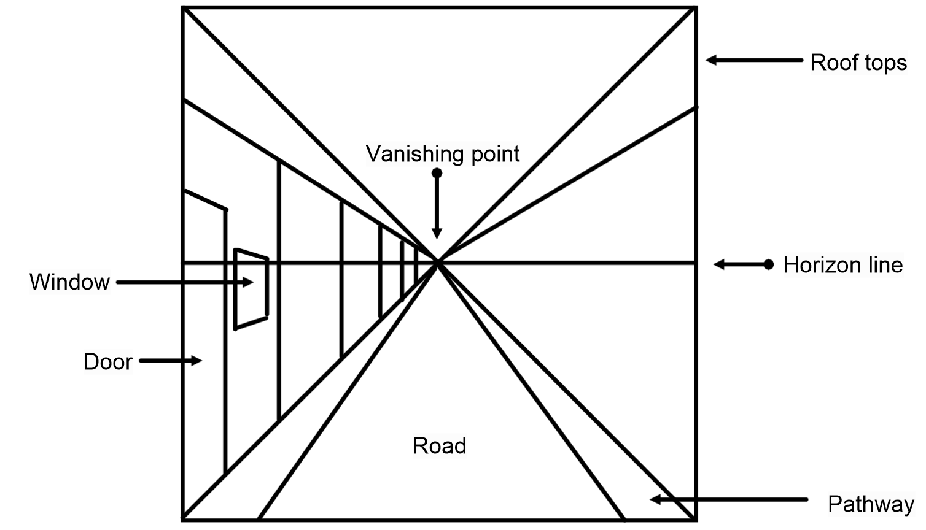

Slide 10
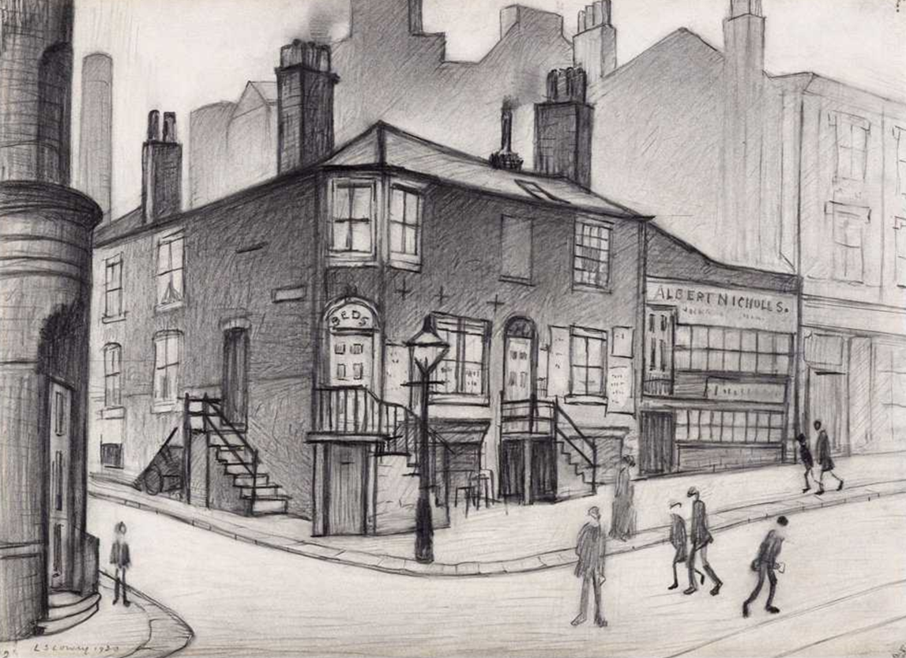
Challenge!

Slide 11
Remote learning tracking
https://forms.office.com/Pages/ResponsePage.aspx?id=eCY4lN73r0G0KV1rDWITzRhTQ2IZqpBOsW8cFVoooF9UNVlMS1dCVkdaM0k0WlhFTE9WVFBTWEg1Ti4u

