Slide 1
Design Technology (D.T)
Thursday 21^{2t} January 2021

Slide 3
Recap on design brief and design specification

Slide 4
Research reminder
Use your knowledge from your learning so far in DT and history this term along with websites and recipe books to research savoury Victorian dishes.
Present your ideas by writing recipes, drawing and annotating sketches.
Challenge one - Research and present two ideas for savoury products. Try and link to the Victorian era and include seasonal (winter) vegetables. Remember to draw and label your dishes.
Challenge two - Research and present three ideas for savoury products thinking carefully about what foods would have been available in the Victorian era as well as seasonality (winter). Ensure you have met the design brief and specification.

Slide 5
Seasonal fruits and vegetables

Slide 6
Refine
Today you need refine your research and choose one of your savoury products to take forward to the making stage next week.
Look at your research from last week and choose one product. If you can’t decide, look at the design brief and make your choice based on the product that fits this the best.
Write out your ingredients list, equipment and utensil list as well as your recipe for making. We would love you to email photos of these to us.
Ask your adult if they are able to buy the ingredients for you to make the savoury product next week.

Slide 7
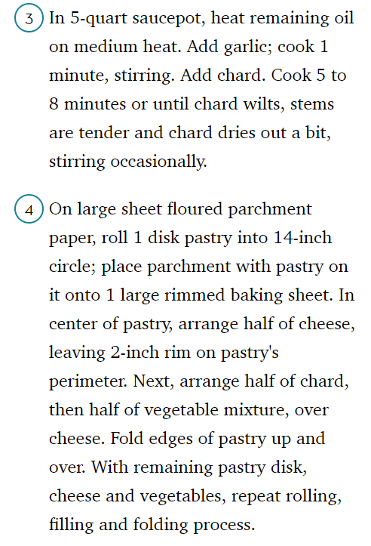
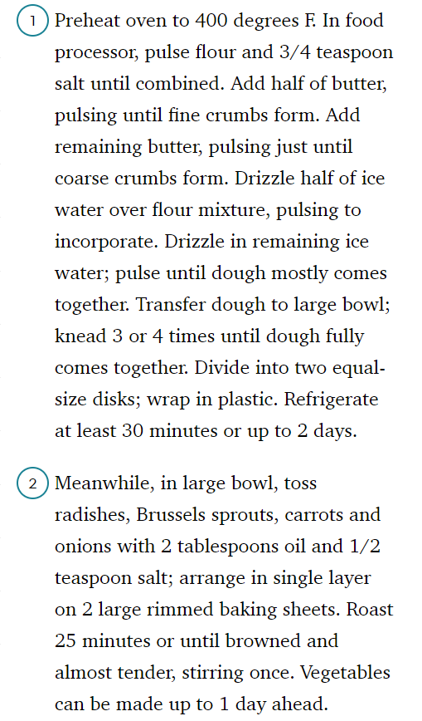
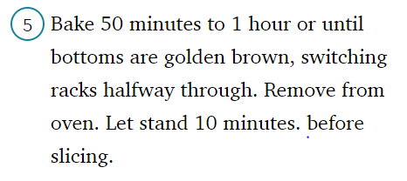
Winter vegetable tart
Equipment/utensils:
food processor,
tea spoon,
table spoon,
large bowl x 2,
cling film,
baking sheets,
saucepan,
baking paper,
weighing scales,
oven.

Slide 8
Website links
http://recipespastandpresent.org.uk/victoriancooking/vegetable.php
https://www.english-heritage.org.uk/visit/inspire-me/victorian-recipes/
Links on the English Heritage site to YouTube for videos on preparing Victorian dishes.
https://www.historyextra.com/period/victorian/7-victorian-recipes/
https://www.bbcgoodfood.com/
You may have recipe books at home that you could use to help you. Think about seasonality (winter) as you flick through.

