Slide 1
Wednesday 10th February 2021
ENGLISH YEAR SIX

Slide 2
L.O. Choose appropriate grammar and vocabulary to write a narrative
Use figurative language (similes, metaphors and personification)
Use relative clauses
Use subordinate clauses
Use dialogue
Use semi colons to mark boundaries between two main clauses
Use emotive language
Expanded noun phrases

Slide 3
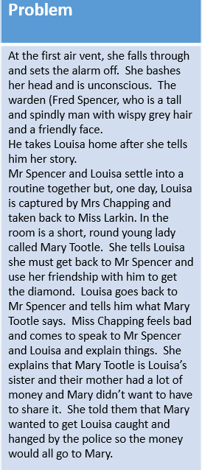
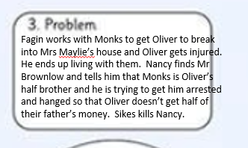

Slide 4
Challenge 1 - use similes, relative clauses, adjectives for description and speech.
Challenge 2 – Use similes, personification, relative clauses, expanded noun phrases, subordinate clauses, speech and emotive language.
Challenge 3 – Use similes, personification, metaphors, relative clauses, expanded noun phrases including prepositional phrases, subordinate clauses, speech and emotive language.
Cheeky challenge – Use a semi colon to mark boundaries between two main clauses.
Remember, it isn’t all about quantity; your writing needs to be quality.

Slide 5
Louisa stared up at the vent. It was a cave. Where it lead she didn’t know and she really didn’t want to find out. “Move it!” hissed Miss Larkin, “We ain’t got no time for messing about.”
Louisa climbed up in the vent and it was very claustrophobic. The cobwebs and dust danced in front of her eyes. As she crawled forwards, she felt a rumble like an earthquake and the vent started to collapse; she was too heavy. Louisa tumbled to the floor like a sack of potatoes and was knocked unconscious. Miss Larkin scarpered as fast as her legs could carry her and Louisa was left alone.
“Hello? Who’s there?” called a deep voice. Mr Spencer crept towards Louisa and when he saw the poor, lifeless girl laying helplessly on the floor his heart sank. Mr Spencer, a gentle man with a friendly smile, knelt down next to Louisa just as she opened her eyes. Mr Spencer breathed a sigh of relief and took her hand. “Oh little lady,” he whispered, “What on earth have you got your self into?” He brushed his wispy, grey hair out of his face and then picked Louisa up in his arms.
Mr Spencer took Louisa back to his town house on the outskirts of the city and put her into bed. He thought he might speak to her when she had got over the shock. He settled himself in front of the roaring flames of his fire and pondered over the events that had happened. He had elected to tell his boss that a rodent, a massive rat, had fallen through the vent and keep Louisa’s existence a secret. Unbeknownst to him though, Miss Larkin had hung around in the shadows like a thief in the night and knew where Louisa was.

Slide 6
Remote learning tracking
Please click on the link below to let us know you have completed this lesson.
https://forms.office.com/Pages/ResponsePage.aspx?id=eCY4lN73r0G0KV1rDWITzRhTQ2IZqpBOsW8cFVoooF9UNVlMS1dCVkdaM0k0WlhFTE9WVFBTWEg1Ti4u

