Slide 1
Thursday 28th January 2021
English
Year 6

Slide 2
L.O. Use figurative language to describe a setting
Identify why authors use figurative language
Use similes (as a/like a)
Use metaphors (is a)
Use personification (giving a human quality)

Slide 3
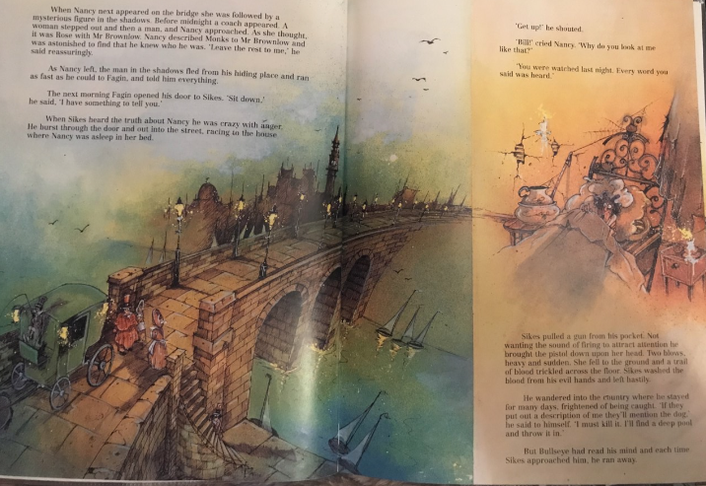

Slide 4
What are similes?
When something is compared to something else usually using as e.g.
Her eyes were as big as saucers.
The candles glowed like miniature stars.
His stomach was as rotund as a barrel

Slide 5
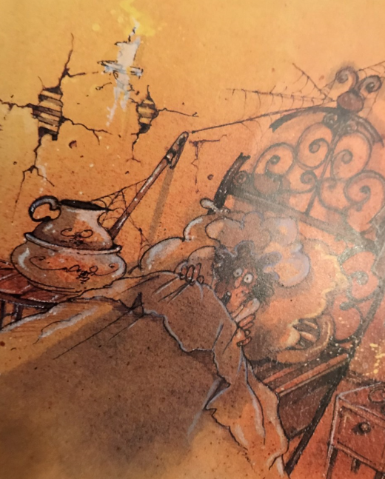
Now it’s your turn

Slide 6
What is personification?
When you use personification you give a noun a human quality e.g. The flames danced in the moonlight.
The cracks slithered across the wall.
Her eyes smiled as she looked across the room.

Slide 7
Now it’s your turn

Slide 8
What is a metaphor?
A metaphor is when you make a direct comparison by saying one thing is something else e.g. The spider webs were lace over her head.
The room was a bomb site.
She had fear in her eyes.

Slide 9
Now it’s your turn

Slide 10
Click on the link below to watch a series of clips from Disney films and see if you can spot the similes and metaphors that they feature.
https://www.youtube.com/watch?v=J4MhnxKGfag

Slide 11
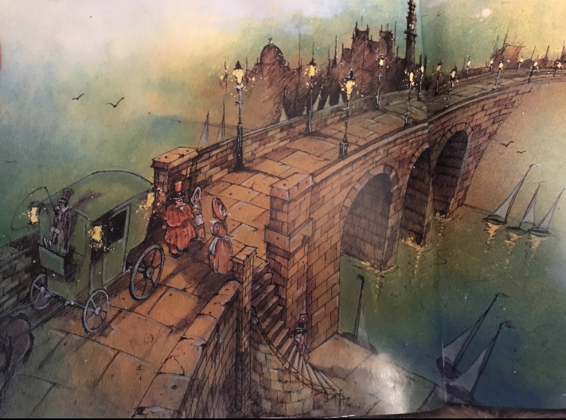

Slide 12
It is a cold, dark night and the moonlight bounces across the rippling water. The boats are bobbing at the water’s edge like ducks which are all in a row. The impressive bridge looms out of the water like it is on stilts. The flames in the street lamps dance in the mild breeze. The paving slabs across the bridge are like a mismatched jigsaw puzzle. Behind the steps, a man hides like a thief in the shadows. The shadows from the arches of the bridge stretch across the rippling waves like a cat waking in front of the fire. The shady towers far beyond the bridge are soldiers standing to attention lit only by the faintest candle light being emitted from the darkened houses. The lamps salute as the gentry and their steeds cross over the far reaching bridge. In the distance, the sails at the port pierce the sky through the clouds.

Slide 13
Challenge 1 – Describe the scene using similes
Challenge 2 – Describe the scene using similes and personification.
Challenge 3 – Describe the scene using similes, personification and metaphors

