Slide 1
Tuesday 9th February 2021
ENGLISH YEAR SIX

Slide 2
L.O. Choose appropriate grammar and vocabulary to write a narrative
Use figurative language (similes, metaphors and personification)
Use relative clauses
Use subordinate clauses
Use dialogue
Use semi colons to mark boundaries between two main clauses
Use emotive language
Expanded noun phrases

Slide 3
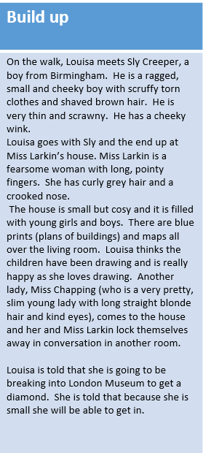
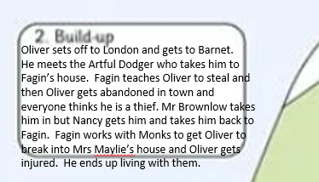

Slide 4
Challenge 1 - use similes, relative clauses, adjectives for description and speech.
Challenge 2 – Use similes, personification, relative clauses, expanded noun phrases, subordinate clauses, speech and emotive language.
Challenge 3 – Use similes, personification, metaphors, relative clauses, expanded noun phrases including prepositional phrases, subordinate clauses, speech and emotive language
Cheeky challenge – Use semi colon to mark boundaries between two main clauses.
Remember, it isn’t all about quantity; your writing needs to be quality.

Slide 5
Louisa, aching and tired, sat down on the side of the room and began to think she had made the wrong decision to leave the workhouse; at least she knew where she was. With her head in her hands, large, bulbous tears began to fall freely from her eyes.
“Alright? How you doing?” came a voice nearby. Louisa looked up and saw a thin, scrawny boy staring down at her with eyes as dark as the night. She gulped and blinked. “I’m called Sly,” the boy smiled. He may have been a slight thing but he had a cheeky twinkle in his eye that made Louisa warm to him. “Hello,” she stuttered, “Are we near Birmingham do you know?”
“Bout half a days walk. Come with me. I’m heading that way anyway.” Louisa stood up slowly and smoothed her scruffy petticoat down. She took his hand and began walking; she didn’t really have any other choice if she wanted to get away.
Several hours and several stops later, Sly pointed at a house nearby, “This is where I am staying. You wanna come in? I am sure they’ll be room for you.” Louisa stayed as quiet as a mouse but nodded; she needed somewhere to stay.
“And who is this?” roared an angry voice.
“Err, Miss Larkin, this is Louisa. She’s fallen on tough times. She could stay here right?” Sly asked with a sparkle in his cheeky eyes.
“Oh you get my every time with that look. Course she can. Hey kid? You got any money?” Miss Larkin asked. Louisa didn’t respond. She was shocked at the woman that stood before her. She was a tower; she must have been at least seven feet tall.

Slide 6
Remote learning tracking
Please click on the link below to let us know you have completed this lesson.
https://forms.office.com/Pages/ResponsePage.aspx?id=eCY4lN73r0G0KV1rDWITzRhTQ2IZqpBOsW8cFVoooF9UNVlMS1dCVkdaM0k0WlhFTE9WVFBTWEg1Ti4u

