Slide 1
Tuesday 19th January 2021
Year 6
English

Slide 2
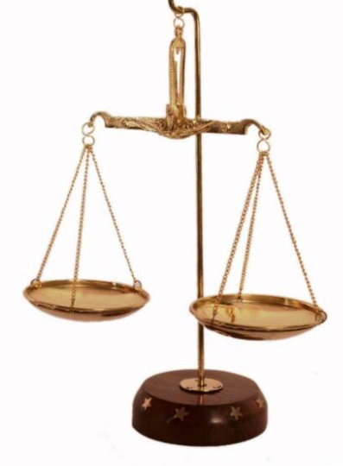
L.O. Choose appropriate grammar and vocabulary to write a balanced argument.
Use contrasting conjunctions e.g whereas, while, However, On the other hand,
Use the language of debate e.g. some people say, it can be argued, On one hand,
Use technical language
Use appropriate structure

Slide 3
What is the purpose of an introduction?
Look at the following three slides and the different introductions I have included.

Slide 4
Should fox hunting be banned?
The recent debate of whether fox hunting should be allowed has caused quite a discussion within the local community. For years, foxes have been threatened by a tradition that involved hunting and killing the creatures for sport. Therefore, as a result of a recent debate, many people are considering that fox hunting should in fact be banned throughout the county. Despite this, there are some people who oppose this opinion and believe it is their right to hunt foxes on their own property. This report will explain both arguments for and against the hunting of foxes for sport.

Slide 5
Should children be allowed to eat chocolate for breakfast?
Breakfast is known as the most important meal of the day; it gives you energy and fuel and therefore powers you for the morning. A decent breakfast should allow you to wake up properly and allow you to function fully in the morning. In supermarkets these days, there are many different options for breakfast. Cereal, toast, yogurts, fruit- all of these items are popular choices for children to start the day with. Having said this, there are some children who would choose a less conventional start to their day- a bar of chocolate. There are arguments for and against the eating of chocolate for breakfast and this balanced argument will examine the opinions for both sides.

Slide 6
Should Dragons be kept as Pets?
Due to their considerable rise in popularity, the practice of keeping dragons as pets has increased causing much debate amongst households around the country. Some people believe that dragons can be a rewarding addition to a family; others, however, are of the opinion that co-habiting with a dragon is detrimental to human health.

Slide 7
Introduction:
identifies what the “issue” or controversy is in a clear way
gives the reader an idea of the main different arguments
identifies why the issue is important/interesting
uses technical language
uses language of debate

Slide 8
Language of debate
Some people believe…
It can be argued that..
It has recently come to light that..
Many people…
This fact…
Those who support…
In the past…
Contrasting conjunctions
On the other hand,..
Whereas…
While..
But…
However,
Key Vocabulary
Workhouse
Victorians
Paupers
Poor
Orphans
Neglect
Homeless
Elderly
Sick
Streets
Gruel
Poor Law Act 1834

Slide 9
Were Victorian workhouses a good idea?
During Victorian times, workhouses were used for paupers who had little or no other choices. They were factory-like buildings which were foreboding to look at. Housing for poor people has been an issue throughout all eras but never more so than in the reign of Queen Victoria. The Poor Law (Amendment) Act of 1834, otherwise known as the 'New' Poor Law, established the workhouse system. Instead of providing a refuge for the elderly, sick and poor and, instead of providing food or clothing in exchange for work in times of high unemployment, workhouses were to become a sort of prison system. It was argued that workhouses were necessary to support the poor and enable them to support themselves. However, it could also be argued that they were no more than prison systems for the poor which victimised those who couldn’t afford clothes, food or any accommodation.

