Slide 1
Year 6 History
Wednesday 3rd March 2021

Slide 2
L.O: Understand the importance of key figures during the Victorian Period.
S.C: Recognise the key figures, their roles and responsibilities and impact.
Recognise their influence on people’s lives especially lives of children.

Slide 3
Recap
Last week we learnt about schooling during the Victorian era. We found out about who had access to schooling during the early part of the Victorian period. Can you remember which children this was?
By the middle of the Victorian era, Ragged schools (1944) were set up so that working children could access education as well as earn money to support their families.
The end of the Victorian Era, all children were able to attend school changing the lives of children forever.

Slide 4
Lord Shaftesbury

Slide 5
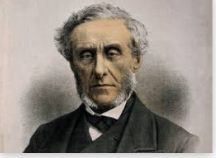
Lord Shaftesbury
Why do you think Lord Shaftesbury was a key figure during the Victorian era?
Use the vocabulary: Factory Act, Mine act, ragged schools, education and poor children in your answer.

Slide 6
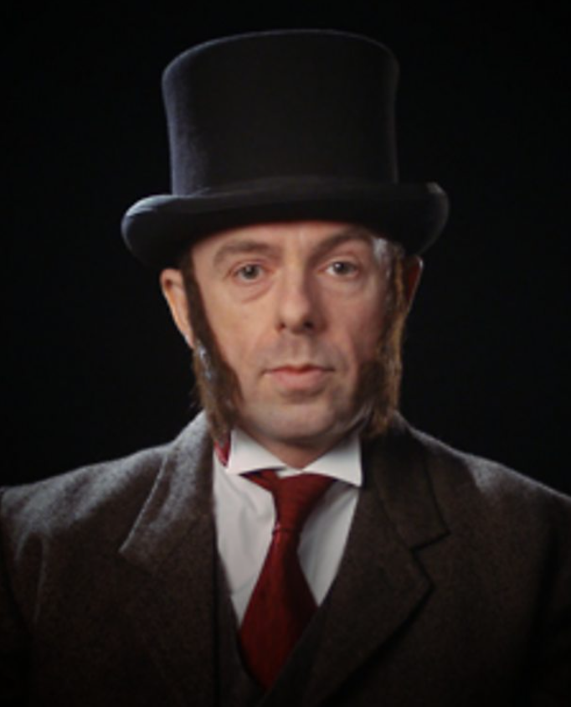
Dr Thomas Barnado
https://www.bbc.co.uk/teach/class-clips-video/true-stories-thomas-barnardo/zky7pg8
Take notes as you watch to support you in writing a biography on Dr Thomas Barnado.

Slide 7
Biography on Dr Thomas Barnado
Introduction.
Thomas John Barnardo, known as Dr Barnardo, was the founder of many homes for poor children and started the charity Barnardos. From the time of his first home in 1870 until his death in 1905, Dr Barnardo helped nearly 100,000 children. Dr Thomas John Barnardo was one of the most significant and important people in the Victoria era and he is well known to this day for the work he did with Victorian children to rescue them, train them and give them better lives.
Early life.
Thomas Barnado was born on 4th July, 1845 in Dublin, Ireland. He was the fourth of five children in the family.
Education.
From an early age, Thomas wanted to become a medical missionary. Age the age of 16 he moved to London to begin his studies.
Working life (Ragged schools and children’s homes).
Impact.
Legacy.

Slide 8
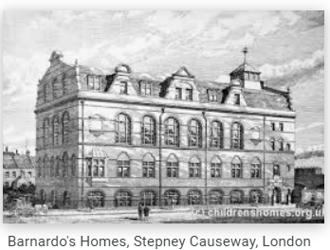
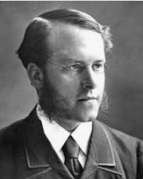
Website support for biography
https://kidskonnect.com/people/dr-barnardo/
https://www.barnardos.org.uk/who-we-are/our-history
https://www.bbc.co.uk/teach/class-clips-video/true-stories-thomas-barnardo/zky7pg8

Slide 9
Challenges
Challenge 1-Write facts on Dr Thomas Barnado including information on his early life, education and achievements.
Challenge 2-Write a biography on Dr Thomas Barnado including early life, education, working life, impact and legacy.
Challenge 3-Write a biography on Dr Thomas Barnado including early life, education, working life, impact on lives of Children and legacy including examples of work by Barnado’s charity.

Slide 10
Barnados fundraising event
When we are all back in school, we thought you might like to organise a fundraising event to support Barnado’s. Have a look at their website and think of some ideas.
https://www.barnardos.org.uk/fundraising-education

Slide 11
Remote learning tracking
Please follow the link below so that we can track who is accessing online PowerPoint learning.
https://forms.office.com/Pages/ResponsePage.aspx?id=eCY4lN73r0G0KV1rDWITzRhTQ2IZqpBOsW8cFVoooF9UNVlMS1dCVkdaM0k0WlhFTE9WVFBTWEg1Ti4u

