Slide 1
Year 6 Maths
Wednesday 27th January 2021.

Slide 2
27.01.2021
L.O: Calculate ratio.
S.C: Build upon knowledge of ratio.
Use the key phrase ‘For every… there are…’ to find both the part and the whole.
Use visuals to support comparing quantities.

Slide 3
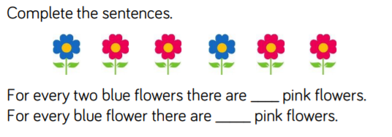
Recap on ratio-describes the relationship between two values and how one is related to another. We can recognise and use the ratio symbol which is a : We also need to learn to use the phrase ‘for every…there are…’ when comparing quantities. We need to calculate the part and whole.
4
2
A gardener plants some flowers in the garden.
For every 1 blue flower there are 2 pink flowers.
She plants 4 blue flowers. How many pink flowers does she plant?
How many flowers are planted in total?

Slide 4
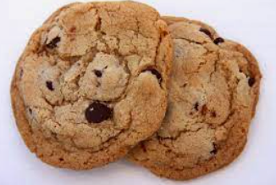
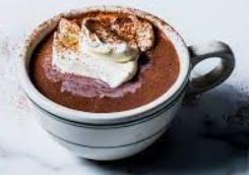
Ratio (:) :
For every 2 cookies there is 1 hot chocolate.
If there are 6 cookies, how many hot chocolates are there?
2:1
4:2
6:3
There are 6 cookies for every 3 hot chocolates.

Slide 5
Ratio (:)
For every 4 carrots there are 2 leeks. 4:2
4x12=48 carrots
2x12=24 leeks
48:24
24 leeks were planted.
48 + 24=72 vegetables planted in total.

Slide 6
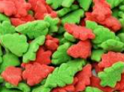
Rehearsal question:
Freddy has a packet of sweets.
For every 3 red sweets there are 2 green sweets.
Freddy has 12 red sweets. How many green sweets does he have?

Slide 7
Rehearsal question answer:
Freddy has a packet of sweets.
For every 3 red sweets there are 2 green sweets.
Freddy has 12 red sweets. How many green sweets does he have?
3:2
6:4
9:6
12:8.
He has 8 green sweets.

Slide 8
Challenge 1
1.
2.
3.

Slide 9
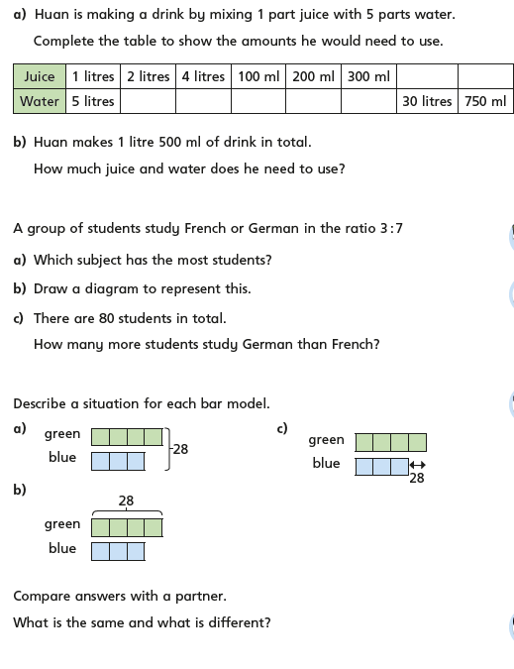
Challenge 2
3.
1.
4.
2.
3.
5.

Slide 10
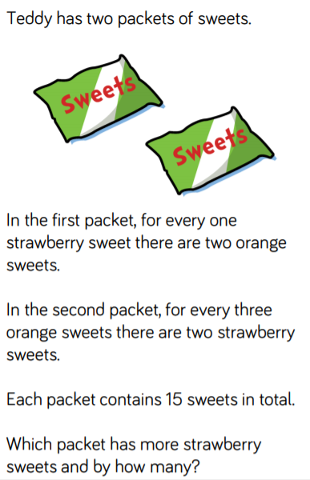
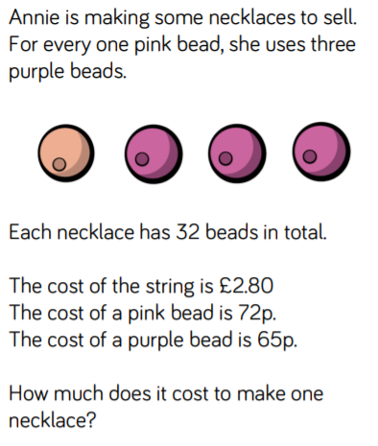
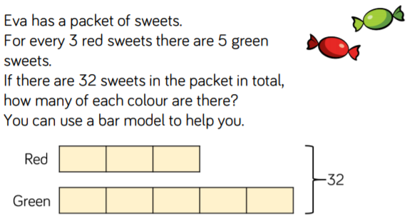
Additional challenges
Create your own ratio questions based on these ones for a friend or family member to answer.

Slide 11
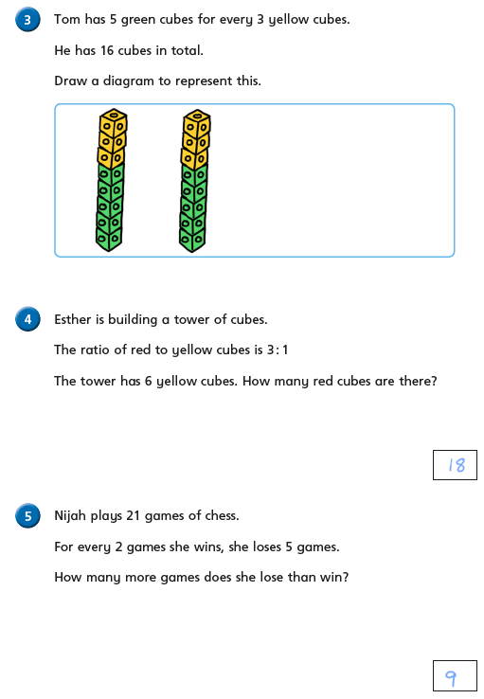
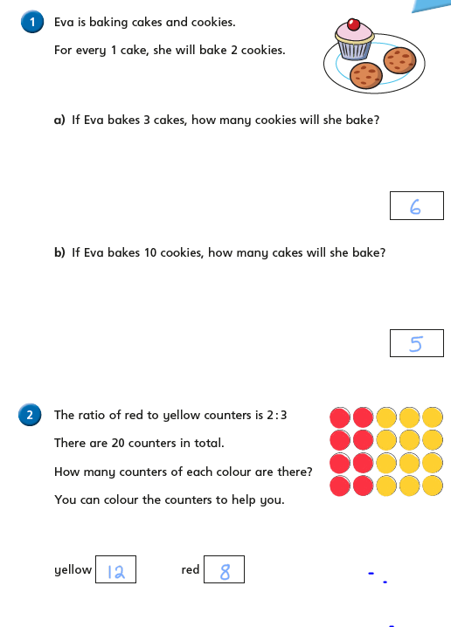
Answers-Challenge 1
1.

Slide 12
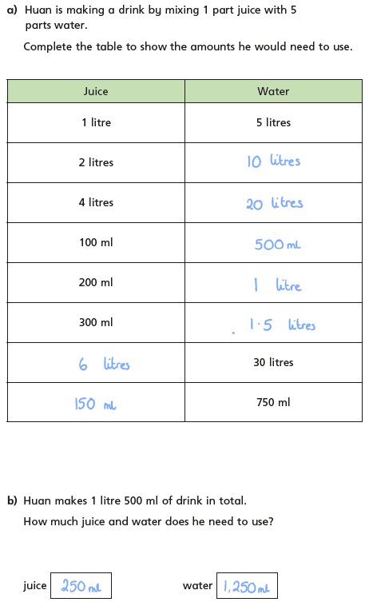
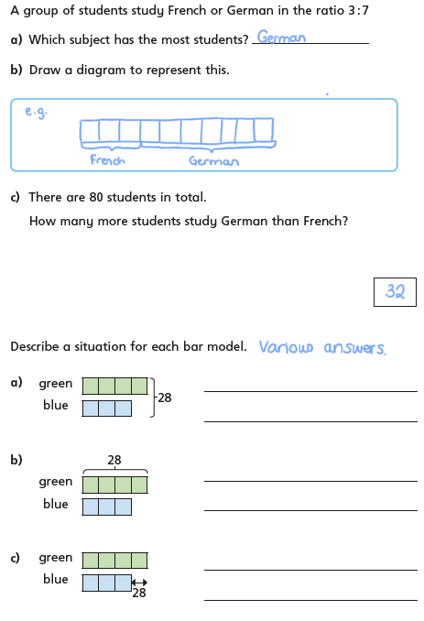
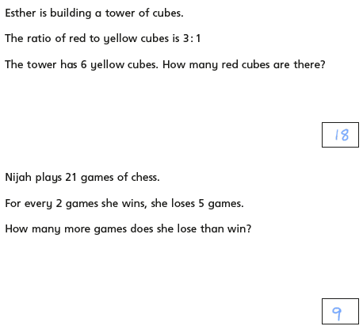
Answers-Challenge 2
3.
4.
1.
3.
5.
2.
4.

Slide 13
Remember to complete your daily 8 and practise your times tables on TTRS. Can you make the top 10 this week?

