Slide 1
Year 6 Maths
29.01.2021

Slide 2
29.01.2021
L.O: Multiply 2 digits by 2 digits.
S.C: Recall methods taught in the Autumn term.
Use mental methods.
Use the grid, compact and expanded method.

Slide 3
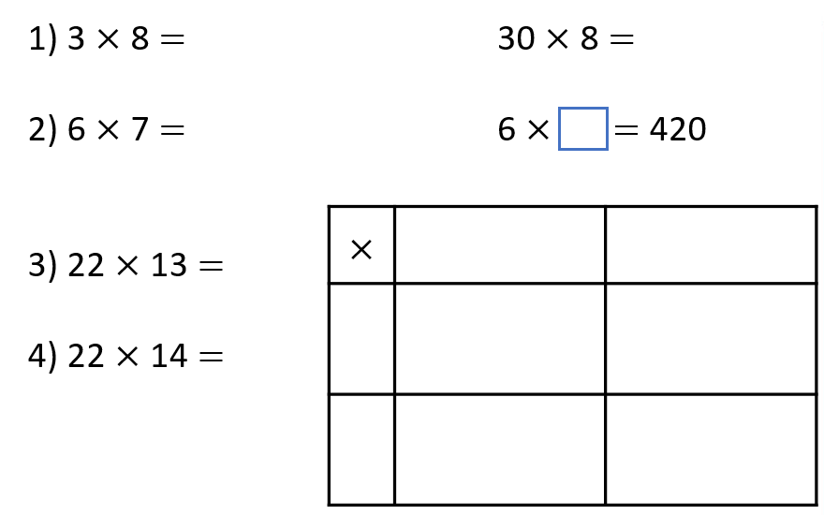
Mental oral starter

Slide 4
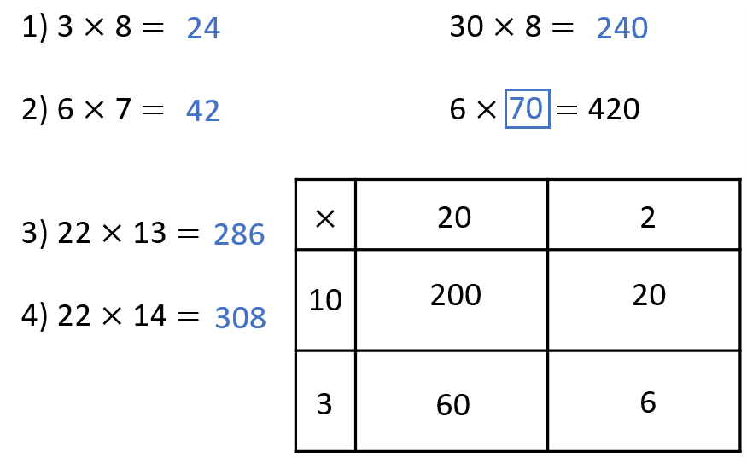
Mental oral answers.

Slide 5
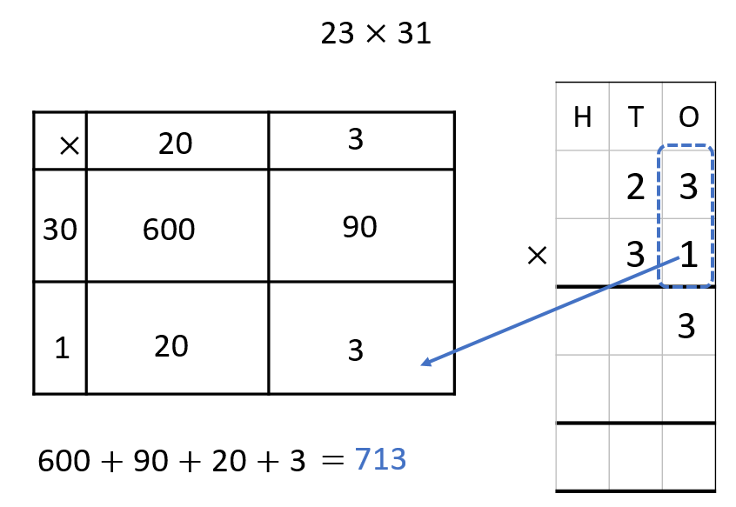
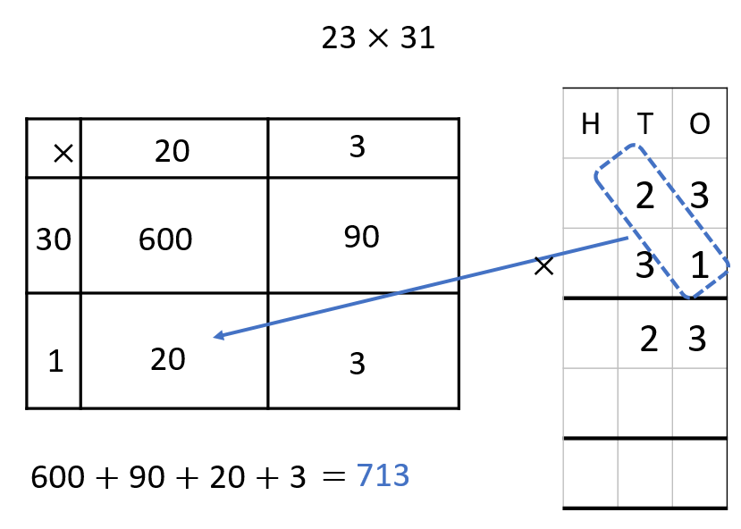
Formal methods

Slide 6
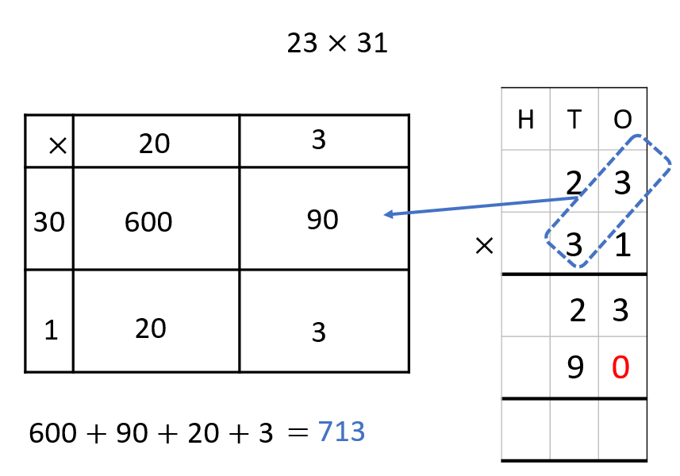
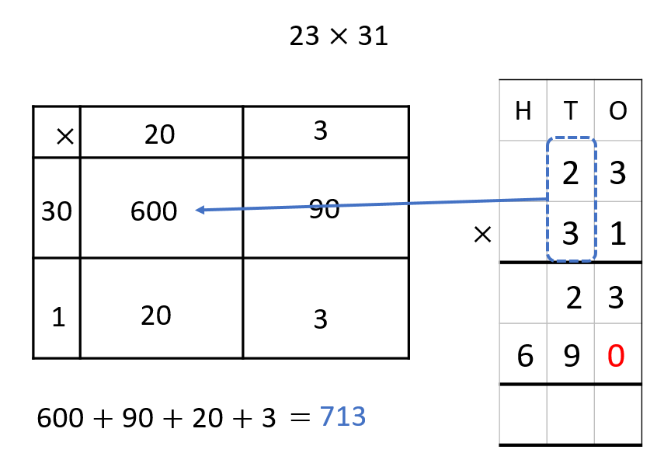
Formal methods

Slide 7
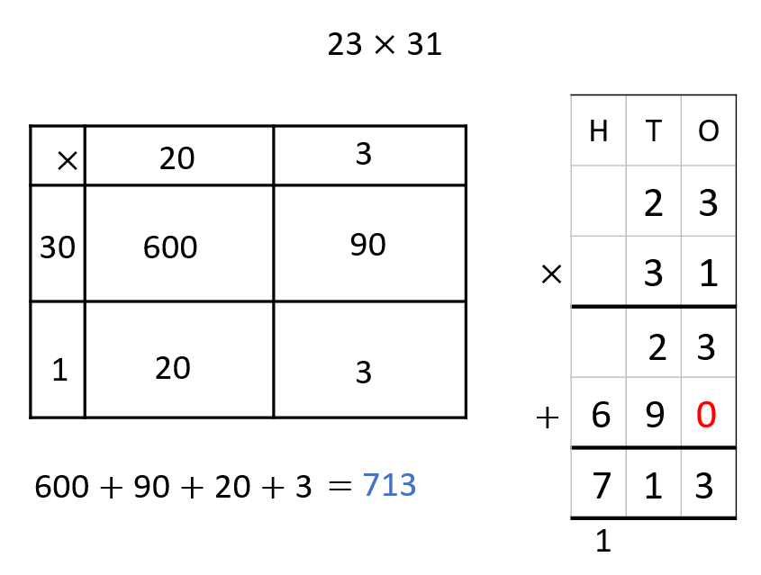
Formal methods

Slide 8
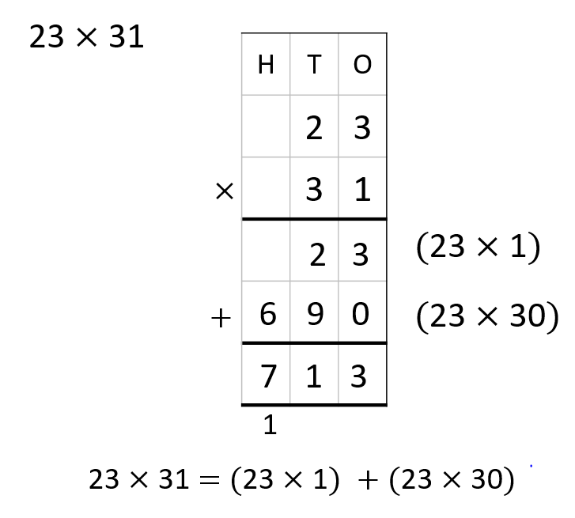
Formal methods

Slide 9
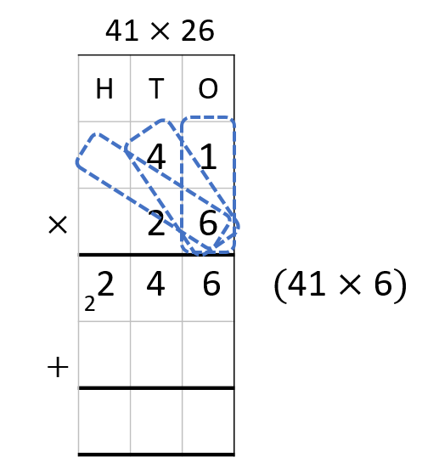
Rehearsal question:

Slide 10
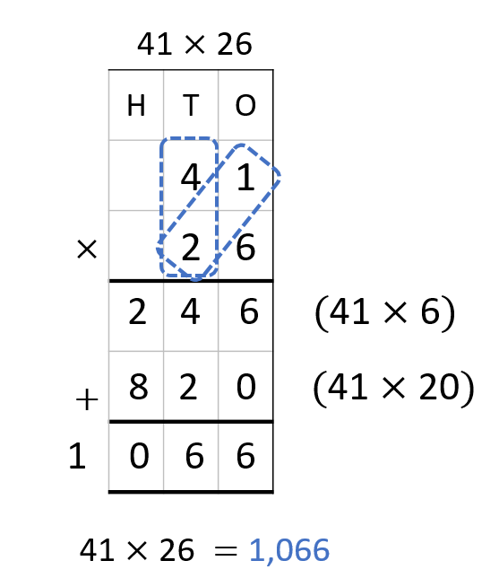
Rehearsal question answers:

Slide 11
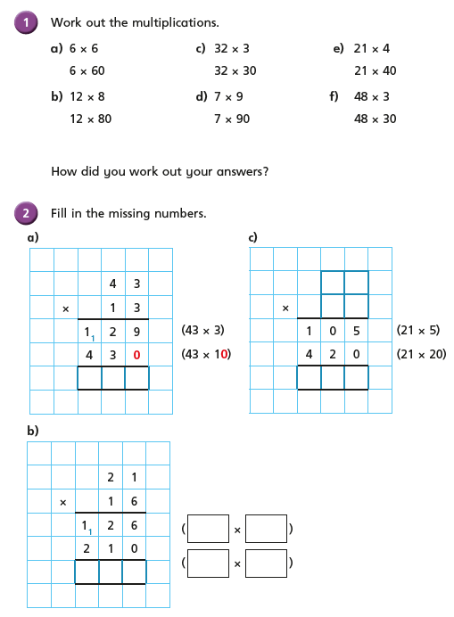
Challenge 1

Slide 12
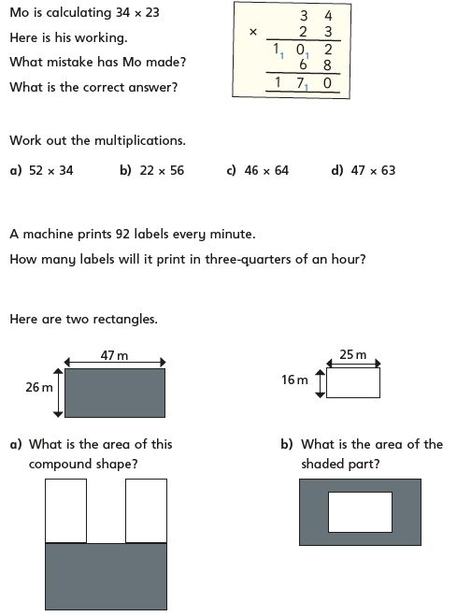
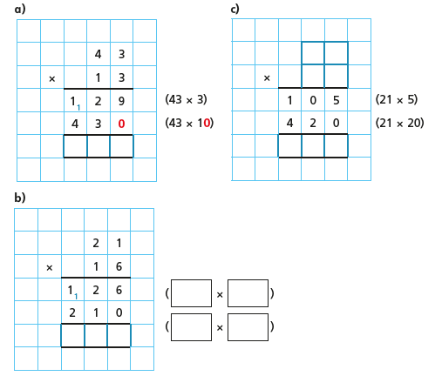
Challenge 2
2
1
3
4
5

Slide 13
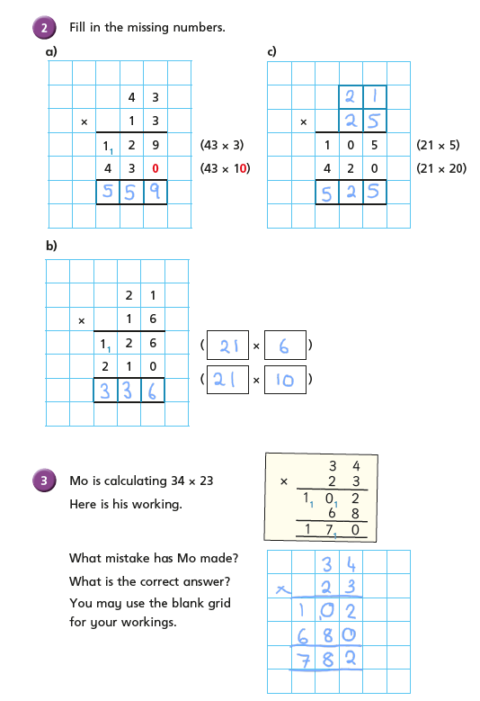
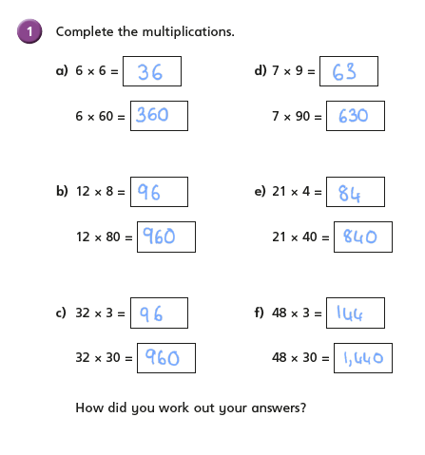
Challenge 1 answers

Slide 14
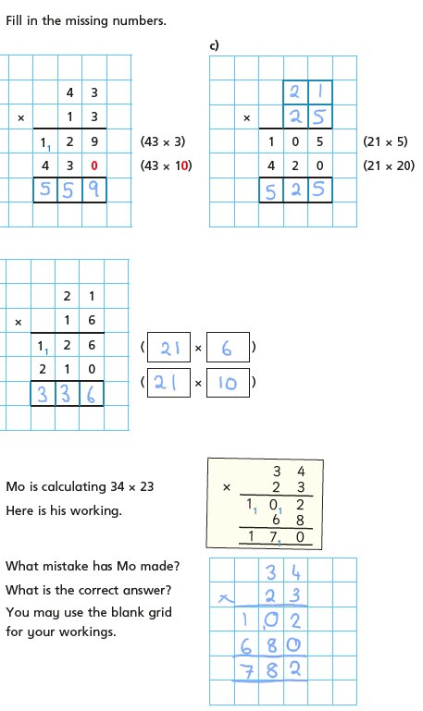
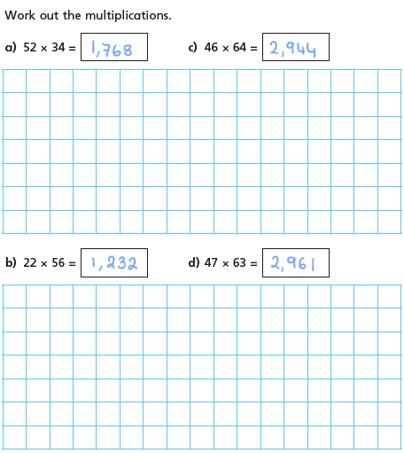
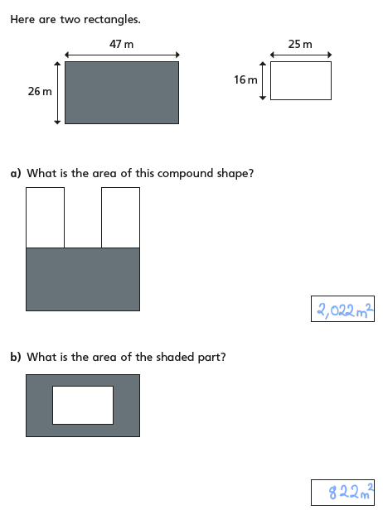
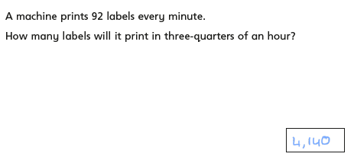
Challenge 2 answers
1
3
5
2
4

Slide 15
Remember to complete your Daily 8 and battle you friends on Times Tables Rock Stars.

