Slide 1
PSHE
Tuesday 2nd February 2021.

Slide 2
PSHE Lesson 4-Rights and Responsibilities.
L.O: Understand why rules and laws are needed in society.
S.C:
Know that rules and laws are there to keep people safe.
Explain some of the rules and laws we have in this country and who is responsible for making and enforcing these.
Know some legal ages for certain responsibilities and the reasons for these.
Know that there are consequences to breaking the law/rules.
Explain the role of influence on others and how you can have a positive influence on others.

Slide 3
Rules for keeping you safe.
Last week we discussed school rules. Today we are going to begin by thinking about the rules you might follow to keep yourselves and others safe when using the roads as pedestrians.
These could include:
Staying on the pavement unless you are crossing the road,
Finding a safe space to cross the road,
Being aware of your surroundings.
Make a note of any of your own rules. Remember rules are to keep you safe. Everyone has the right to feel safe.

Slide 4
Laws
Can you think of any laws that affect us in society?
There are laws about many things including:
Driving,
Stealing,
Vandalism,
Attending school,
Drinking alcohol,
Violence.
These laws are made in Parliament by Members of Parliament (MPs) who are elected by the public. People over the age of 18 have the right to vote.
If someone wasn’t respecting a law, who would enforce the law?

Slide 5
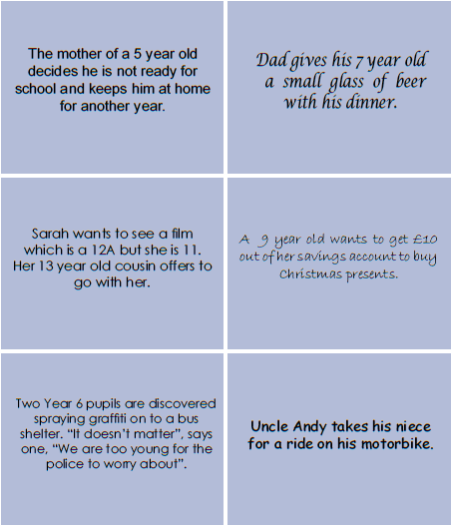
Legal or illegal?
Look at the scenario cards. Has the adult in the situation acted legally (followed the law) or illegally (not followed the law)? How do you feel about these laws? What is your opinion? Are the laws keeping people safe?

Slide 6
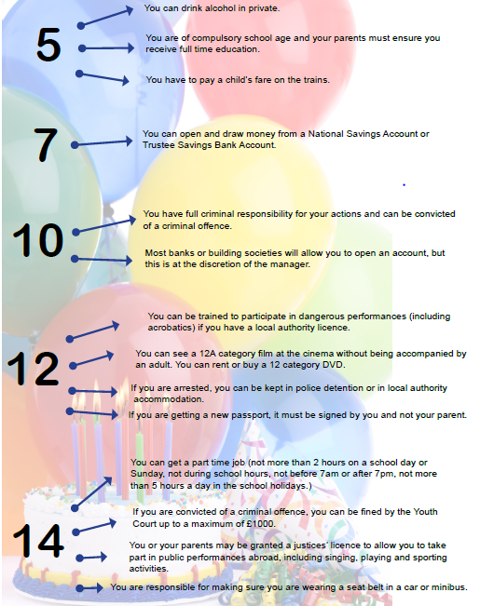
Legal ages
Read through the legal ages.
Do you agree with them? Why?
Why not?
Are there any that surprise you?

Slide 7
Rules and laws.
We are now going to think about rules and laws in our school context.
Challenge 1-Think about a rule that has been broken by a child at school. Put yourself in their position and write about the reasons for rule breaking as well as the consequences. Was this person influenced by others? How could you have a positive influence on others?
Challenge 2- As challenge 1 but link to a law.
This is a scenario that I have made up:
A child in school has been physical towards another child. I believe the reason they were physical was because they were so wound up that they just couldn’t control themselves. They let their emotions take hold and their fists lash out. This person has seen other people being physical with each other and has heard other people cheering them on. The consequences of this behaviour could be to miss breaks and to have to work in isolation. This person was influenced by others showing the same behaviour and people encouraging them. Being involved in violence could lead to you getting in trouble with the police. At the age of 10 you are responsible for your own behaviour.
I could have a positive influence on others by following the rules and laws in school. This will help keep everyone safe and help others know how to behaviour.

