Slide 1
Make up
High expectations
High respect

Slide 2
Do you wear it to fit in with your friends?
Do you wear make-up to impress people you like?
A question you can ask a variety of people including adults:
Who do you wear make-up for?
So why do we wear make-up?
Or is it worn for yourself?
Is it worn because it’s required to get a job?
Notes:
It may sound like a simple question but the implications are greater than what you would expect. Of course, there is no simple answer.

Slide 3
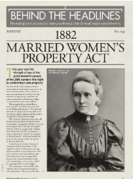
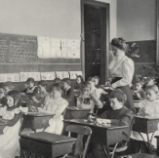
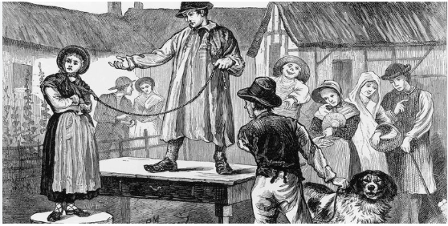
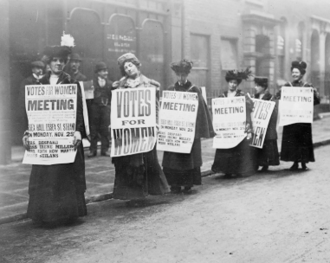
Where does make- up come from?
Previously in history:
Women were deemed second class citizens to men.
Women were considered the property of men.
Girls were rarely educated to the same level as boys until the Education act.
Professions or roles that provided money or power were banned for women.
If a woman wanted money, she had to ask her husband or her father.
They had fewer rights and were not allowed to vote.

Slide 4
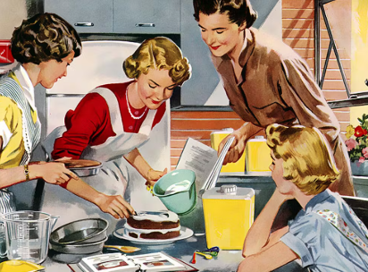
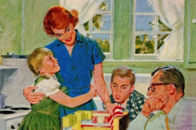
So what was expected of women?
Where does make- up come from?
A woman’s purpose:
Their chief role was as wives and mothers.
For a long time, this was the aspiration for women.
There was a lot of pressure to find a good husband and be a good wife.
They were expected to be passive, gentle and caring, and often valued for how they looked and not what they did.
Play the role of accessories or commodities to complement men.
Because of this, women put their efforts into their appearance. Beauty meant survival and a nice life. As second class citizens, this was the only way.

Slide 5
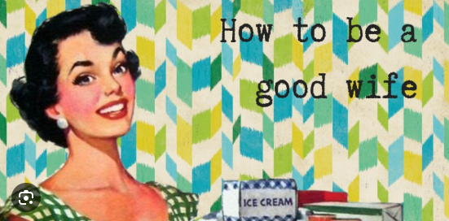
Throughout history, beauty was a form of self-advertisement to achieve this aspiration. Women would promote themselves by embellishing their physical features...especially by wearing make-up!
Where does make- up come from?

Slide 6
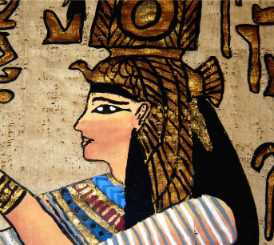
Example from history
The first traces of make-up in Ancient Egypt.
Worn for various purposes.
Khol around the eyes to deflect the sun in the desert.
Believed to ward off the evil eye.
Enhance their lip colour with pigment to show good health to be a good wife.

Slide 7
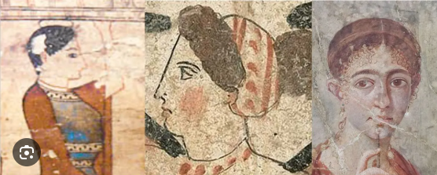
Example from history
In Ancient Greece, it became the fashion for flushed cheeks.
Again, it showed good health to make a good wife.

Slide 8
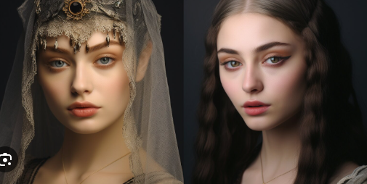
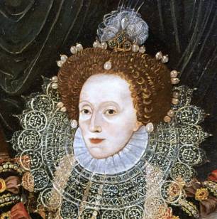
Example from history
In the Middle Ages, make-up was also used to show social class and status.
Lower class women used dark colours.
Higher class women would use ceruse powder to make their skin pale.
Again, fair skin was a sign of good health…which is funny because ceruse was made out of lead powder known to cause muscle paralysis and early DEATH!

Slide 9
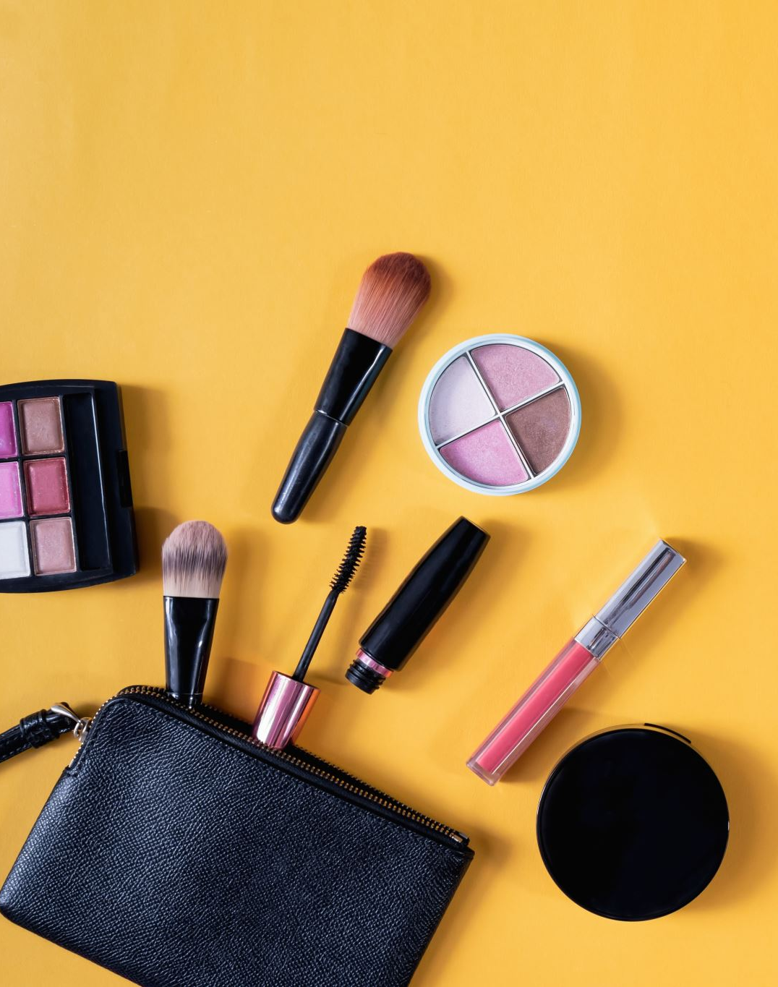
Make-up today
Trends change faster.
The cosmetics industry is HUGE!
It is more accessible than ever.
People of all ages and classes can wear make-up.
Groups of people can use make-up to express themselves and symbolise their subculture e.g. Goth.
A great presence on social media. Anyone can promote or post about it. Fashion lover, make-up artist, influencer…
There are tutorials online and on socials they are also readily available.
Used to create art.
Make-up is used more by all genders.
It is important to think about how much has the message of beauty and female status changed? What is make-up for today? How does it affect us?

Slide 10
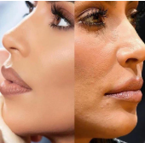
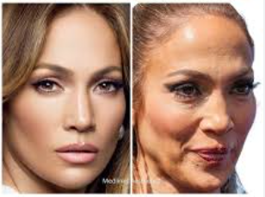
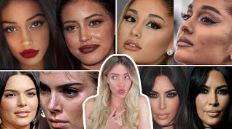
Social media dangerous examples:
Filters, software, airbrushing, photo shop that change the reality of a photo – nothing is real which means the standards of beauty are UNACHIEVEABLE.
The pursuit of ‘perfect skin’ can fuel perfectionist tendencies. There is no such thing!

Slide 11
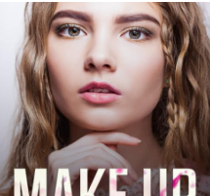
Impact on children today
If make-up was originally worn to help find a ‘good husband’, is it appropriate for children?
Children are concerned with beauty from an earlier age than ever before.
Major consequences on the development of identity.
Research says that if a child is worried about beauty at the age of 8, they often grow into teenagers that define themselves based on their looks.
This links to low self-worth and self-confidence.
This can cause mental illness such as eating disorders, depression and anxiety.
Social media and mass media still seem to advertise the same ideal of beauty which creates a huge amount of pressure.

Slide 12
Why we have make-up rules:
As teachers, we don’t just learn how to teach a subject. It is part of our job to look after and support the well-being of children and young people.
The use of make-up throughout history shows the concern of it being appropriate for children.
We are aware of the mental health risks the beauty industry poses for children at our school. We know the research. This is WHY we know best.
We aim to create a safe space and focus on the development of your confidence WITHOUT relying on make-up.
We care. We want you to be inspired, empowered and successful and this is not be based on your looks.
We’ve been in your position and we have experience to know this will help you.

Slide 13
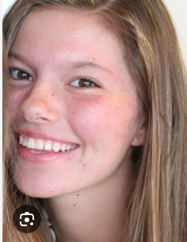
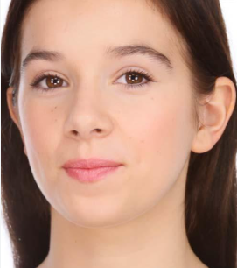
KMS expectations:
No eye make-up.
No lip make-up.
No eyebrow make-up.
We appreciate that there will always be an element of self-confidence with teenage skin which is why we will allow:
A light coverage of foundation or tinted moisturiser.
Minimal use of concealer.
Lip balm.
Make-up must appear natural.
We should not notice it

