Slide 1
RSHE information evening
Mrs Johnson
Please click here to see the video version of this presentation

Slide 2
Definitions
RSHE: Relationships education, relationships and sex education and health education.
Health education: Physical health and mental wellbeing.
Relationships education: The physical, social, legal and emotional aspects of human relationships including friendships, family life and relationships with other children and adults.
Sex education: There is no agreed definition in the new RSHE guidance. In our policy the definition of sex education is ‘how a baby is conceived and born’ (reproduction and birth).
RSE: Relationships and sex education.
PSHCE: Personal, Social, Health, Citizenship and Economic (PSHCE) education.

Slide 3
Relationships, Sex and Health Education
RSHE is taught as part of our PSHCE curriculum.
We want all children to grow up healthy, happy, safe, and able to manage the challenges and opportunities of modern Britain. Teaching children Relationships, Sex and Health Education (RSHE) is a key part of this process. These subjects are designed to equip your child with knowledge to make informed decisions about their wellbeing, health and relationships as well as preparing them for a successful adult life.
We have always taught RSHE at Kirkburton however our curriculum has been updated in line with the recent changes nationally. Please see below for more information about RSHE and some examples of the content covered in school.

Slide 4
By the end of primary school, pupils will have been taught content on:
Relationships Education:
Families and people who care for me
Caring friendships
Respectful relationships
Online relationships
Being safe
Health Education:
Mental wellbeing
Internet safety and harms
Physical health and fitness
Healthy eating
Facts and risks associated with drugs,
alcohol and tobacco
Health and prevention
Basic first aid
Changing adolescent body

Slide 5
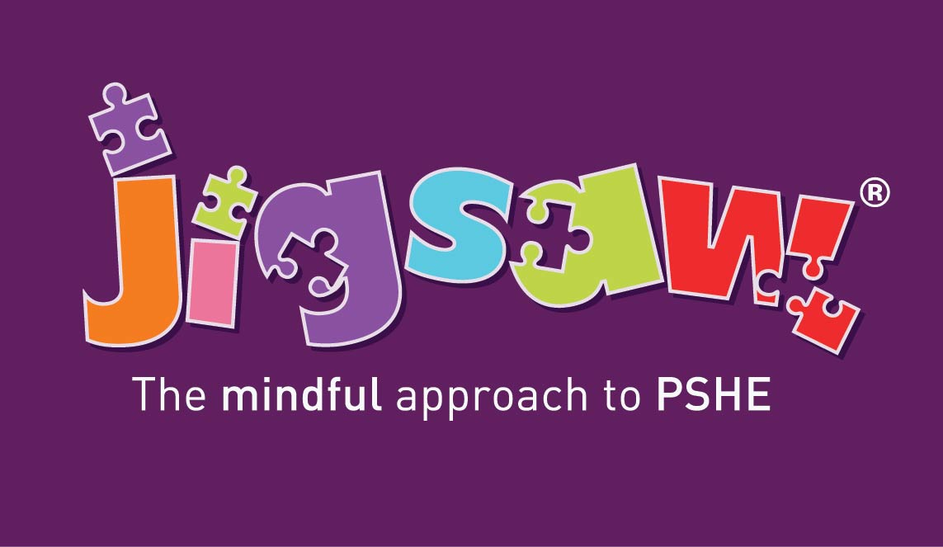
Y6 Sex Education
Be aware of my own self-image and how my body image fits into that
Know how to develop my own self esteem
Describe how a baby develops from conception through the 9 months of pregnancy, and how it is born
Recognise how I feel when I reflect on the development and birth of a baby
Explain how girls’ and boys’ bodies change during puberty and understand the importance of looking after myself physically and emotionally.
Express how I feel about the changes that will happen to me during puberty.

Slide 6
By the end of secondary school, pupils will have been taught content on:
Relationships and Sex Education:
Families
Respectful relationships, including Friendships
Online media
Being safe
Intimate and sexual relationships, Including sexual health
Health Education:
Mental wellbeing
Internet safety and harms
Physical health and fitness
Healthy eating
Drugs, alcohol and tobacco
Health and prevention
Basic first aid
Changing adolescent body

Slide 7
When will RSHE be taught?
Newsletter
Website

Slide 10
Signposting

