Slide 1

Year 6 SATs 2026 Presentation for Parents, Carers & Guardians

Slide 2
SATs week
11th – 14th May 2026
All tests will be done in the mornings of this week. If pupils are absent on the morning of a particular test, we can conduct it later, but the child will need to be isolated from their peers to maintain the integrity of the test until all pupils have completed it.

Slide 3
Monday 11th English SPaG
(Paper 1 punctuation and grammar 45 minutes)
(paper 2 spellings 15 minutes)
Tuesday 12th English reading
(1hour including reading time)

Slide 4
National Standards
There is no SAT English writing paper; the standard of a pupil’s writing is assessed by the teacher on their work throughout the year and reported to the DfE in late June.
They will be given one of three judgements:
Working towards the expected standard;
Meeting the expected standard;
Working at greater depth in the expected
standard.

Slide 5
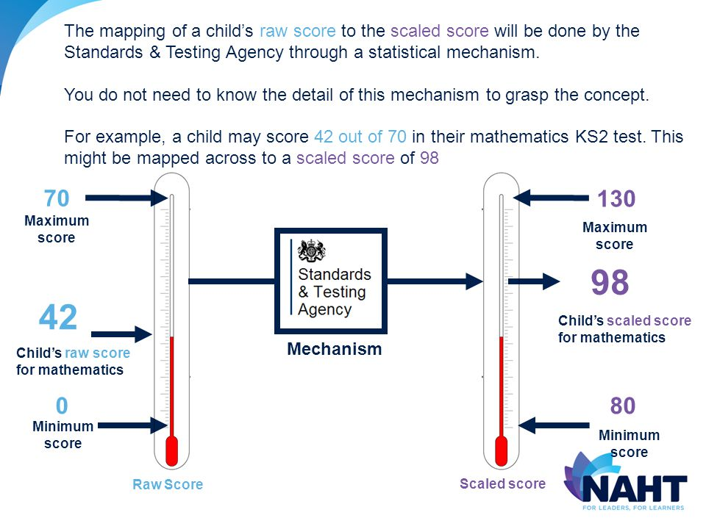
How the tests are reported:
After the tests are marked, in early July the results come back into school.
The marks on each paper are combined to give a raw score this is then converted into a scaled score between 80 -120
120.

Slide 6
KS2 ENGLISH SATs
2026

Slide 7




What will be assessed?
Reading paper with 3 different texts that could be any combination of:
- Fiction
- Non-fiction
- Poetry
- Older literature
I hour

Slide 8
Expected Standard (EXS - Scaled Score 100): Raw Score 28/50 (56%).
Greater Depth Standard (GDS - Scaled Score 110): Raw Score 40/50 (80%)

Slide 9

The reading paper focuses on:
Understanding vocabulary in context
Retrieval of information / key details
Summarising
Making inferences and justifying these with evidence
Predictions
Explain meaning of text
Explain effect of language choices
Make comparisons.

Slide 10
Answering the questions:
Multiple choice questions
One word / phrase answers (find and copy)
Matching
Explanations requiring evidence

Slide 11
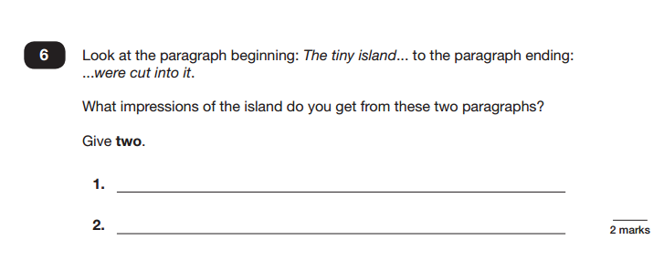
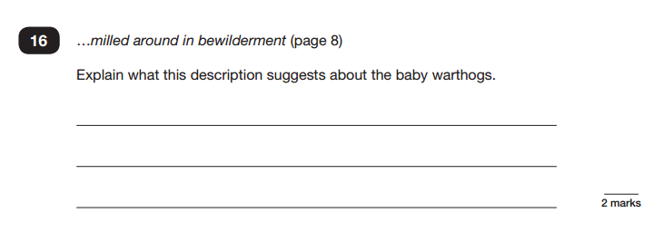

Making inferences (up to 50%)

Slide 12
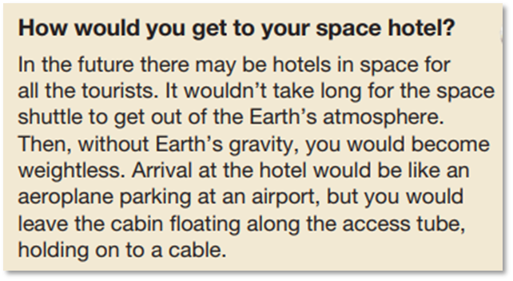
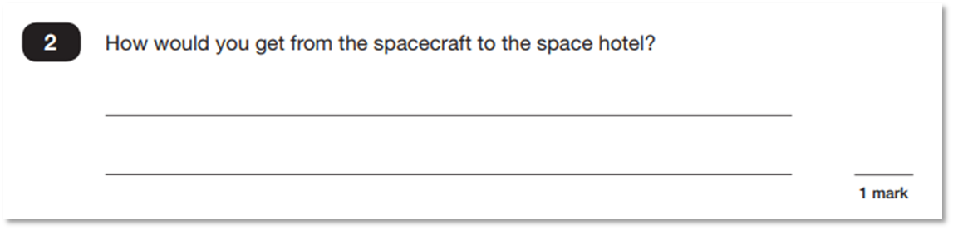
Retrieval questions (42% in 2019)

Slide 13
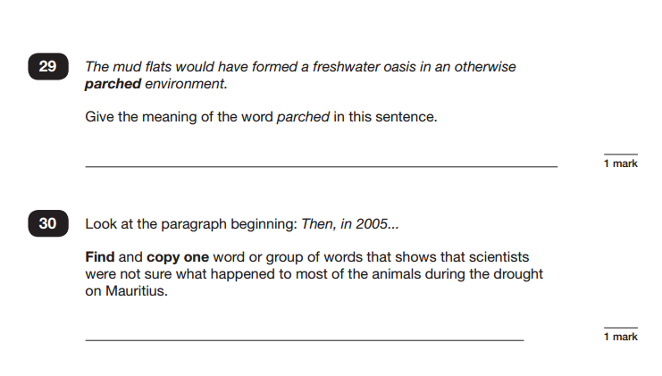
In the last few years, up to 20% of marks focused on explaining the meaning of words in context.

Slide 14
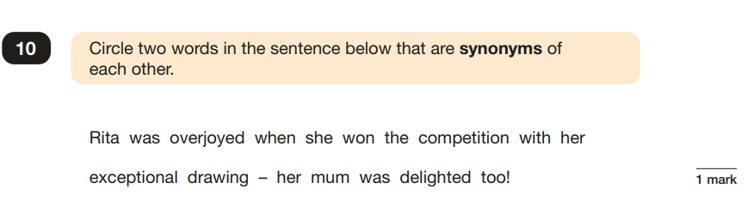
Reading The Questions Carefully
0
At home, asking your child to read things to you can help process words and instructions.

Slide 15
How can you help at home?
Read for pleasure from a wide range of texts (including challenging older literature).
Discuss the meaning of new vocabulary / can you find a word meaning?
Practise scanning - find it quickly.
Ask searching inference questions (how do you know?).
Build reading stamina.
Make it enjoyable.

Slide 16
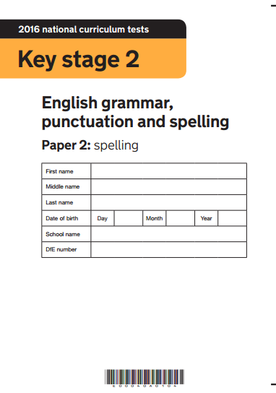
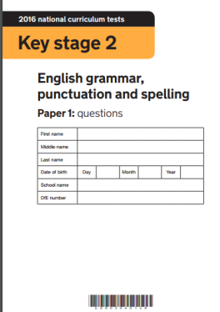
What will be assessed?
SPaG
Paper 1 short answer questions
Paper 2 spelling

Slide 17
Grammar, Punctuation and Spelling (Paper 1) focuses on the following areas:
- Grammatical terms/word classes;
- Functions of sentences;
- Combining words, phrases and clauses;
- Verb forms, tenses and consistency;
- Punctuation;
- Vocabulary;
- Standard English and formality.

Slide 18
In 2025 the threshold for the expected standard was 35/70 (50%) which was the same as the previous year.
The threshold for working at greater depth was 53/70 (75%) which was also the same as the previous year.

Slide 19
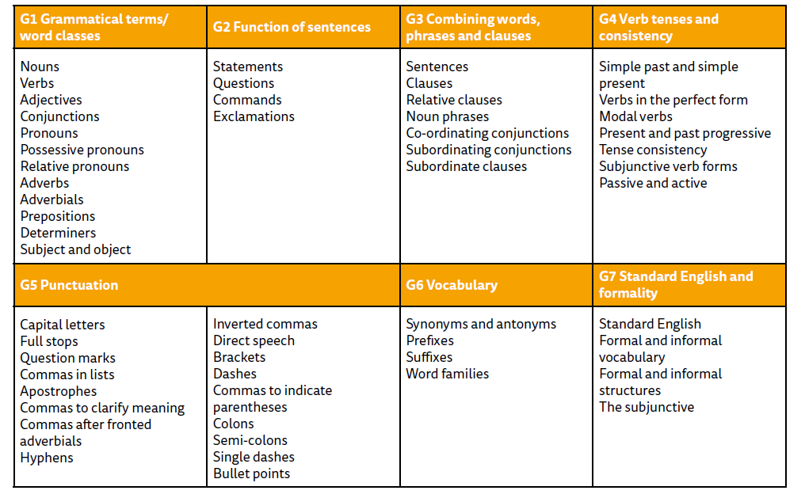
Terminology

Slide 20
ACCURACY and Challenge
Many pupils lost marks because they did not read the question, circle or underline, or tick the correct number of boxes.
There is a strong emphasis on accuracy.
Pupils lost marks for not starting a
sentence with capital letter, failing to
put a full stop, inaccurate
spelling and formation and size of , ;.
Notes:
Questions presented in order of difficulty

Slide 21
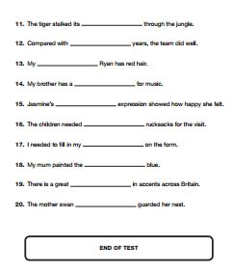
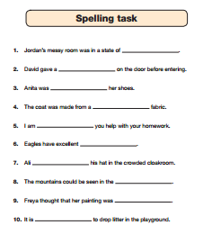
And finally…

Slide 22
2025 words
knight
through
rewarded
adventure
developed
explosion
passed
scene
affordable
suggestion
angrily
alteration
reindeer
residential
anchor
plaque
jealousy
flourish
disappointed
receiving

Slide 23
2024 words
young
island
famous
texture
social
replacing
symbol
increase
examination
frequently
vein
league
chaos
queue
solution
reluctance
memorable
persuasion
referring
nutritious

Slide 24
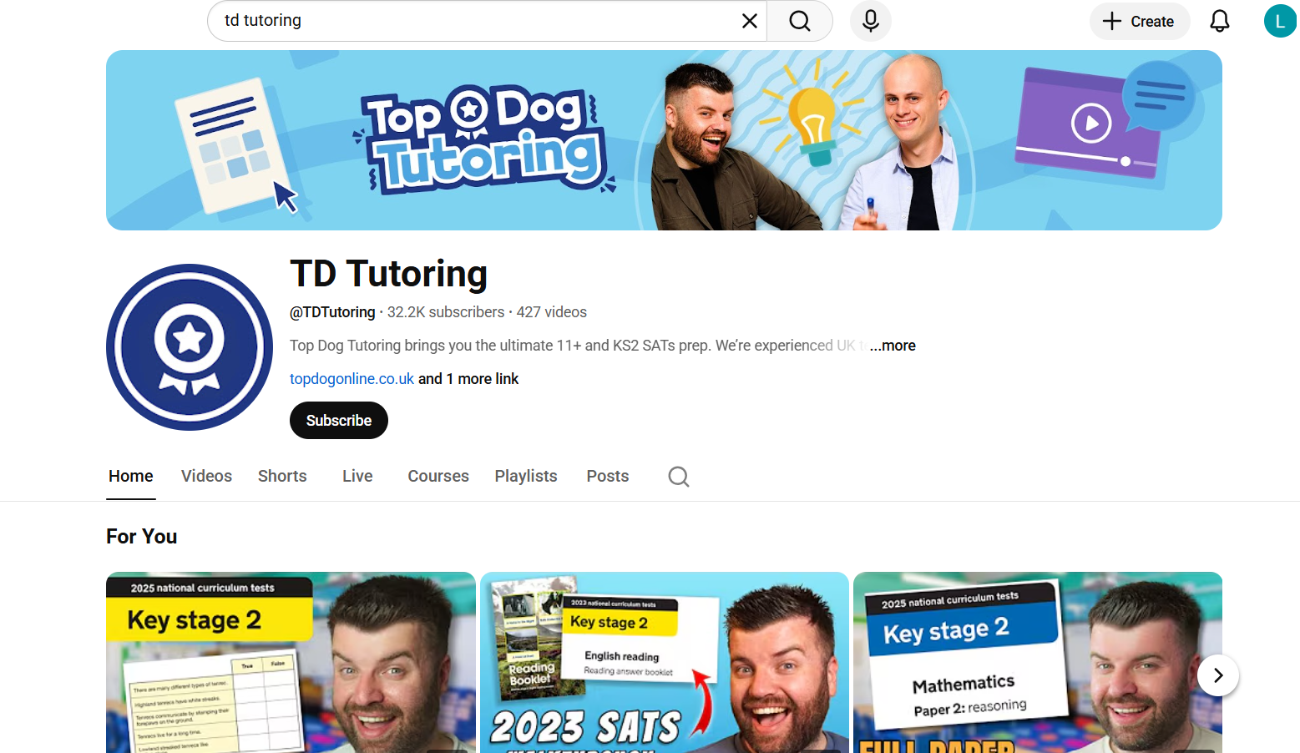
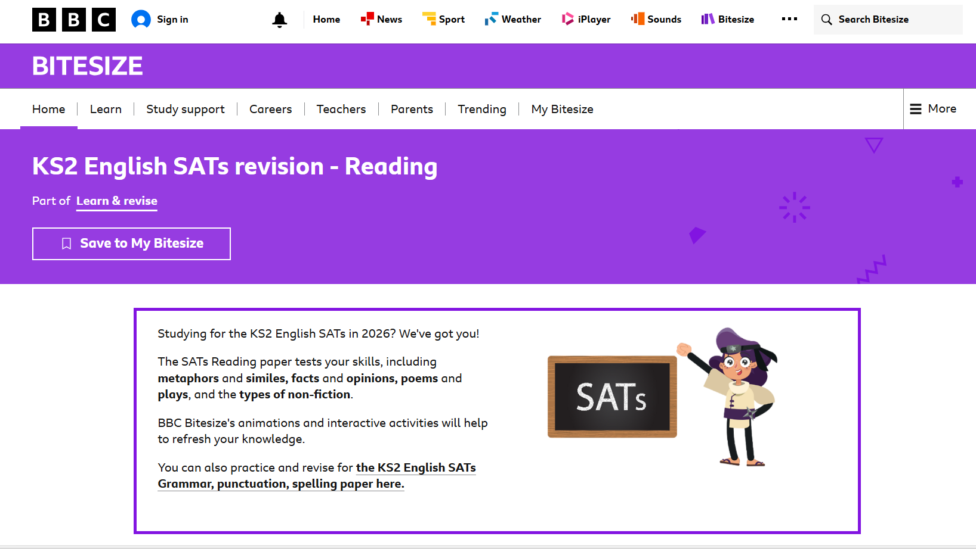
Resources
YouTube: TD Tutoring
BBC Bitesize: SATS Revision

Slide 25
This evening: preparing to support your child
Please do NOT use past papers at home.
Managing homework
Encouraging your child to read
Completing additional SATS revision through booklets
YouTube resources
Reducing stress and pressure

Slide 26
What are the SATs?
SATs are the Standardised Assessment Tests that are given to children at the end of Key Stage 2.
The SATs papers consist of in Maths:
  Maths (paper 1: Arithmetic)
  Maths (paper 2: Reasoning)
  Maths (paper 3: Reasoning)
Notes:
Note that there are no science assessments this academic year (including sampling tests).

Slide 27
When and how the SATs are completed
The tests take place during normal school hours, under exam conditions.
Children are not allowed to talk to each other from the moment the assessments are handed out until they are collected at the end of the test.
After the tests are completed, the papers are sent away to be marked externally.
The results are then sent to the school in July.
Each test lasts no longer than 40 minutes:
  Maths (paper 1: Arithmetic) – 30 minutes
  Maths (paper 2: Reasoning) – 40 minutes
  Maths (paper 3: Reasoning) – 40 minutes

Slide 28
Specific arrangements for SATs
Children with additional needs (who have similar support as part of day-to-day learning in school) may be allotted specific arrangements, including:
Additional (extra) time;
Tests being opened early to be modified;
An adult to scribe (write) for them;
Using word processors independently;
An adult to read for them (including a translator);
The use of prompts or rest breaks;
Arrangements for children who are ill or injured at the time of the tests.
Pupils with an EHCP are automatically allowed up to 25% additional time (except for the spelling paper, which is not strictly timed). Pupils who use the modified large print or braille versions of the tests are automatically allowed up to 100% additional time.
Please speak to Mr Lawlor if you have any questions about additional time and special arrangements.
Notes:
The DfE Key Stage 2 access arrangements guidance (https://assets.publishing.service.gov.uk/government/uploads/system/uploads/attachment_data/file/1024558/2022_key_stage_2_access_arrangements_guidance.pdf) give more details on this, including which arrangements need prior permission.
It should be noted that there are cases when pupils can have access to multiple arrangements (e.g. addition time and a scribe). These are detailed in the above document.
Also note, any pupil can ask for a question to be read to them, though not explained to them. In mathematics, words and numbers may be read but mathematical symbols cannot be read.

Slide 29
The results
Tests are marked externally. Once marked, the tests will be given the following scores:
A raw score (total number of marks achieved for each paper);
A scaled score (see below);
A judgement on if the National Standard has been met.
After marking each test, the external marker will convert the raw score to a scaled score. Even though the tests are made to the same standard each year, the questions must be different. This means the difficulty of the tests may vary. Scaled scores ensures an accurate comparison of performance over time.
Scaled scores range from 80 to 120.
A scaled score of 100 or more shows the pupil is meeting the National Standard.
Notes:
There is no separate test that would indicate a pupil is working above the national standard.
A scaled score of less than 99 would indicate a pupil is working below the national standard.
To have a scaled score, pupils must have a minimum raw score (determined each year). If the pupil does not achieve the minimum raw score, they have not demonstrated sufficient understanding of the KS2 curriculum in the subject.

Slide 30
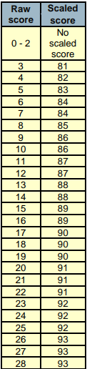

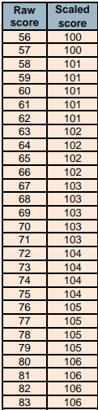
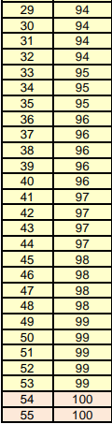
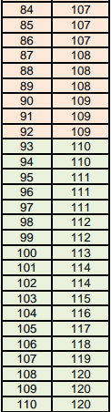

Slide 31
Maths: Wednesday 13th May and Thursday 14th May
The maths assessments consist of three tests.
Paper 1: Arithmetic (30 minutes)
Paper 2: Reasoning (40 minutes)
Paper 3: Reasoning (40 minutes)
Examples of all these paper available to look at and discuss with us after this presentation.

Slide 32
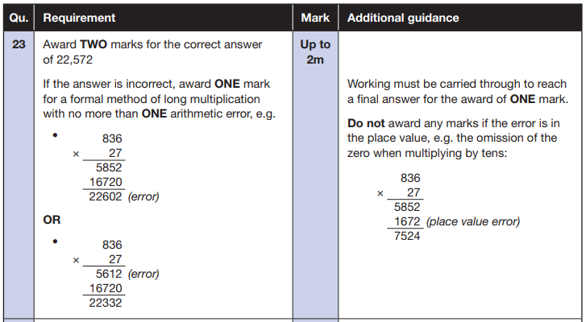
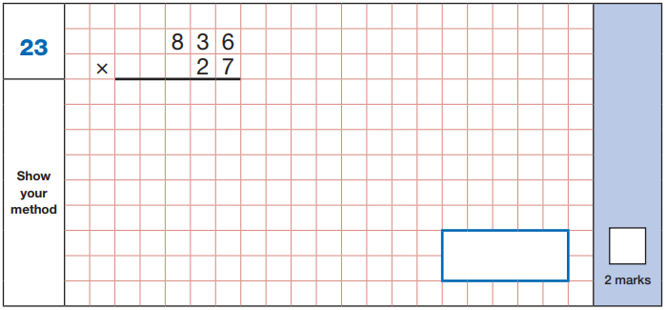
Maths Paper 1 (Arithmetic)
The maths arithmetic paper has a total of 40 marks.
The test covers the four operations (addition, subtraction, multiplication, division, including order of operations requiring BIDMAS), percentages of amounts and calculating with decimals and fractions.
Example question:
Notes:
Identify that there are some questions that have 2 marks and some that have 1. If the answer to this question is wrong, children could still get a mark for a correct method containing an error.

Slide 33
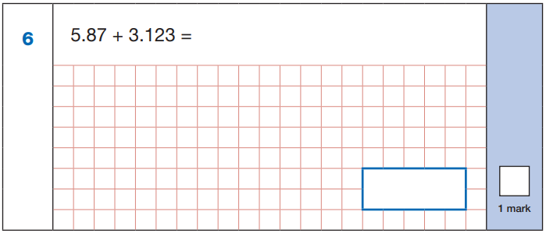
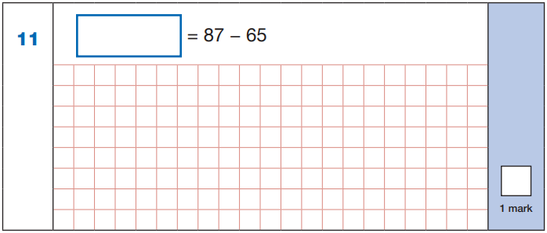

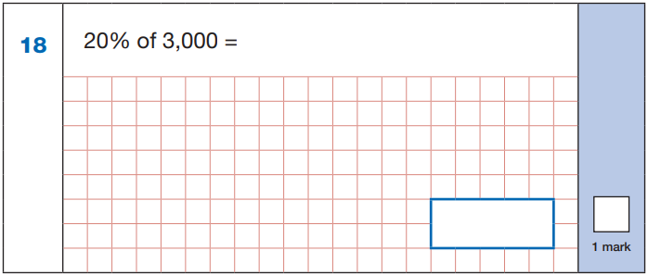
Maths Paper 1 (Arithmetic)
Example questions:
22
5.87
+ 3.123
8.993
87
- 65
22
8.993
60 ÷ (30 - 24)
60 ÷ 6 = 10
10% of 3,000 = 300
20% of 3,000 = 600
10
600
Notes:
These are examples of how children could solve the calculations. There are some that could/ should be solved mentally as it is far quicker that way (40 marks in 30 minutes does not allow for 1 minute + per mark).
Answers should always be given in their simplest form unless stated otherwise (e.g. for question 11, 20 + 2 would not be accepted as a correct answer).

Slide 34
Maths Papers 2 and 3 (Reasoning)
Paper 2 and paper 3 These tests have a total of 35 marks each.
These papers require children to demonstrate their mathematical knowledge and skills, as well as their ability to solve problems and their mathematical reasoning. They cover a wide range of mathematical topics from key stage 2 including,
Number and place value (including Roman numerals);
The four operations;
Geometry (properties of shape, position and direction);
Statistics;
Measurement (length, perimeter, mass, volume, time, money);
Algebra;
Ratio and proportion;
Fractions, decimals and percentages.
Notes:
In general, the questions get progressively harder throughout the paper. As this is the case, it is not unusual for children to be unable to complete the entire paper in the given time. Maths Paper 1 (Arithmetic)

Slide 35
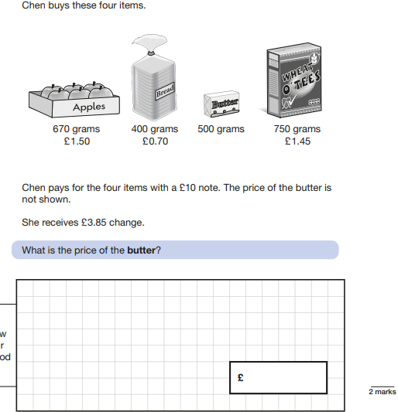
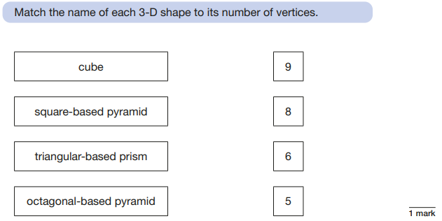
Maths Papers 2 (Reasoning)
Example questions:
1.50
0.70
1.45
3.65
3.65
3.85
7.50
10-7.50 = 2.50
+
+
2.50

Slide 36
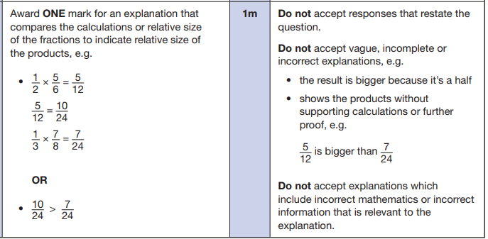
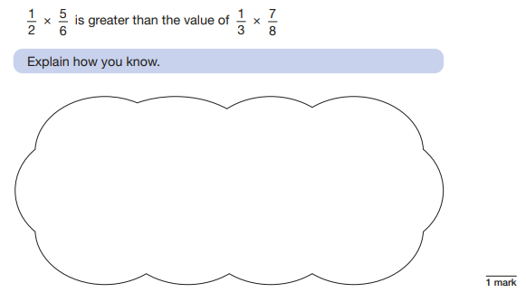
Maths Papers 2 (Reasoning)
Example question:
Notes:
This question is an example where pupils will need to justify their answer.

Slide 37
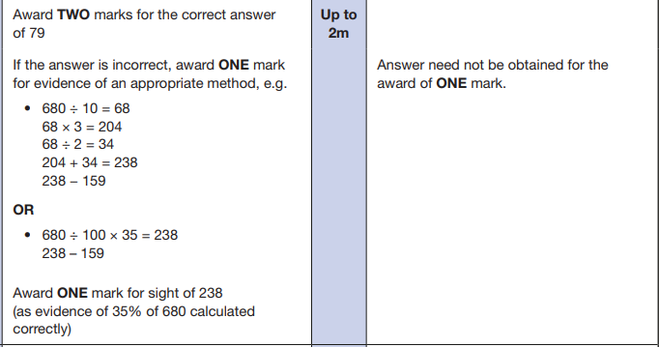
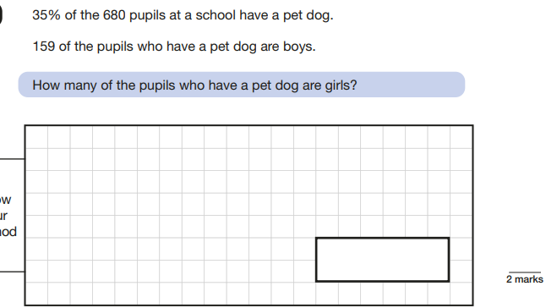
Maths Papers 3 (Reasoning)
Example questions:
Notes:
Question 9: Pictograms are part of the Year 3/ 4 curriculum.
Question 15: This show that children will need to know how to convert but they do not need to remember the conversion fact.

Slide 38
Supporting your child in preparing for the SATs
Firstly, a positive attitude goes a long way. Give them as much encouragement and support as you can (but we don’t need to tell you that)!
Tips:
Don’t use past papers as they are used in school to prepare the children.
Attend any SATs meetings at school (or read any literature sent home).
Talk to your child’s class teacher if you have any concerns rather than worry your child.
Encourage your child to talk to their teacher or a trusted adult (including yourself) about their anxieties. Don’t forget that a small amount of anxiety is normal and not harmful.
Give your child a quiet, distraction free space to complete homework or study.
Give your child time to go outside and reduce screen time.
Ensure your child is eating and drinking well and getting a good amount of sleep.
Plan something nice and fun for the weekends before and after SATs. This will help them to relax before the SATs and give them something to look forward to after.
Notes:
Encourage parents not to use past papers at home. If they want to use past papers with tutors, suggest that they could take copies of completed test home to work through with tutors. This may help them to work through specific misunderstandings.

Slide 39
Supporting your child in preparing for the SATs
Further tips:
Create a revision timetable that works for you and your child. For some families, 10 to 20 minute activities over a few days works best. For others, a longer study session one day a week might be better.
Keep revision light. Going over key skills (times tables, real world mental maths as you are shopping or cooking) is a good way to keep revision light.
As we said before, avoid using past papers. There are plenty of free or inexpensive SATs practice materials for parents available.
If you’re looking to support your child further with maths at home, there are lots of good websites with free Year 6 revision resources.
Start with
https://www.kirkburtonmiddleschool.co.uk/subjects/ks2-sats-revision

Slide 40
Revision resources for supporting your child at home

Slide 41
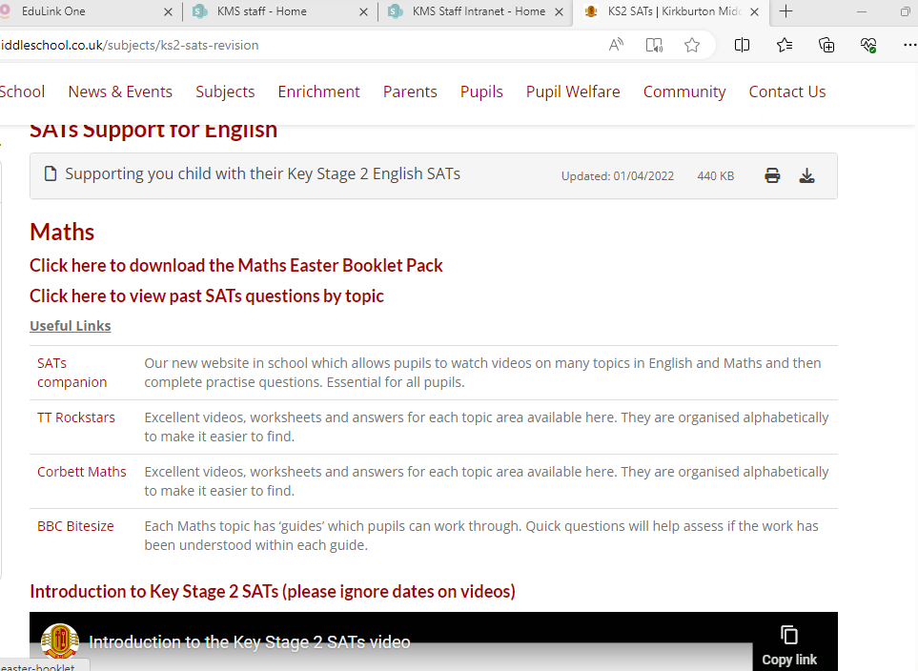

Slide 42
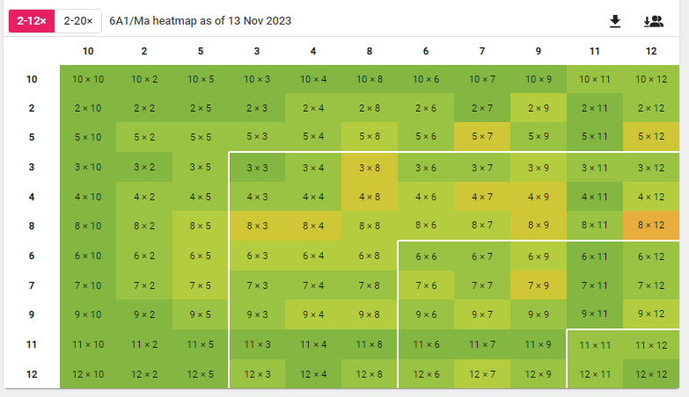
TTrockstars - Times Tables Rock Stars: Play (ttrockstars.com)
Aim to do 20 minutes on ttrockstars 3 times a week.
The heat map tells them which times table they are struggling with.

Slide 43
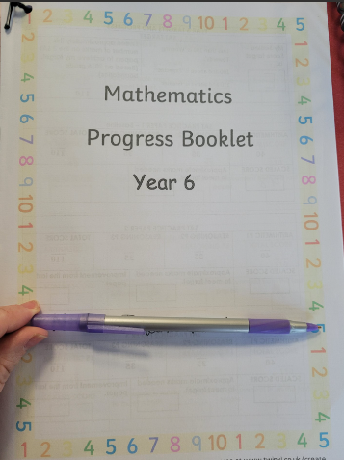
All pupils have a Maths progress booklet in the back of their Maths books.
They can bring this booklet home at any time as long as it is brought back to school for next lesson and stays neat.

Slide 44
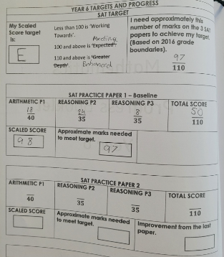
All practice SAT results are recorded in the booklet including their target grades and how many marks they roughly need to meet their target.

Slide 45
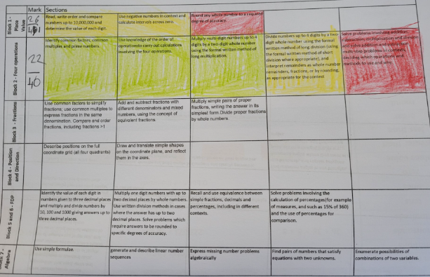
Pupils complete end of unit assessments and RAG themselves against the objectives tested.
Green – correct
Amber – some mistakes
Red – needs attention

Slide 46
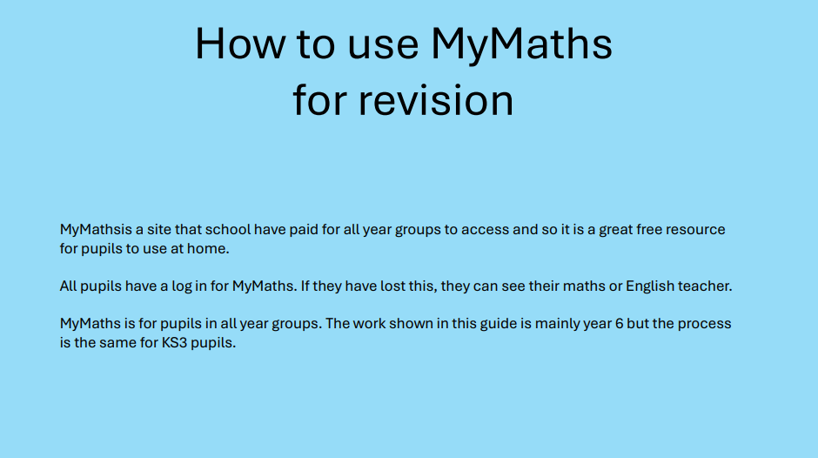
Notes:
Like SATs companion Miss Charlesworth has also sent this mymaths guide home via edulink.

Slide 47
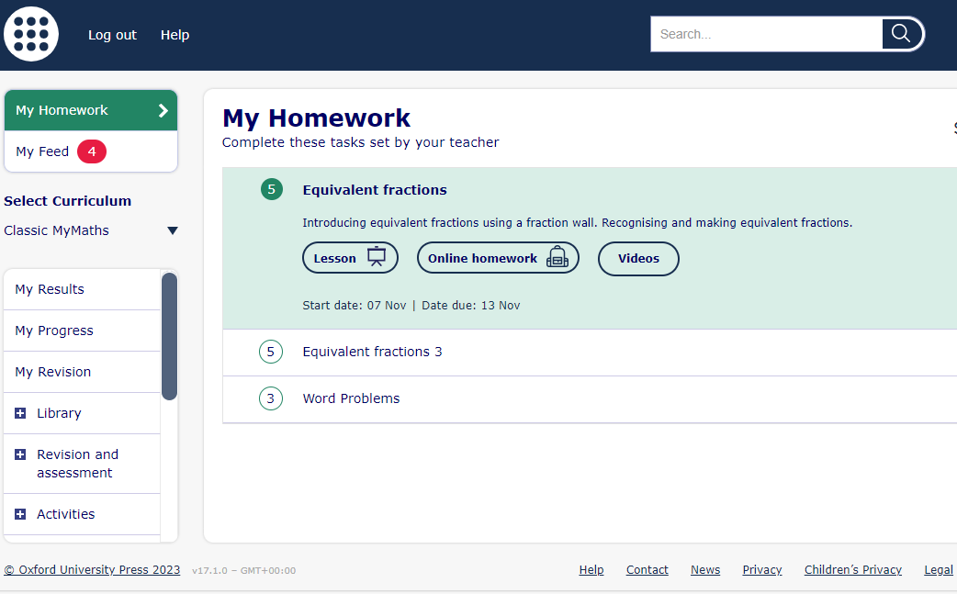
MyMaths – www.mymaths.co.uk
Pupils or parents can search topics using key words from their target areas.
Notes:
Your child can search for topics using the search bar.

Slide 48




Revision Guides
CGP revision guides for KS2 are split into meeting expected level and stretch (enhanced)
There are also packs of practice papers and 10 minutes booklets produced by CGP which could help revision. These can be found online (Whsmiths, Amazon) but not through school.
Notes:
A letter has been sent home about how to order revision guides and practice books.

Slide 49
Things to remember about SATs
SATs focus on what children know about Maths and English.
They will not reflect how talented they are at science, geography, art, PE…, and they certainly won’t highlight all of their amazing personal characteristics.
SATs don’t tell the whole story.
Their results will say if they did or did not meet a certain standard but not necessarily by what margin. These thresholds change each year according to the overall national performance, so what was classed as ‘meeting the expected standard’ this year might not be the same as last year. Your school may be able to provide you with more detailed feedback.
SATs are only four days out of a whole Primary School career.
In reality, there’s one or two papers each day that last 30 to 60 minutes.

Slide 50
What to do if you are worried about your child
SATs often induce a certain degree of worry or anxiety but there is, of course, a tipping point.
SATs anxiety should not:
Affect a child’s appetite
Affect a child’s sleep
Affect a child’s personality
Induce panic, tears or disengagement from lessons
Be a reason not to attend school.
If any of the above are evident, SATs may be causing an excessive degree of anxiety and may benefit from some additional support. This isn’t about removing the reality of SATs but rather equipping your 10 or 11 year old with the ability to better cope with the situation.

Slide 51
What to do if you are worried about your child
Talk to the school
Sometimes concerns present at home and not at school. If you notice a change in your child, talk to the school so that everyone concerned can offer the support needed.
Talk to your child
Talk to your child about what aspect of SATs concerns them the most. If you can help them pinpoint what is bothering them the most, you can take specific steps to help reassure them.
Encourage your child to talk to their teacher
SATs are obviously linked to school. Don’t be surprised if your child would prefer seek reassurance from teachers over family members.
Try not to project your own anxieties or views about the SATs
Children can be very intuitive. If they see that you are anxious, this could add to their own anxieties. Similarly, if you don’t believe in SATs, your child may reflect this view.
Notes:
It may also be appropriate to discuss if there are any changes at home that could add stress to the child (e.g. moving house, a new sibling, recent bereavement).
There may be media coverage around the SATs, parents may want to discuss this with their children (positive or negative).

Slide 52
Advice for Year 6 children
Listen to your teacher.
The adults you work with all want you to do your best.
Get plenty of sleep and eat well, this will help your brain.
Read all the questions carefully. This can help you to avoid silly mistakes.
Don’t panic. There may be questions you think you can’t answer. Take a deep breath. Read it again. You can always move on and go back to it later. It’s often better to write something rather than nothing.
Remember that the Year 6 SATs last for 4 days out of your whole life!
“Stay focused in class so you don’t have loads of extra studying to do at home!” – Year 7 pupil’s advice.

Slide 53
School contacts
Please contact school if there is anything you would like to discuss with regards to SATS
Emails to be sent to the office and they will forward you email to the relevant member of staff.

