Slide 1
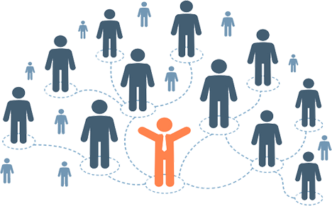
Y8 RSHE
LO1 To consider the qualities you find important in a friend and a partner
LO2 To understand different opinions on the appropriate ages for stages in a relationship

Slide 2
LO1 To consider the qualities you find important in a friend and a partner
LO2 To understand different opinions on the appropriate ages for stages in a relationship
A good friend is.......
Get into small groups
Task - Choose your top 10 statements for the qualities that you want in a friend.
Extension:
Rank your chosen statements from most to least important
Notes:
10 mins (25 mins)

Slide 3
LO1 To consider the qualities you find important in a friend and a partner
LO2 To understand different opinions on the appropriate ages for stages in a relationship
So what can you do to make sure you are a good friend to others?
A good friend is.......

Slide 4
LO1 To consider the qualities you find important in a friend and a partner
LO2 To understand different opinions on the appropriate ages for stages in a relationship
A good partner is.......
Task - Choose your top 10 statements for the qualities that you want in a partner.
Extension:
Rank your chosen statements from most to least important
Notes:
10 mins (35 mins)

Slide 5
LO1 To consider the qualities you find important in a friend and a partner
LO2 To understand different opinions on the appropriate ages for stages in a relationship
What do I want?
Choose your top 3 qualities that you want in a friend or partner.
Write them in a full sentence in your book

Slide 6
LO1 To consider the qualities you find important in a friend and a partner
LO2 To understand different opinions on the appropriate ages for stages in a relationship
At what age is it appropriate to...
Have a relationship?
Have a sexual relationship?
Have a baby?
Start a family?
Notes:
10 mins (45 mins)

Slide 7
LO1 To consider the qualities you find important in a friend and a partner
LO2 To understand different opinions on the appropriate ages for stages in a relationship
TASK – Make a list of 3 Rights and 3 Responsibilities we have in relationships.
Rights in a Relationship | Responsibilities in a Relationship
Notes:
10 mins (55 mins)
Right to have my own space
Right to see my friends
Right to say no
Res to not get jealous
Res to listen

Slide 8
TASK
Your teacher will split the room in half (rights/responsibilities)
Make a flag with a right/responsibility on it – these will be made into bunting for your PSHE classroom!
LO1 To consider the qualities you find important in a friend and a partner
LO2 To understand different opinions on the appropriate ages for stages in a relationship
Notes:
20 mins (75 mins)

Slide 9
LO1 To consider the qualities you find important in a friend and a partner
LO2 To understand different opinions on the appropriate ages for stages in a relationship
Complete the following sentence in your books.
The 3 most important things I look for in a relationship are…..
Notes:
5 mins

