Slide 1
Essential Online Safety Awareness for Parents
Fiona Denham
Kirklees Learning Service
Notes:
11
1
The quote - This is our starting point;
we (at least those over 30) are already playing catchup
Those who are born today, and those born over the last 20 years or so are born into an increasingly digital world,
its relatively recently that us older ones have twigged that there are great opportunities and risks and are engaging with them
So for no other reason than its there, and we are growing together in it, there is a need to talk about staying safe in a digital world, and how we help those born into this “new world” make the most of it

Slide 2
My eSafety roles
Teacher
Parent
Governor
Kirklees Learning Partner

Slide 3
Remember that Technology is mostly positive…

Slide 4
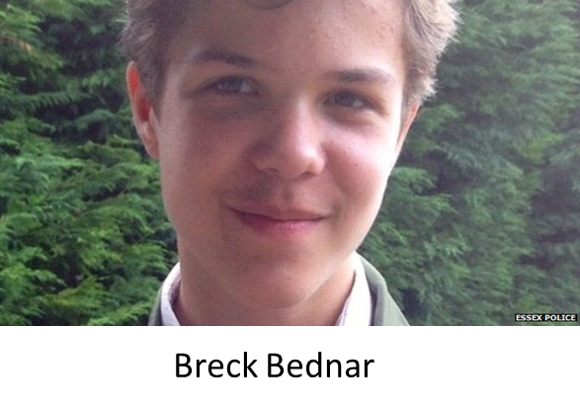
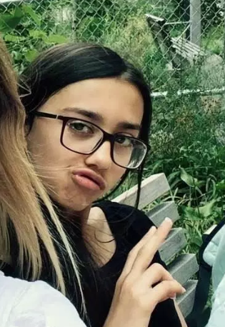
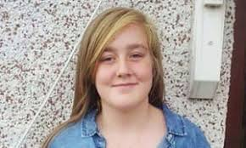
Leilani Clarke
Kayleigh Haywood

Slide 5
Risks to Children and Young People using Technology
(content warning)

Slide 6
Risks of Using Technology
Content Viruses Spam Viewing or receiving inappropriate content | Conduct Damage to reputation Trolling Cyberbullying Financial risks Giving out personal information Health and wellbeing Sexting Peer on peer abuse | Contact Online bullying Inappropriate contact from adults Grooming by paedophiles Radicalisation

Slide 7
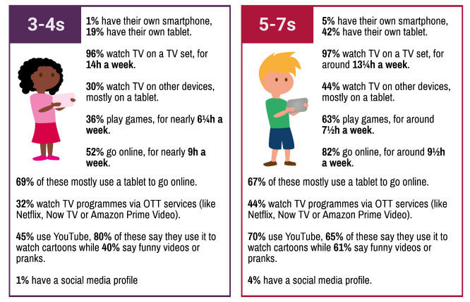
Ofcom Children and Parents Media Use and Attitudes Report 2018 (published Jan 2019)

Slide 8
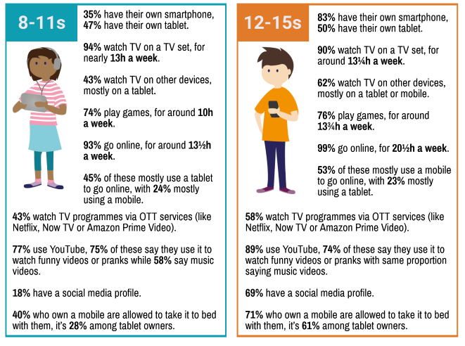
Ofcom Children and Parents Media Use and Attitudes Report 2018

Slide 9
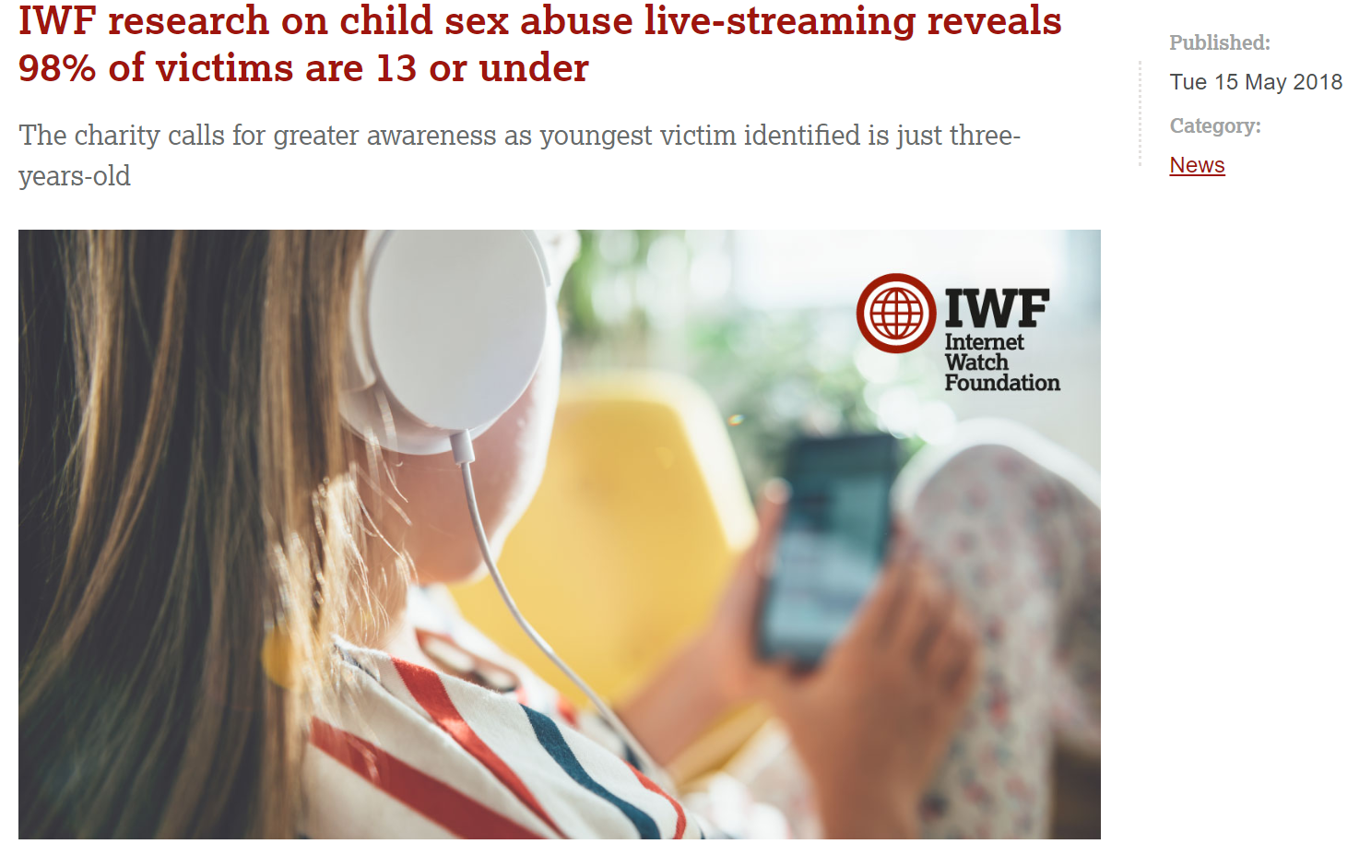

Slide 10
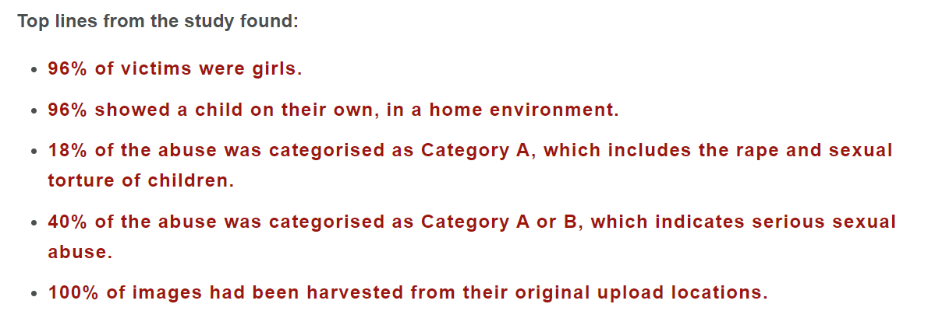

Slide 11
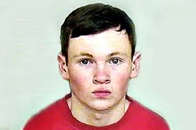
Who are your children talking to online?
Lewis Daynes
Notes:
By way of illustration:
Do you recognise this face – this is 49 year old Robert Williams who persuaded a 15 year old girl from Grimsby to go off to France with him. She met him in an internet chat room and spent 6 months or so chatting to him online. Do you think she would have been so keen if she has known just who she was talking to?
But how do you know who you are talking to online?
Show Child morphing to man video, teen chat and IM video
But online chatting technology and chatting before you met can work for some people
Many people today do form relationships with people they meet online and some recent research suggested that 1 in 4 marriages which took place last year in America were between couples who met online.
And people need to learn that an on online relationship develops differently from what we might consider to be a traditional face to face relationship – and we have to adopt new strategies to manage those risks.
1111

Slide 12
Virtual worlds and Online Gaming
Club Penguin
Neopets
Moshi Monsters
Minecraft
Games consoles

Slide 13
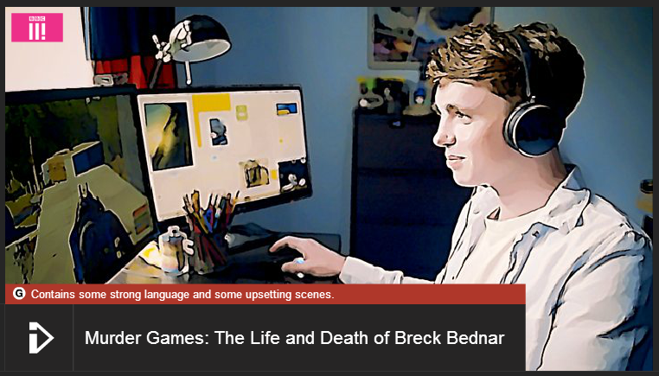
Online Grooming
http://www.bbc.co.uk/news/uk-21314585

Slide 14
Instant Messaging and Private Chat

Slide 15
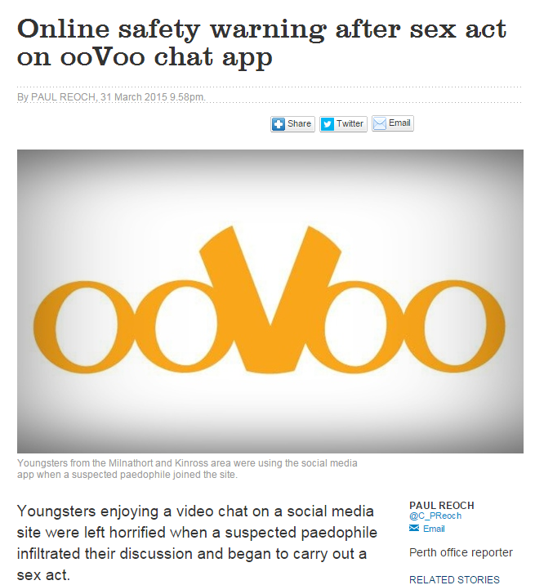
Webcam Chat

Slide 16
Social Networking

Slide 17
Social Networking – It’s More than Twitter and Facebook
The App Challenge

Slide 18
Live streaming
Live streaming is the broadcasting of real-time, live video to an audience over the internet – most social media platforms now have live streaming

Slide 19
Live streaming benefits
Chance to be a creator, a performer and be seen by an audience
Positive feedback from peers
Risks
Uncensored, unedited and unrehearsed
Negative comments, online bullying
Attention from strangers

Slide 20
Peer to Peer Apps

Slide 23
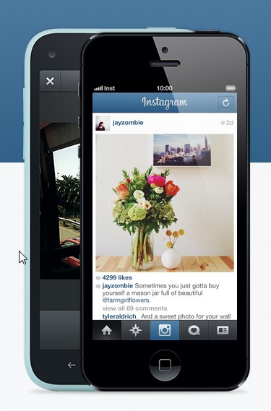

Slide 25
Sexting
The act of sending sexually explicit images or photographs
Sexually explicit text based conversations
Laws on Revenge Porn put children over 10 at risk of a criminal record

Slide 26
Primary Sexting Resource: NSPCC Share Aware

Slide 27
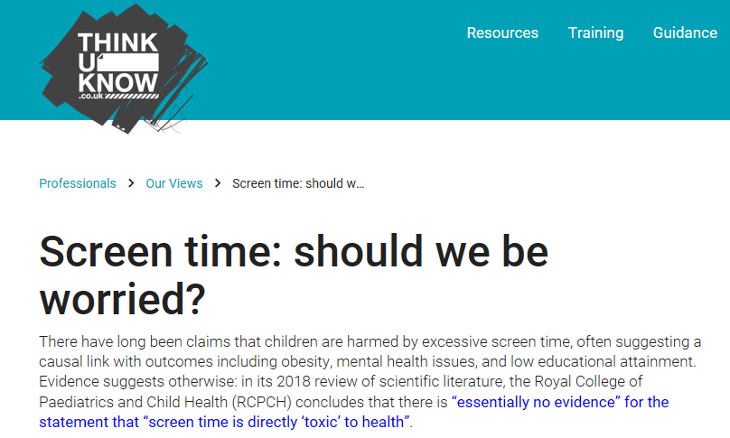
https://www.rcpch.ac.uk/resources/health-impacts-screen-time-guide-clinicians-parents

Slide 28
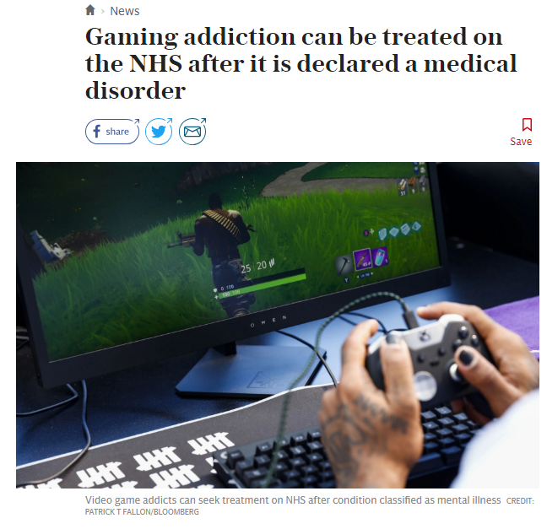
WHO classified it as a medical disorder in June 2018

Slide 29
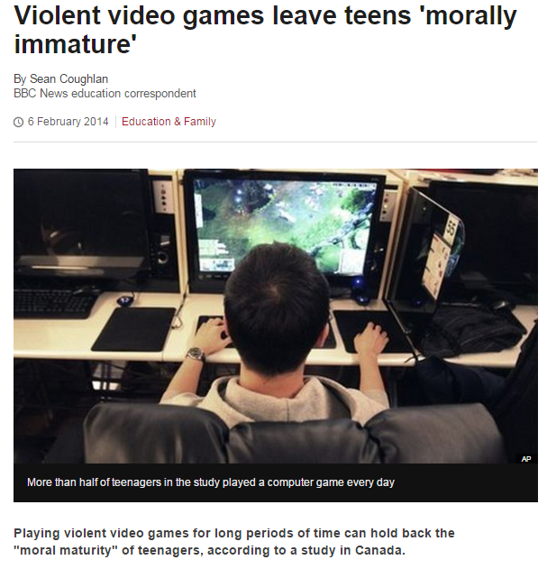

Slide 30
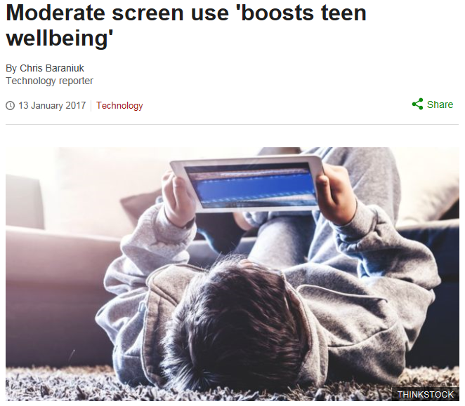
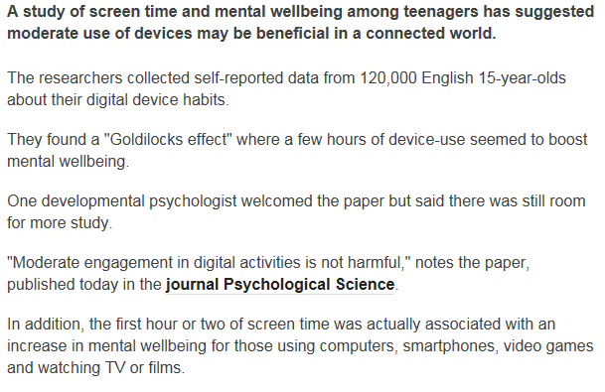
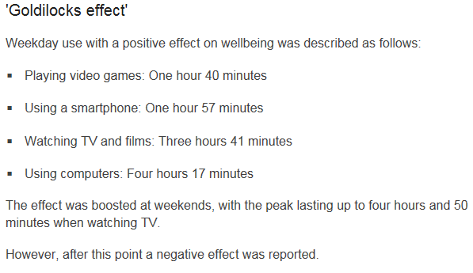

Slide 31
PEGI Rating Symbols

Slide 32
The Dark Web

Slide 33
How Does The Dark Web Differ From The ‘Normal’ Web?
Think of the web in three parts:
1 The ‘Normal’ Web Or The Surface Web
2 The Deep Web
The content of databases and other web services that conventional search engines such as Google and Yahoo can’t index.
3 The Dark Web

Slide 34
The Dark Web is a part of the internet that can only be accessed by using a specialised browser such as Tor.
The Dark Web does not appear in search engines and is encrypted
It is not illegal to use a browser such as Tor to access the Dark Web
It can be accessed on a PC, laptop, tablet or smartphone

Slide 35
TOR stands for ‘The Onion Router’. It works by adding multiple layers of encryption onto your website traffic as it moves around the network, then peeling those layers off, one by one, so by the time your internet activity has reached the website you’re seeking, no one could possibly detect your identity.

Slide 36
Why do people use the Dark Web?
Internet access in parts of the world where this is restricted or people are at risk (political censorship)
Privacy – avoiding data collection
Hidden services e.g. whistleblowing
Illegal activity – weapons, drugs, extreme pornography and child abuse images

Slide 37
Dark Web risks to children
Older children are more likely to be interested due to drink, drugs, fake IDs etc.
Younger children at risk of having images shared
Risk of self harm and suicide content – tragic Leiliani Clarke case in February

Slide 38
Dark Web risks to children
Webcam hacking is more of a risk on the Dark Web
It is easy for children to download and install TOR once they know it exists
Parents advised to check for TOR or other apps and remove
Set up smartphones for parental approval of apps

Slide 39
JUST SAY no! lock up the computer!
Notes:
Some say “just say no or lock up your computer”
Or (excuse the pun)
“You must be webcrackers to let children use the digital world”..... but how can they avoid it”
And more importantly what can we do?
39

Slide 40
And there is another way….
Building protective and resilience skills…children keeping themselves safe
Notes:
Can we summarize what the pictures tell us bout mentoring:
its about practice, engagement, opening eyes to possibilities, understanding feelings, promoting safer strategies, taking care, building confidence and peer support, getting young people involved positively etc – only sometimes implementing technical control or locking things away or shocks
So let look some more about acting as protector of childrens contact/sharing
40

Slide 41
What can I do to keep my child safe?
Top Tips for Parents

Slide 42
Keep Informed:
Know what your child is doing online and be aware of the risks
Ask them to teach you how to use their programmes/games (be involved)
Encourage children to use technology in a ‘public’/family space
Google your child’s name, what can you find out about them?
Be observant for changes in behaviour which may indicate online bullying or grooming
Notes:
A way to start is information gathering
May want to tell children or implement other technical controls to protect contact:
Could give case of what do with teenage children – blocking software too rough cut – prevents homework – and their friendship network is via internet! Need to trust them and check up occasionally for most content/contact and help them with the positive – protect them from obvious viruses and hacking/spam/illegal sites by using AV/antispyware and reputable ISP.
(See other things in the column in my table to add in here) – privacy settings, antispam, antispyware,
42

Slide 43
Signs to Look for:
Victim:
• Being ill at ease when receiving an email, IM, or text message
• Feeling upset after using the computer
• Refusing to leave the house or go to school
• Withdrawing from friends and family
Cyberbully:
• Switching screens or closing programs when you walk by
• Using the computer late at night
• Getting upset if he/she cannot use the computer
• Using multiple online accounts or an account that belongs
to someone else
(A Parent’s Guide to Social Networking Sites, McAfee)
Notes:
A way to start is information gathering
May want to tell children or implement other technical controls to protect contact:
Could give case of what do with teenage children – blocking software too rough cut – prevents homework – and their friendship network is via internet! Need to trust them and check up occasionally for most content/contact and help them with the positive – protect them from obvious viruses and hacking/spam/illegal sites by using AV/antispyware and reputable ISP.
(See other things in the column in my table to add in here) – privacy settings, antispam, antispyware,
43

Slide 44
Communicate:
Have family rules for using technology
Talk about technology use and staying safe with your child– communication is the most importing factor in keeping children safe
Help your child to understand they should never give out personal details to online friends
Remind your child never to open or respond to email or other messages if they do not know the sender
Talk to your child about the importance of balancing their screen based and physical/social activities
Notes:
A way to start is information gathering
May want to tell children or implement other technical controls to protect contact:
Could give case of what do with teenage children – blocking software too rough cut – prevents homework – and their friendship network is via internet! Need to trust them and check up occasionally for most content/contact and help them with the positive – protect them from obvious viruses and hacking/spam/illegal sites by using AV/antispyware and reputable ISP.
(See other things in the column in my table to add in here) – privacy settings, antispam, antispyware,
44

Slide 45
Keep Your Technology Safe:
Protect your computer with up to date anti-virus and firewall software
Set up a user account on the family computer for your child
Set up software to monitor internet usage on laptops and restrict access to adult content
Use browser content controls
Use parental controls on the TV and games consoles
Notes:
A way to start is information gathering
May want to tell children or implement other technical controls to protect contact:
Could give case of what do with teenage children – blocking software too rough cut – prevents homework – and their friendship network is via internet! Need to trust them and check up occasionally for most content/contact and help them with the positive – protect them from obvious viruses and hacking/spam/illegal sites by using AV/antispyware and reputable ISP.
(See other things in the column in my table to add in here) – privacy settings, antispam, antispyware,
45

Slide 46
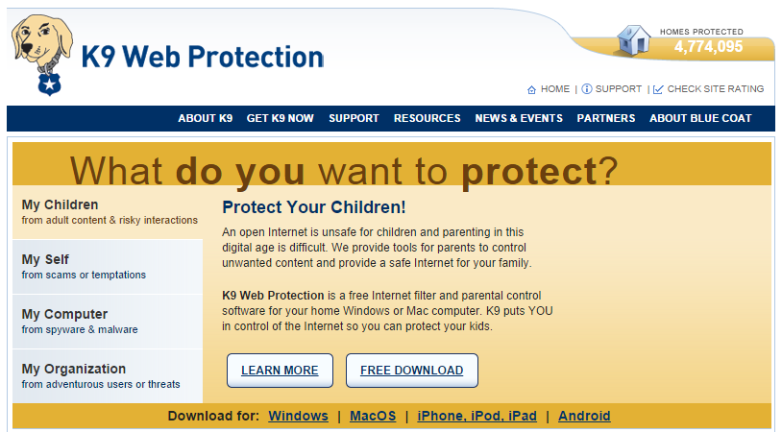

Slide 47
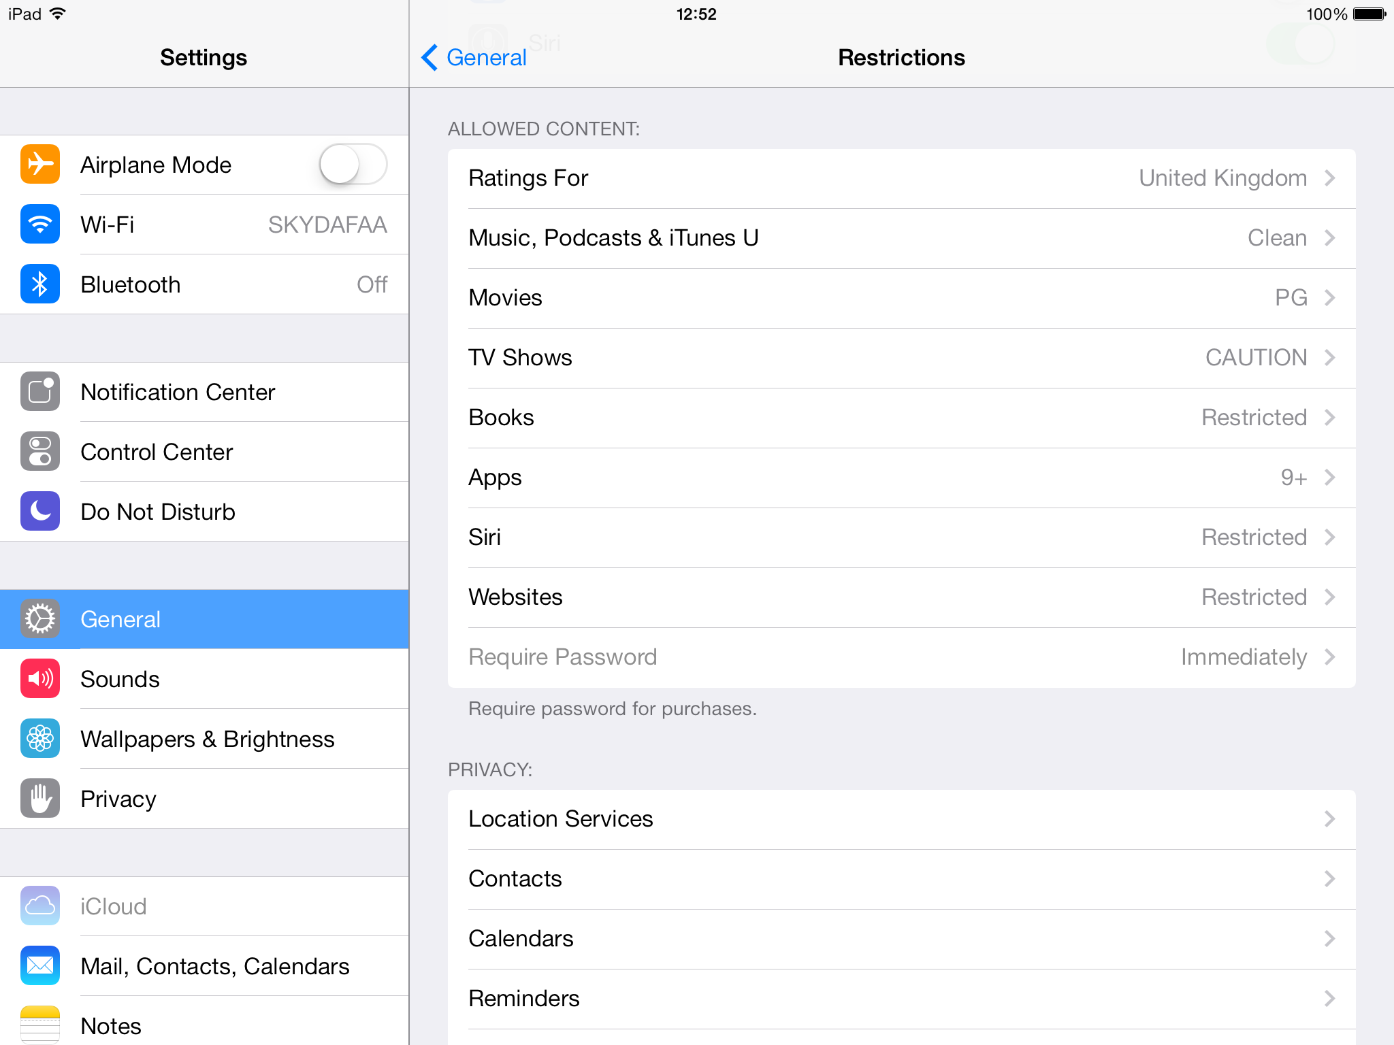

Slide 48
Safe Social Networking:
Discourage young children from using Facebook and similar sites for over 13s
If your child IS using chat and social networking sites, ask to be on their friends list but do not participate
Make sure your child’s profile is private
Remove tags or inappropriate pictures posted by someone else
Report inappropriate use to Facebook and ask them to remove inappropriate content
Inform school of any cyberbullying incidents and support school staff in investigating incidents
Notes:
A way to start is information gathering
May want to tell children or implement other technical controls to protect contact:
Could give case of what do with teenage children – blocking software too rough cut – prevents homework – and their friendship network is via internet! Need to trust them and check up occasionally for most content/contact and help them with the positive – protect them from obvious viruses and hacking/spam/illegal sites by using AV/antispyware and reputable ISP.
(See other things in the column in my table to add in here) – privacy settings, antispam, antispyware,
48

Slide 49
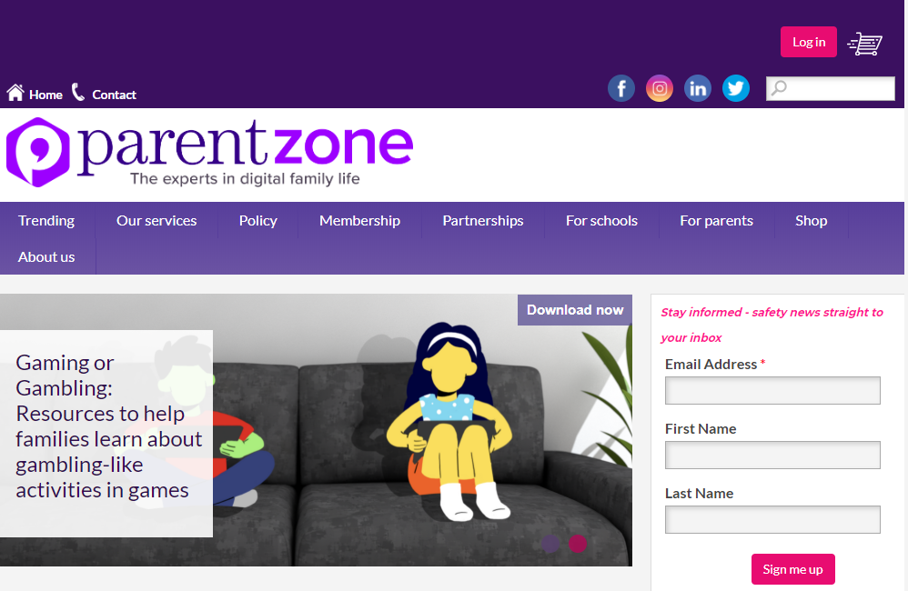
Further Information for Parents

Slide 50
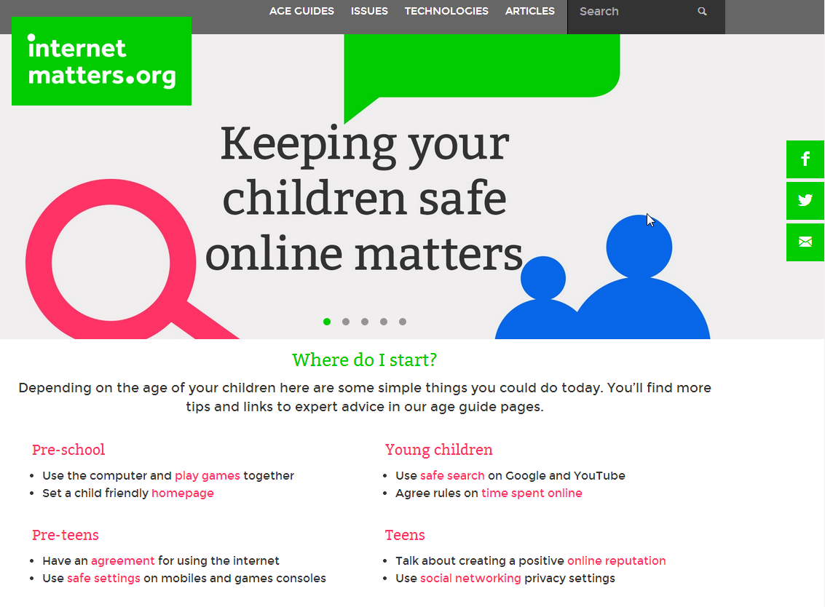

Slide 51
Questions ? ? ? ? ?

