Slide 1

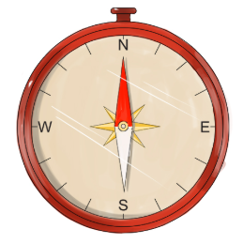
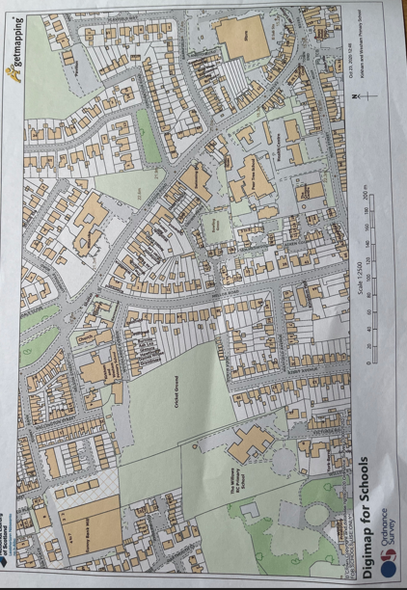
The Locality of Kirkham
Geography
ESSENTIAL VOCABULARY
Word | Definition
landmark | A feature (e.g. building, statue, bridge, mountain, park) that is easily recognised and would help people know where they are.
aerial | From up above.
human feature | Made by people. Something that would not be there without humans.
physical feature | Something that is natural and was not made by humans.
compass | An object that helps you find direction.
route | A way to get from one place to another.
Key Concepts
Our school is in the town of Kirkham which is in the county of Lancashire, in the country of England.
England is part of Great Britain which is part of the United Kingdom which is in the continent of Europe.
There are several landmarks in Kirkham which people know are linked to Kirkham and they would recognise them.
Human features of Kirkham include Fox’s Biscuit Factory, St Michael’s Church and the fishstones.
Physical features of Kirkham include Wrangway Wood and the countryside/fields.
A compass needle always points North.
North, East, South and West are the four main compass directions.
At the end of the topic, I will know…
some landmarks in Kirkham.
some human and physical features of Kirkham.
how to use a compass to find North.
how to identify where one landmark is in relation to another using North, East, South and West.
how to follow a route on a map.
how to draw a map of my walk around Kirkham, including landmarks in the correct positions.

