Slide 1

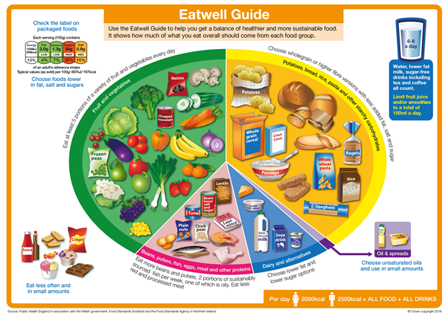
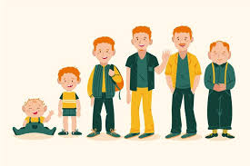
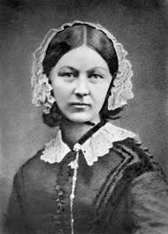
What do humans need to survive?
Vocabulary you will know…
offspring | The child of a human or young animal.
life cycle | The different stages animals go through to grow into adults.
hygiene | Keeping clean to stay healthy and stop dieses from spreading.
exercise | A physical activity.
live young | Born alive, animals that don’t hatch from an egg.
diet | The food and drink that a person or animal usually eats or drinks.
reproduction | How living things make babies or new life, e.g. when a cat had kittens or plants grow from seeds.
Vocabulary you will hear…
growth, stages of development (e,g, child, toddler, adults etc) heartbeat, breathing, pulse, energy, germs, diseases nutrition, healthy, unhealthy, food types (e.g. dairy, carbohydrate, protein, fats etc.)
Science
Cedar Class Autumn 1
Scientific Images
The Human
Lifecycle
What I will know at the end of the unit.
Know that animals, including humans, have offspring that grow into adults.
Describe the basic needs of animals, including humans, need food, water or air to survive.
The life cycle of a human.
Exercise keeps people healthy.
Humans needs to eat the right types of food to stay healthy.
Keeping clean is important for staying safe and healthy.
Scientist
Florence Nightingale was a kind nurse who taught people how to keep people healthy. She found that cleaning hospitals and washing hands helped stop people getting sick. Her smart ideas helped doctors and nurses take better care of patients all over the world.

